Slide 1
Planting Science - Independent Lab
Hashim ,Carolina, Madeline, Marissa

Slide 2
Purpose

Slide 3
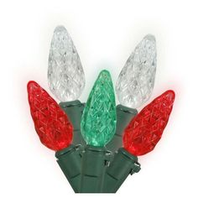
How do the effects of photosynthesis change when impacted by different colors of light?

Slide 4
Hypothesis

Slide 5
If we alter a plant’s light source color, then their heights and rates of photosynthesis will vary because their chloroplasts will absorb different colors of light in various ways.

Slide 6
Hypothesis support
I think this is what’s going to happen because…
Based on previous knowledge, chloroplasts will absorb red light more effectively than any other light. Chloroplasts can not absorb green light effectively. The control group will most likely have normal results.
Variables that may affect the outcome...
The plants are kept indoors
Type of plant used
Temperature of classroom

Slide 7
Materials

Slide 8
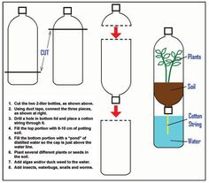
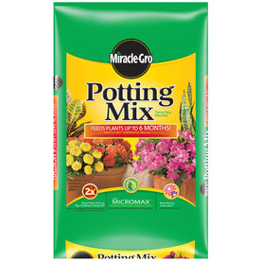
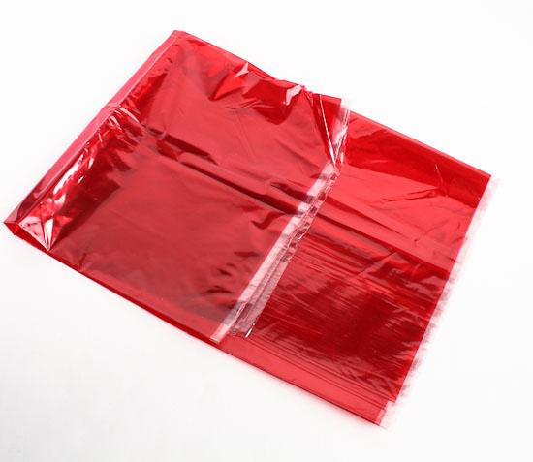
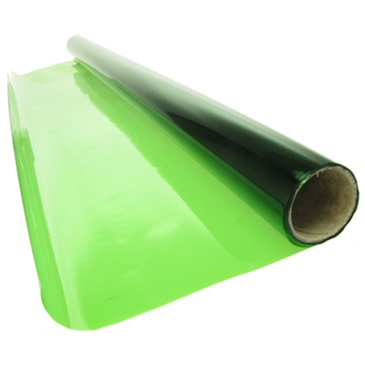
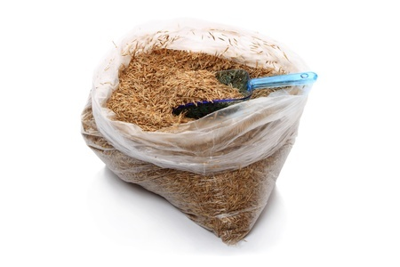
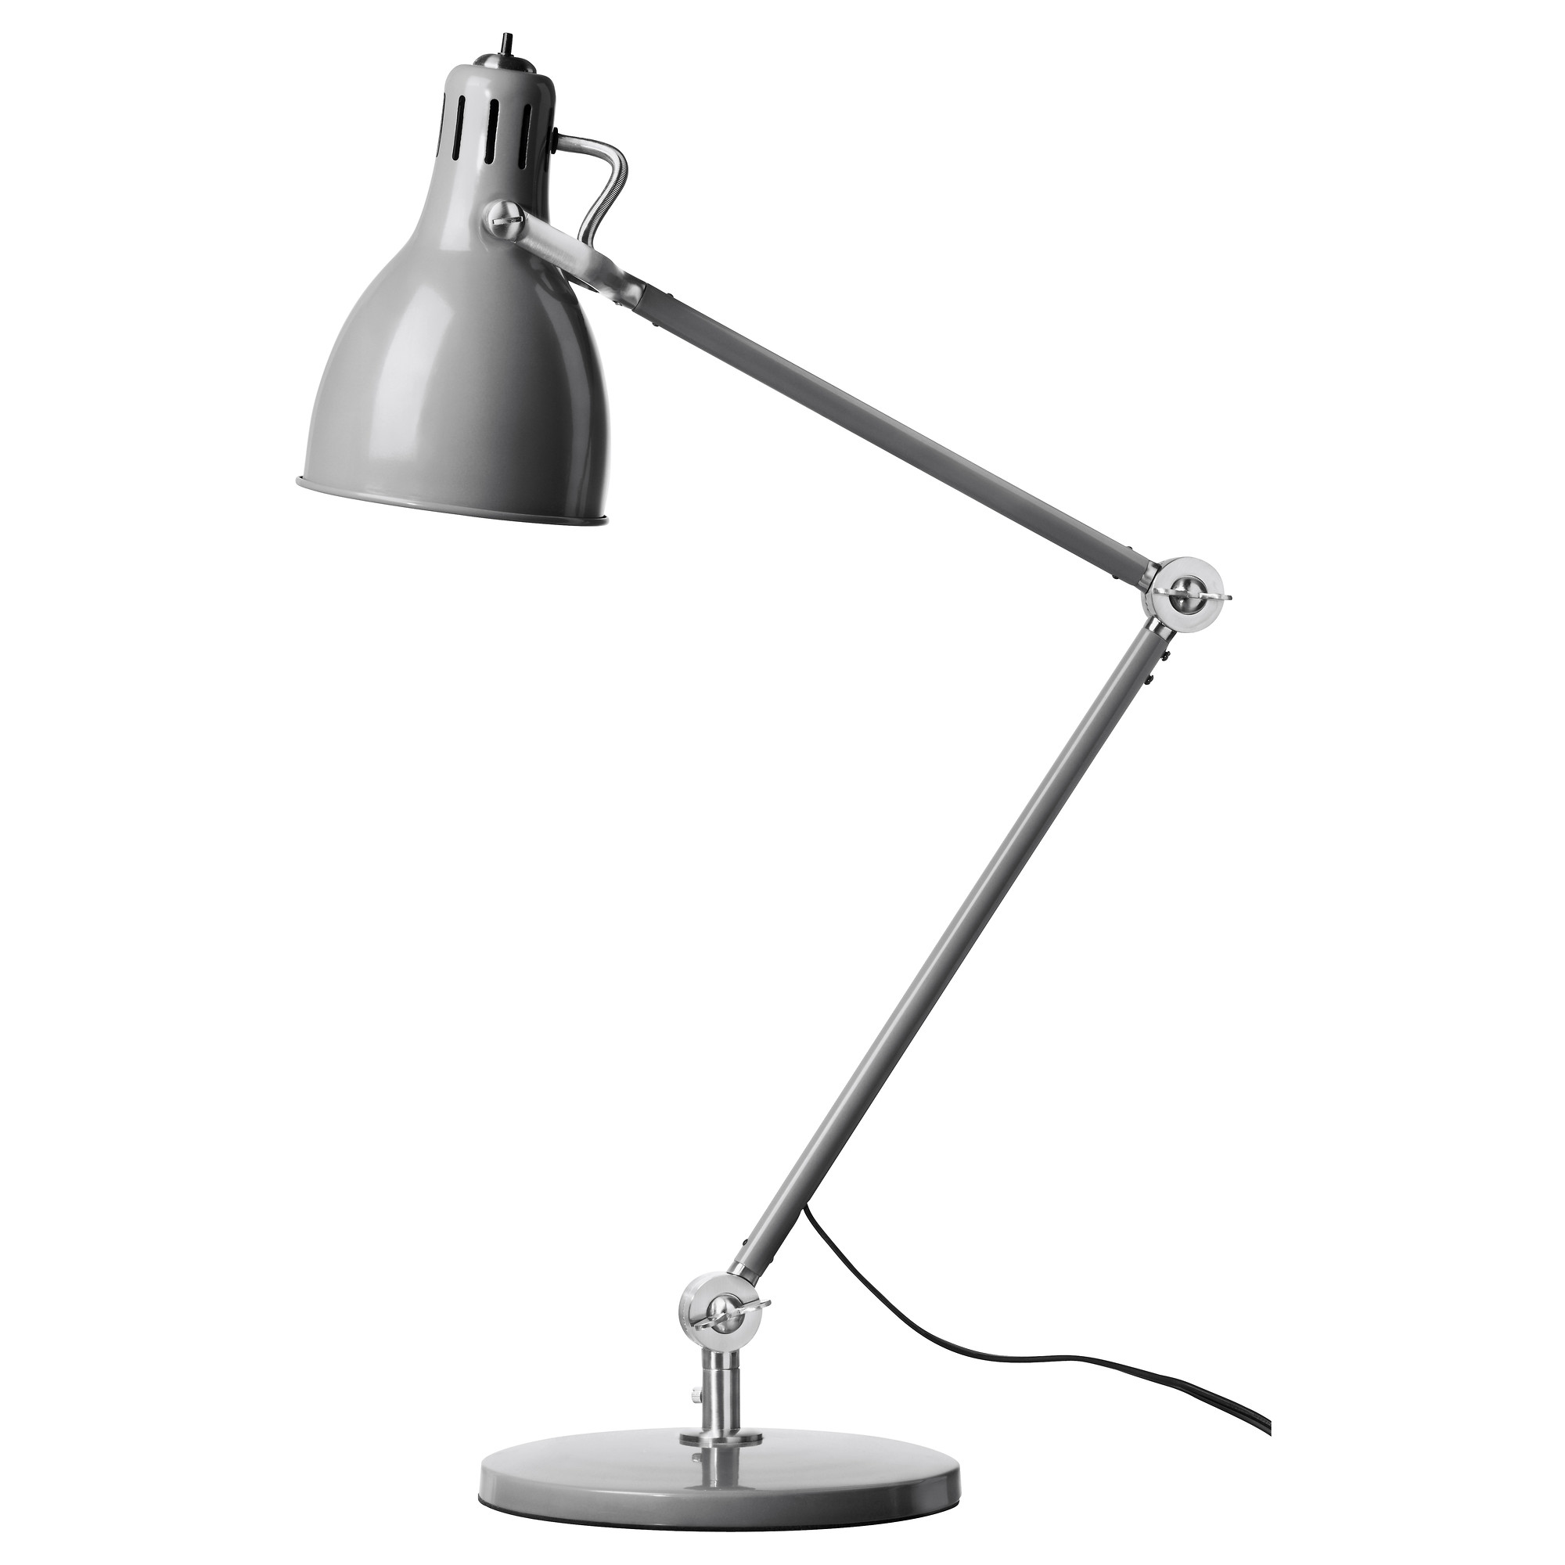
3- 1,000 mL Samples of Potting Soil
5 Soda Bottles
1 Pickle Jar
5.0g of Grass Seed
150mL of Water
3 Lamps
Red Cellophane
Green Cellophane
Plastic Bag
3 Beakers (to measure soil/water)
Rubber Bands
Scale
Ruler

Slide 9
Procedure

Slide 10
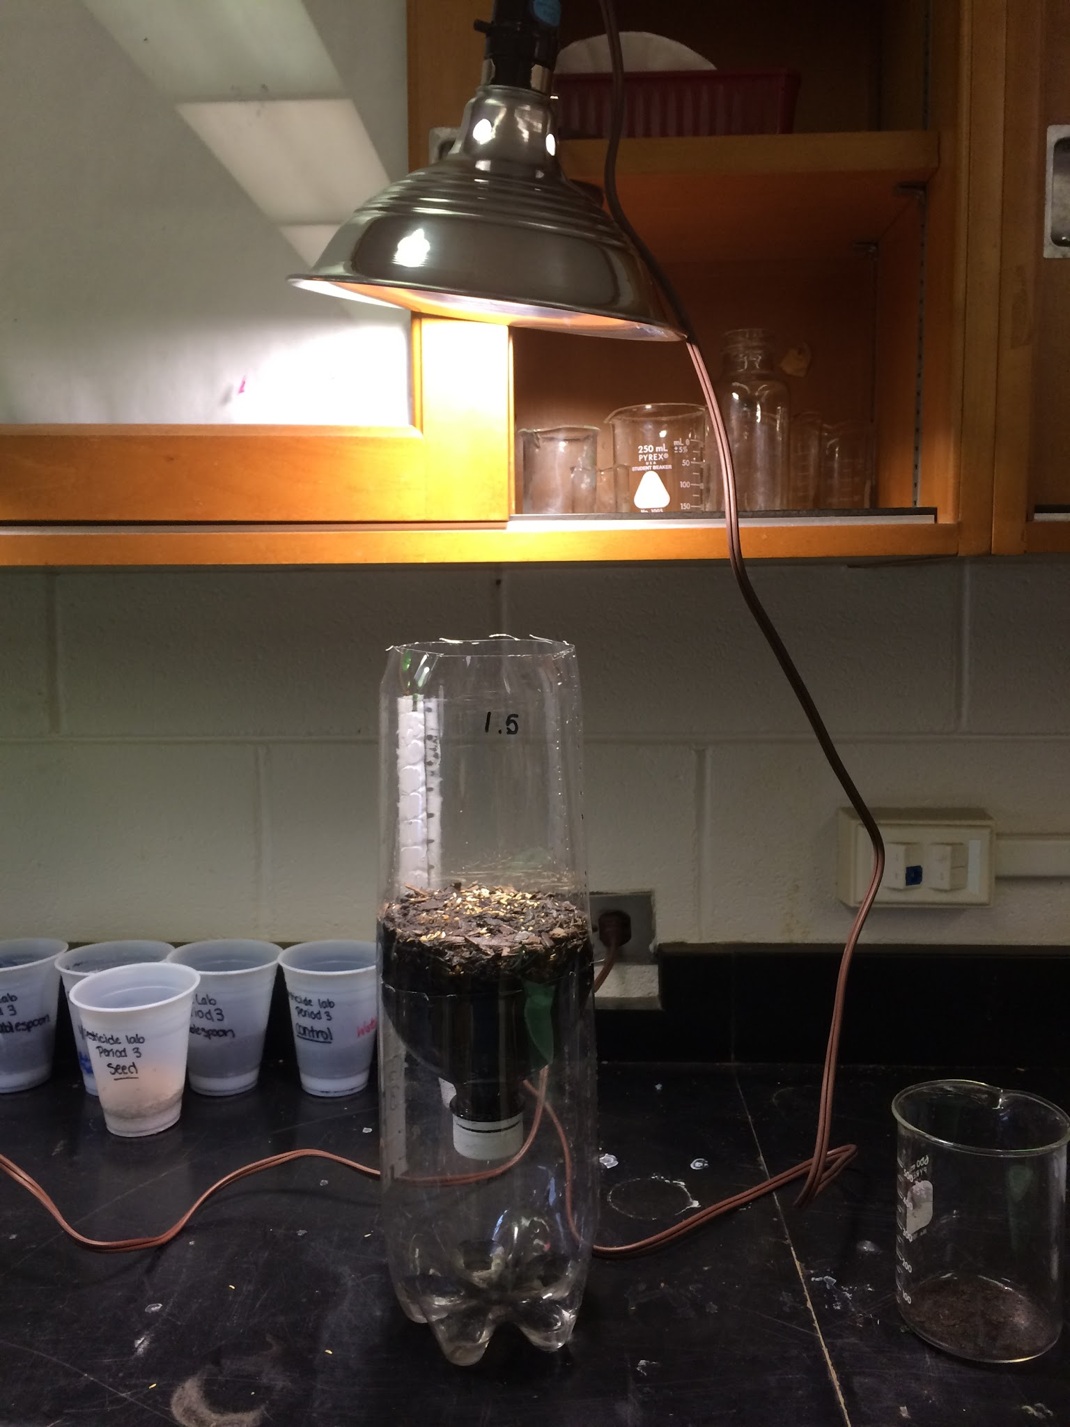
Procedure
Soda bottles were cut and stacked to allow water to drip through
3, 1000 mL samples of potting soil were measured
3, 5g samples of grass seed were measured
Potting soil was placed in bottle, followed by grass seed
Each pot was watered with 150 mL of water

Slide 11
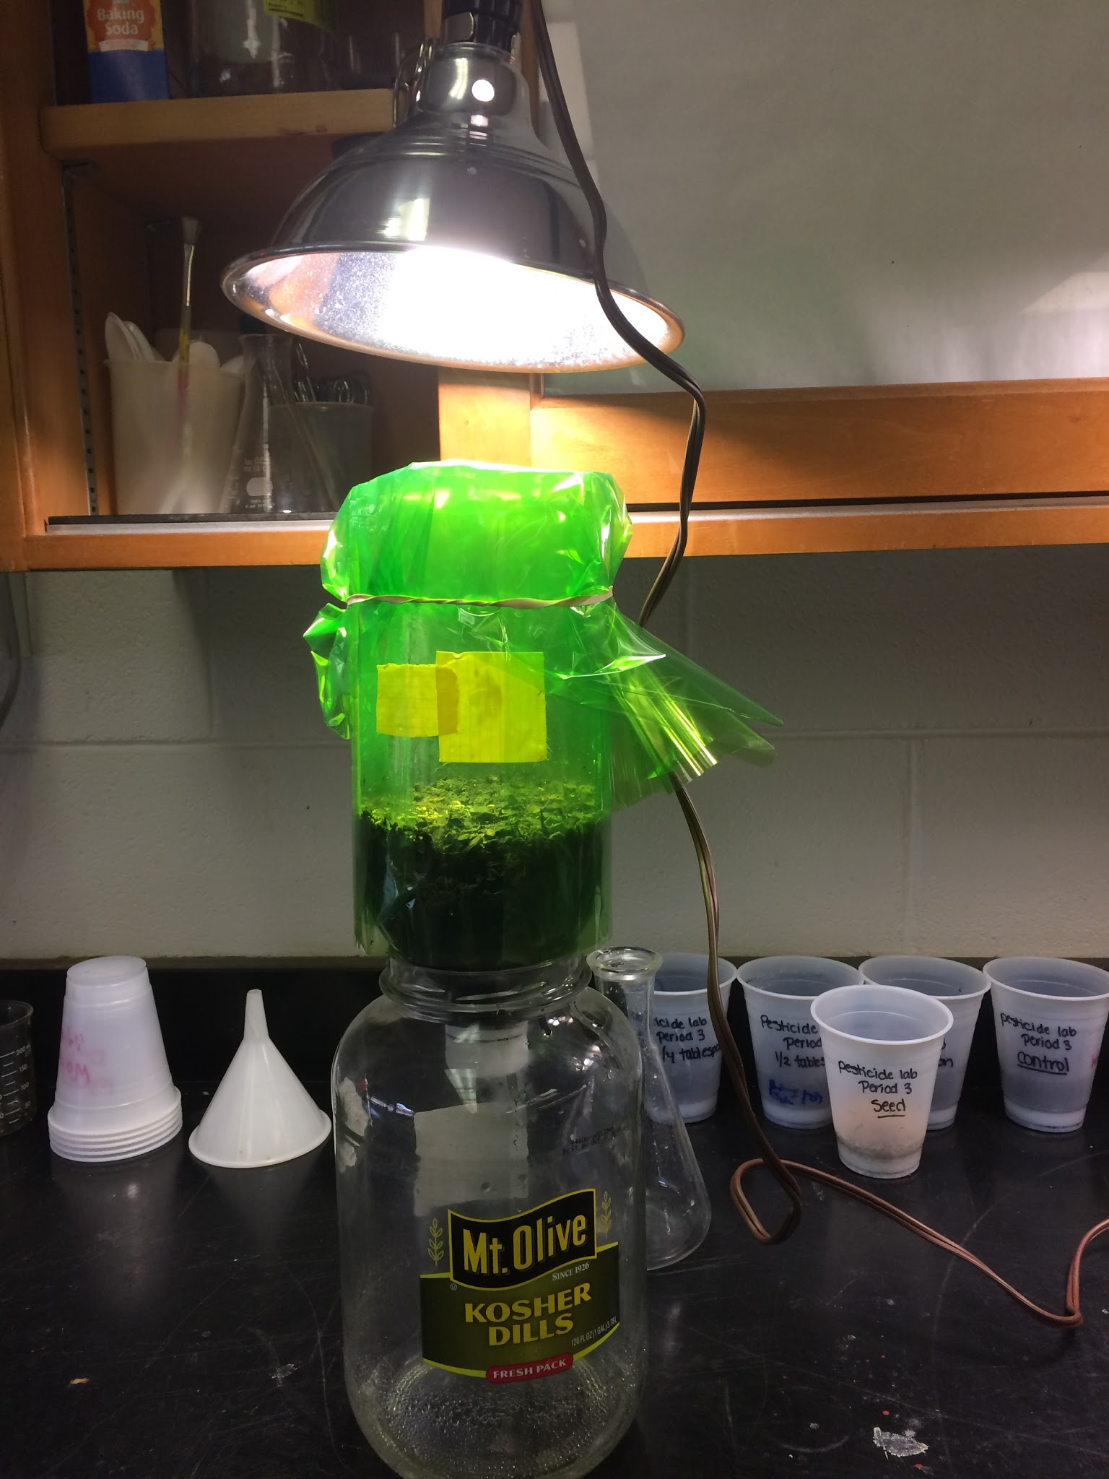
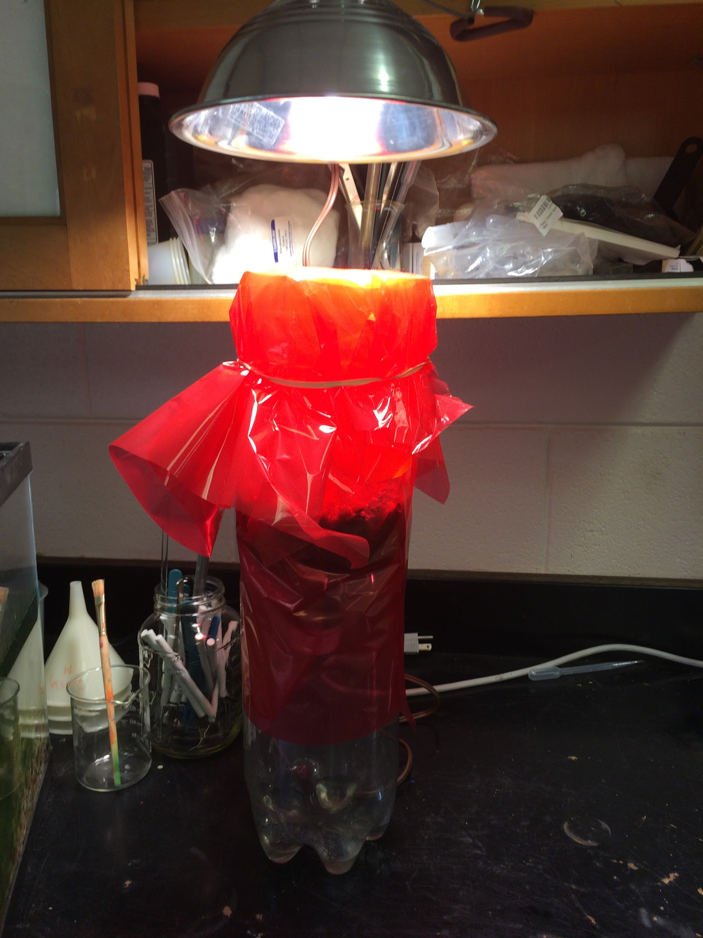
Procedure (Continued)
6. Respective bottles were covered with red and green cellophane and labeled A (Red), B (Green), and C (Control)
7. Each sample was placed under a light source
8. Samples were left over a period of time to allow for growth
9. Photos were taken periodically to document set-up and plant growth

Slide 12
Variables

Slide 13
Variables/Constants:
Independent variables- Colors of light used for growth ( Red, Green, Normal)
Dependent variables- Amount of plant growth after X amount of days, height/ length of grass, and root growth, and weight of grass after drying.
Constants- Amount of liquid, amount of soil, amount of seed, location, containers, light sources, tools used, and room temperature.

Slide 14
The Experiment

Slide 15
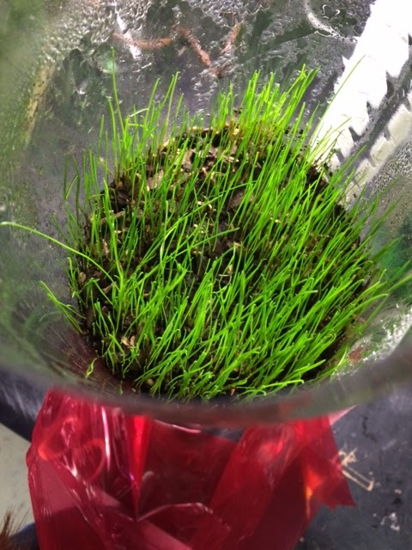
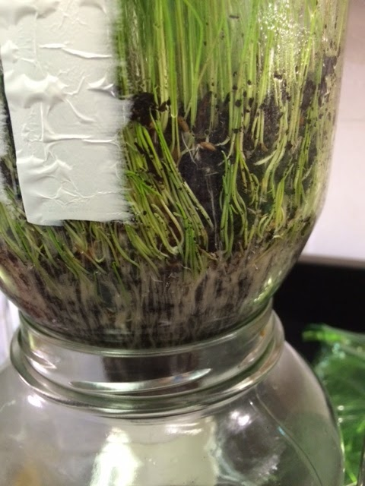
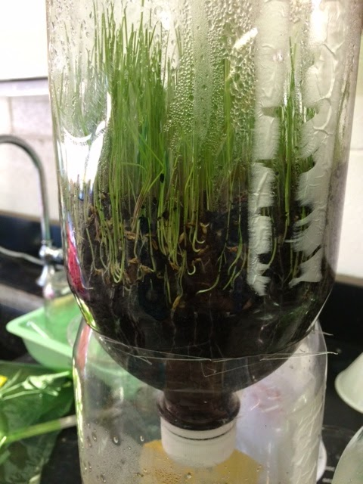
The Experiment

Slide 16
Observations

Slide 17
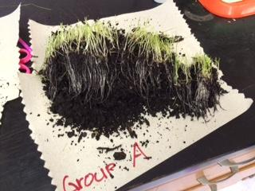
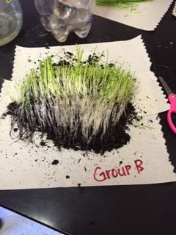
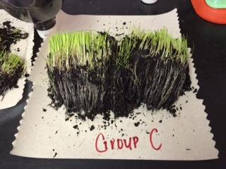
Observations
The pot with the most dense root growth was Group B (Green)
The pot with the second most dense root growth was Group A (Red)
The pot with the least dense root growth was Group C (Control)

Slide 18
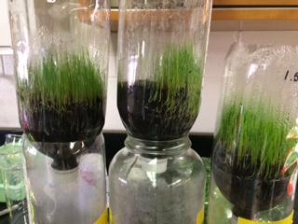
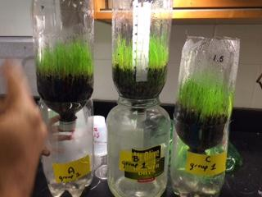
Observations and Data continued:
Measurements: (root-to-shoot; after 6 days)
A (red) 17.5cm
B (green) 19cm
C (control) 16cm
Weight of cut and dried Grass:
A (red) 1.1g
B (green) 1.0g
C (control) 1.5g

Slide 19
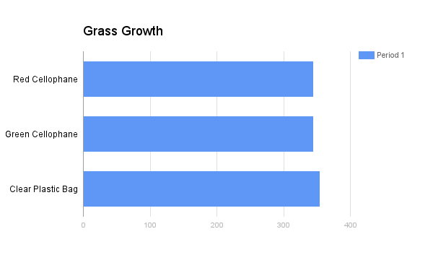

Slide 20
Conclusion

Slide 21
Conclusion
Our hypothesis appeared to be partially accurate because the light sources did alter the rate of growth for each plant, but not in the exact ways that we predicted. The control showed the most normal growth with evenly distributed roots. The red and green each showed dense root growth because they were required to search the most to photosynthesize (the green was the densest because it had the hardest time). We also noted that the group B grass grew on one side, which we attribute to human error or shifting seeds. We expected the grass with the red light source to have the most growth, which was not accurate because natural or white light was the best source for photosynthesis to occur.

