Slide 1
Planting Science
The Planting Protagonists
By Cadence, Benjamin, Antony, and Owen
Notes:
Add photo (icon, picture of your group or of your experiment in the background (Presenting Anthony)

Slide 2
Research Question
Does salt affect the the growth rate and height of a cress plant? Does salt affect seed germination of cress?
Notes:
Ben (Presenting Ben)

Slide 3
Prediction
We think that the plant will survive for some time with the salt. We think that some seeds will germinate but not all. With a ton of salt it might survive for a week but no longer.
Notes:
We - what variable are you changing (burn the seeds before planting), then (they will germinate faster than the control group) because (the fire removed part of the seed coat, so water can soak inside faster to activate the enzymes that will tell the seed to sprout) Owen (Presenting Owen)

Slide 4
Materials
-10 Containers -5 Paper Towels
-200 Cress Seeds -5 Petri Dishes
-5 Cups of Soil -5 Water Container
-5 Liters of Water -4 Soda Bottles
-50 Grams of Salt -5 Graduated
Cylinders
Notes:
Make a complete list of everything you need to set up your experiment - be as specific as possible. Think in terms of a recipe - what would someone else have to know in order to duplicate your experiment? Anthony (Presenting Anthony)
Materials -ten containers -200 cress seeds -5 cups of soil -5 Liters of water -50 grams of salt -5 Paper Towels -5 petri dishes -5 water container- Soda bottles? -5 graduated cylinders EXPERIMENTAL DESIGN Put soil in containers mix water Put...

Slide 5
Experimental Design
Put soil in containers mix water
Put 200 ml of water in soil
Soak paper towels in water
Place paper towels in petri dishes
Plant seeds in soil
Put some seeds in petri dishes
Add 25-50 ml of salt water daily depending soil wetness and measure (Start with normal water for pot plants until grown)
Notes:
You may need more than one slide for this - this is the very detailed instructions for setting up your experiment, and how you will measure change. Anything you do to your plants must be recorded here. Cadence (Presenting Cadence)

Slide 6
Observations
*PPT means parts per thousand*
Concentration of Salt | Average Ending Height (cm) | Average # of Healthy Plants at End of Experiment
Control | 4.2 | 3.5
5 ppt | 0.8125 | 2
10 ppt | 2.75 | 0
15 ppt | 4.05 | 0
20 ppt | 4.115 | 0
Salt Concentration | # Germinated at End of Experiment | Average Mass Per Sprout at End of Experiment in Grams
Control | 8 | 0.025
5 ppt | 10 | 0.01
10 ppt | 0 | N/A
15 ppt | 0 | N/A
20 ppt | 0 | N/A
Notes:
Add important observations that your group made that helped you determine if your prediction was supported or not. Cadence (Presenting Cadence)

Slide 7
Data Table-Plant Condition for in Pot Plants
Date | 0g A | 0g B | 5g A | 5g B | 10g A | 10g B | 15g A | 15g B | 20g A | 20g B
10/14/2021 | Wet 1 seed | Wet 4 seeds | With Ben | With Ben | Wet 2 seeds | Wet 6 seeds | Wet 4 seeds | Wet 3 seeds | Wet 7 seeds | Wet 6 seeds
10/18/ 2021 | Wet 7 seeds | Wet 10 seeds | Wet 3 seeds | Wet 10 seeds | Wet 9 seeds | Wet 10 seeds | Wet 6 seeds | Wet 6 seeds | Wet 7 seeds | Wet 8 seeds
10/25/21 | 5 happy seeds | 1 happy seeds | 0 happy seeds | 1 happy seeds | 0 happy seeds | 0 happy seeds | 0 happy seeds | 0 happy seeds | 0 happy seeds | 0 happy seeds
10/26/21 | 5 happy seeds | 2 happy seeds | 2 happy seeds | 2 happy seeds | 0 happy seeds | 0 happy seeds | 0 happy seeds | 0 happy seeds | 0 happy seeds | 0 happy seeds
10/28/21 | 5 happy seeds 0.3g | 2 happy seeds 0.2 | 2 happy seeds 0.0 | 2 happy seeds 0.0 | 0 happy seeds 0.0 | 0 happy seeds 0.0 | 0 happy seeds 0.0 | 0 happy seeds 0.0 | 0 happy seeds 0.0 | 0 happy seeds 0.0
Notes:
Add your data table here. If you made two different tables, add another slide and include that as well. Cadence (Presenting Anthony)

Slide 8
Data Table- Average Height (in cm) for Potted Plants
Date | 0g A | 0g B | 5g A | 5g B | 10g A | 10g B | 15g A | 15g B | 20g A | 20g B
10/18/ 2021 | 3.49 | 1.13 | N/A | N/A | N/A | N/A | N/A | N/A | N/A | N/A
10/19/ 2021 | 4.57 | 4 | 1.4 | 2.7 | 1.9 | 4.8 | 4.4 | 2.82 | 4.6 | 4.86
10/25/ 2021 | 5.3 | 3.57 | 3.2 | 1.1 | 6 | 5 | 3 | 3.87 | 4 | 5.2
10/28/ 2021 | 5.2 | 3.2 | 1.125 | 0.5 | 3 | 2.5 | 3.77 | 2.33 | 3.33 | 4.9
Notes:
Add your data table here. If you made two different tables, add another slide and include that as well. Cadence (Presenting Owen)

Slide 9
Data Table-# of Seeds Germinated in Germination Experiment
Date | 0g # | 5g | 10g | 15g | 20g
10/18/2021 | 10 | All 10 sprouted | 1 sprouted | 0 sprouted | 0 sprouted
10/19/2021 | 10 sprouted | 10 sprouted | 1 sprouted | 0 sprouted | 0 sprouted
10/25/2021 | 10 sprouted | 10 sprouted | 1 sprouted | 0 sprouted | 0 sprouted
10/26/2021 | 10 sprouted | 10 sprouted | 1 sprouted | 0 sprouted | 0 sprouted
10/29/2021 | 8 grown Avg-5.22 0.2g total 0.025 per plant | 10 grown Avg-2.79cm 0.1 total 0.01 per plant | 0 grown | 0 grown | 0 grown
Notes:
Add your data table here. If you made two different tables, add another slide and include that as well. Cadence (Presenting Ben)

Slide 10
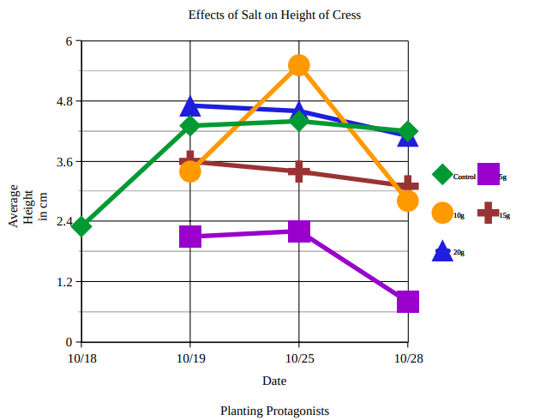
Graph-Effects of Salt on Height of Cress
Notes:
Cadence (Presenting Cadence)

Slide 11
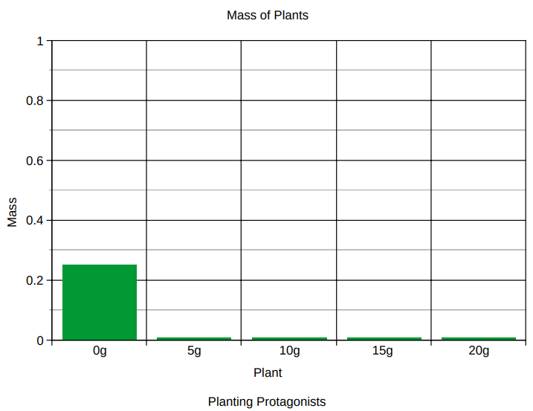
Graph-Mass of Plants
Notes:
Cadence (Presenting Anthony)

Slide 12
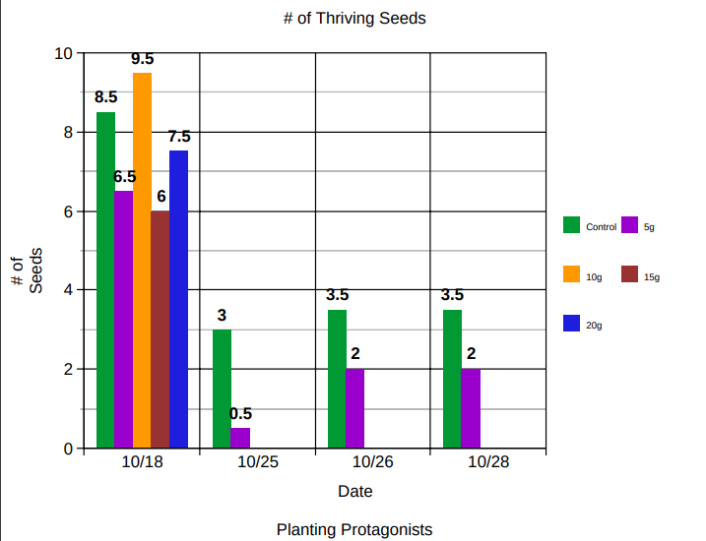
Graph - # of Thriving Seeds
Notes:
Cadence (Presenting Ben)

Slide 13
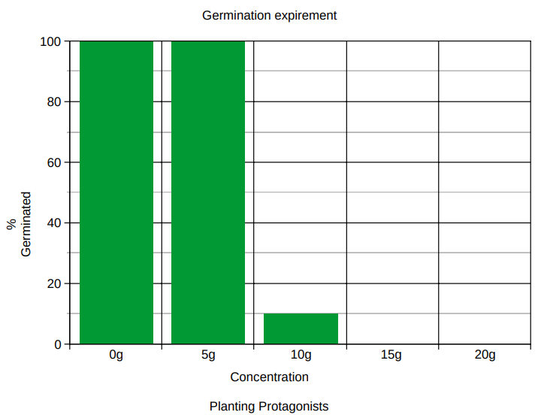
Graph-Germination Experiment
Notes:
Cadence (Presenting Owen)

Slide 14
Data Analysis / Conclusion
PPT
Means
Parts per Thousand
The data supported our prediction that the plants will survive for some time with some salt, maybe a week, and the plants with less salt would survive longer. We can prove this with our healthy plathents chart. One example in the healthy plants chart is that our twenty ppt B pot had eight healthy plants on 10/18 and by 25th there were 0 healthy plants. Another way we can prove this is by looking at 15 ppt B. On the 19th, the average height was 2.82 cm, and on the 28th the average was 2.33 cm. Not all of the plants survived which changed our average. This helps prove our point because if you look at one of our control pots, over the same period of time, the control plant grew .63 cm.
Notes:
Cadence (Presenting Cadence)

Slide 15
Data Analysis / Conclusion Continued
It also supported our prediction that some seeds will germinate but not all. The best way to prove we were correct in saying that some seeds will germinate but not all is to look at our germination graph. If you look at our germination graph you can see that all ten of the 0 ppt had sprouted and 8 grew. On the other hand in our 10 ppt experiment only 1 had sprouted in the experiment but ended up dying. In this experiment you can see the line between the 5 ppt and the 10 ppt. In the 5 ppt all of them sprouted and all of the spouts grew into plants, unlike the 10 ppt. At the end of this experiment, we ended up looking at all of the plants that had germinated and taking some more measurements. In doing this, we also found that the control is heavier per sprout. In the control, the average weight per sprout was 0.025g, and in the 5 ppt, the average weight per sprout was 0.01g. We figured out that not only does salt affect the amount of germination, but it also affects the weight of the plants germinated. droopy. We didn’t really have any unexpected results, and pretty much everything went as planned. Using all of that data you can conclude that cress plants can survive up to 5 ppt but no more, this would be about a seventh as salty as ocean water.
Notes:
Cadence (Presenting Cadence)

Slide 16
Data Analysis / Conclusion Continued
Although our experiment turned out okay, there were a few major experimental errors along the way. When one of our group members was bringing in some of the plants he was growing at home, another student accidentally knocked the plant out of his hands as he was walking past. Another issue we had was with the watering. We think that somewhere along the line one of our control plants got watered with the wrong water because it was looking droopy. We didn’t really have too many mistakes and experimental errors, and pretty much everything went as planned. Using all of that data you can conclude that cress plants can survive up to 5 ppt but no more, this would be about a seventh as salty as ocean water and not anywhere close to the amount of salt that would be in the snow and ice that has been salted for winter.
Notes:
Cadence (Presenting Cadence)

Slide 17
Future Experiment/Real World Connection
An idea for a future experiment would be to find out if salt affects the mass of other germinated seeds that weren’t cress. One real world connection would be in the massive drought in California; all of their crops are failing because they have little freshwater. They do have lots of salt water, so using this data you can find a way to use the salt water to water the crops.
Notes:
Cadence (Presenting Ben)

Slide 18
Special thanks to our mentor,
Steven G Saupe
He helped us a lot!
Notes:
Owen (Presenting Everyone)

