Slide 1
Dragon Blood Trees
Quinn, Jazzlyn, Mackenzie, and Luke
Notes:
By: Quinn

Slide 2
Research Question
Our research question is can corn grow if watered with water that has salt dissolved in it? We are interested to help agriculture in areas with less rainwater and more brackish water. We hope to figure out a solution for this problem by asking this question and testing it.
Notes:
By: Quinn

Slide 3
Prediction
Our prediction is that we think that the roots will shrivel up and rot in the 0.8g salt concentration, it will not grow as big or as fast as it would in the 0.4g salt concentration, and it will grow pretty well in the .1g salt concentration. We think that the control with no salt will grow the best. These concentrations are what we are watering each time.
Notes:
By: Quinn

Slide 4
Materials
Materials: Salt: .8 grams times three=2.4 .4 grams times three=1.2 .1 grams times three=.3 12 pots ¾ cup of soil per pot (times twelve)=nine cups sixty corn seeds-five per pot 39 grams of salt Put 3/4 of a cup of soil into a pot and plant 5 corn seeds 2 inches down, spread 2 centimeters apart. Repeat twelve times, as there are going to be three pots for each salt concentration. The first time watered, water with 50 ml of water. Water regularly with 25 ml of water with various salt concentrations of .1, .4, .8 grams of salt and no salt, one for each set of plants, in a Monday-Wednesday-Friday cycle for all other times.
Notes:
By: Quinn

Slide 5
Experimental Design
Steps: Step 1: Put 3/4 of a cup of soil into a pot and plant 5 corn seeds 2 inches down, spread 2 centimeters apart. Repeat twelve times, as there are going to be three pots for each salt concentration. The first time watered, water with 50 ml of water. Water regularly with 25 ml of water with various salt concentrations of .1, .4, .8 grams of salt and no salt, one for each set of plants, in a Monday-Wednesday-Friday cycle for all other times. At the end of the project, measure the dry weight of all of the plants measured with a specific salt concentration. Our salt to water ratios are 0 grams to 25 ml, .1 grams to 25 ml, .4 grams to 25 ml, and .8 grams to 25 ml. Step 2: Measure and document plant growth and also make charts/graphs. Step 3: End with a conclusion
Everything changed throughout the project: We moved the plants tp a grow light towards the end of the project. We changed our watering cycle to just watering once a week on Wednesday.
Notes:
You may need more than one slide for this - this is the very detailed instructions for setting up your experiment, and how you will measure change. Anything you do to your plants must be recorded here.
By: Mackenzie

Slide 6
Observations
Beginning: The plants all look healthy and have a nice bright green color. All of the plants with salt in them are turning a little yellow at the bottom. The .8 salt concentration is the tallest plant and has a few brown spots.
Middle: The plants are all starting to turn slightly yellow and whiter than they used to be. All of the controls look the healthiest and the .1 salt concentration looks the worst. The stems of the plants are red and the plants are beginning to lean over. The tips of the plants are very brown and dying.
End: The plants are discolored and very brown. The plants are very weak and falling out of their pots in every pot. The control pots are doing the best, but they are still not doing very well. The plants leaves are all shrivelled up and all of the plants are pretty much dead.
Notes:
Add important observations that your group made that helped you determine if your prediction was supported or not.
By: Mackenzie

Slide 7
Data Table
Notes:
By: Quinn

Slide 8
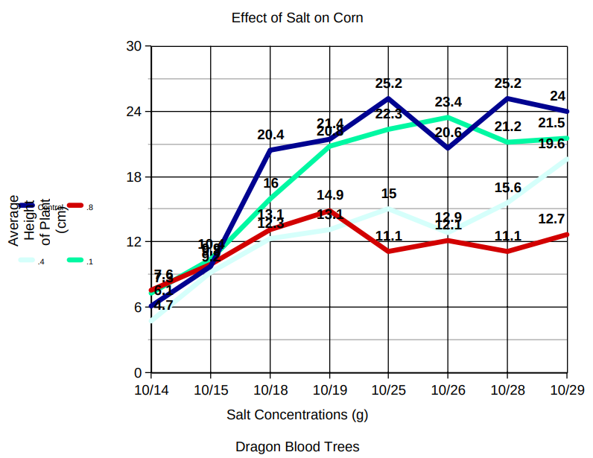
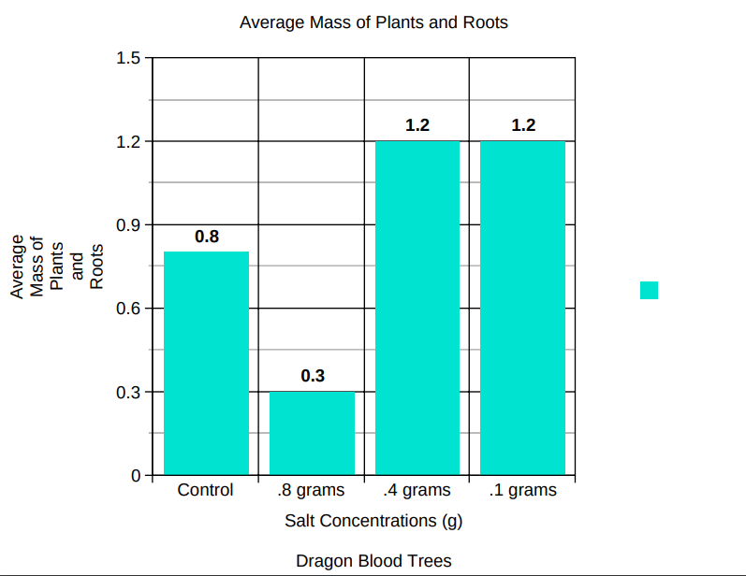
Graph
Notes:
By: Mackenzie

Slide 9
Data Analysis / Conclusion
The data we collected partially supports our prediction. We thought that the roots would shrivel up and rot in the 0.8 g salt concentration, it would not grow as big or as fast as it would in the 0.4 g salt concentration, and it will grow pretty well in the .1 g salt concentration. We think that the control with no salt will grow the best. As shown in our graph, by the end of the experiment the control plants average height was 24 cm, the .1 g concentration plants average was not far behind at a height of 21.5 cm, the .4 g concentration plants average height was 19.3 cm, and the .8 g concentration plants average height was 12.7 cm. Due to overwatering and lack of sunlight, the plants shriveled up. The .8 g plants were healthy up until the overwatering but were growing slower than the rest of the plants. The salt concentrations we used are close to that of brackish water.

Slide 10
Ending Result
Control: 24cm (tallest)
.8 Concentration: 12.7 cm (smallest)
The tips were dry because of the presence of mold. The .8 g concentration plants looked the healthiest out of the salt concentration plants, the .1 g concentration plants looked the worst, and the .4 g concentration plants were not doing well, but were slightly better than the .1s, although not by much. The control plants did the best. The mold on the .8 g plants was killed off by the salt. The control plants were not moldy. The .8 g and .4 g concentrations had thick stems, whereas the .1 g concentration and the controls had thinner stems. All of the plants' stems were red and had bulges in them. The rest of the plants, except for the stems, were green and healthy until the overwatering caught up with them on October 26, 2021.

Slide 11
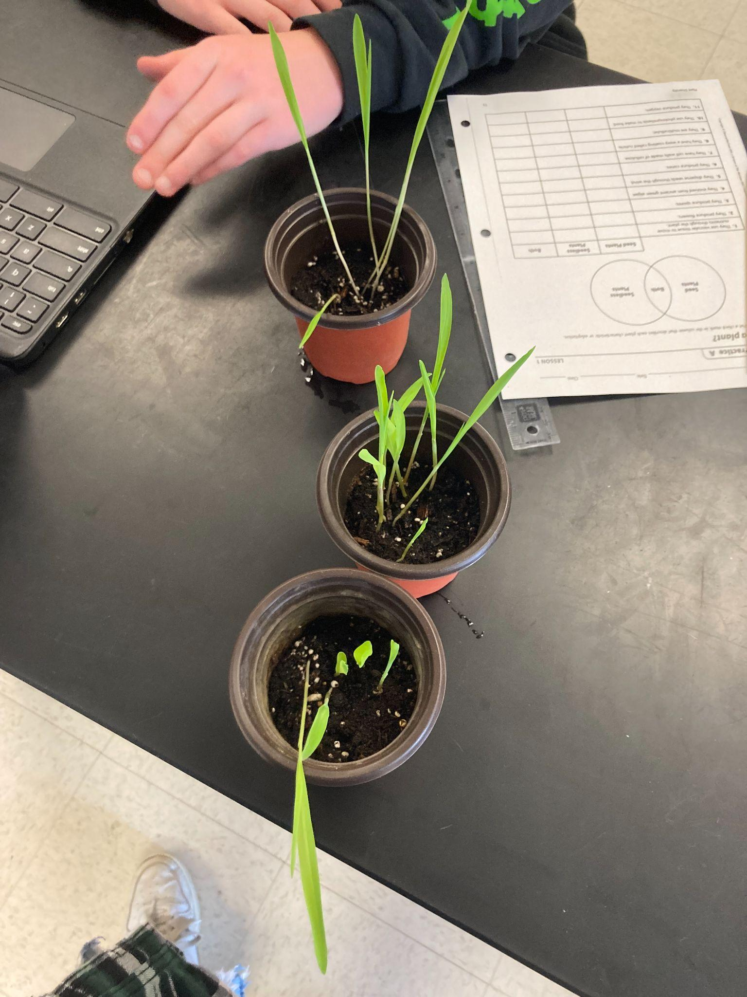
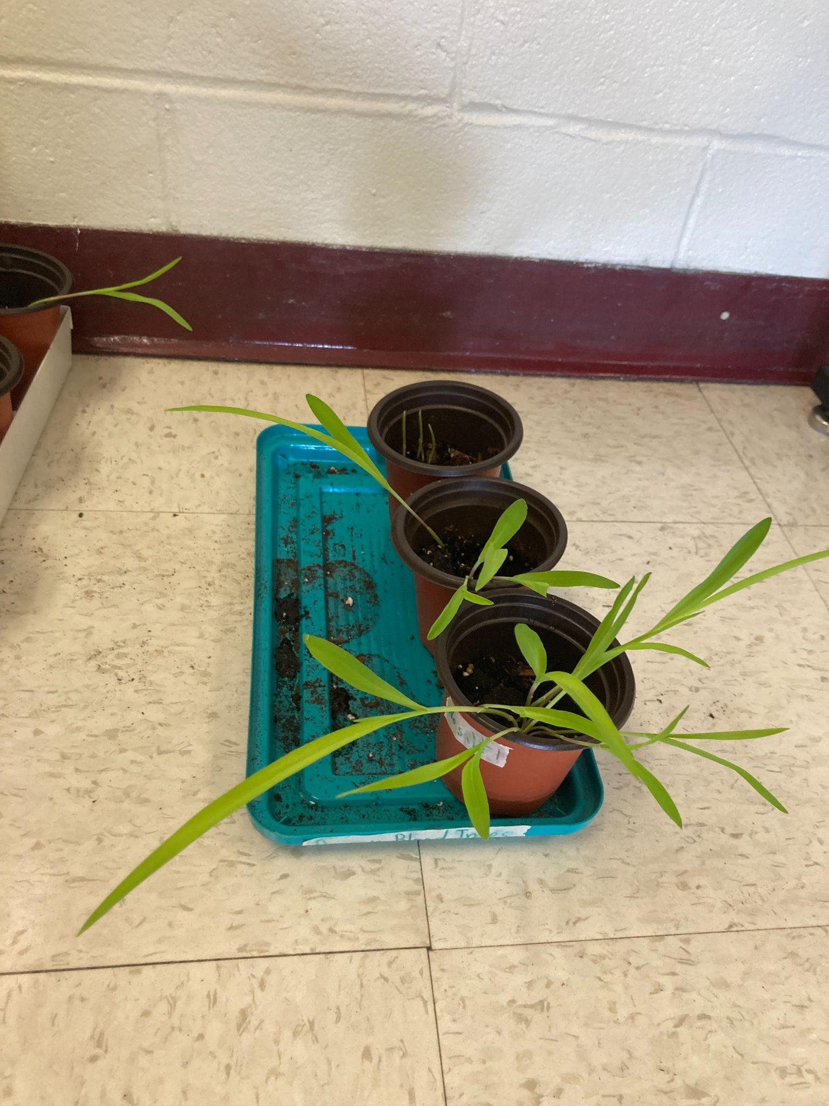
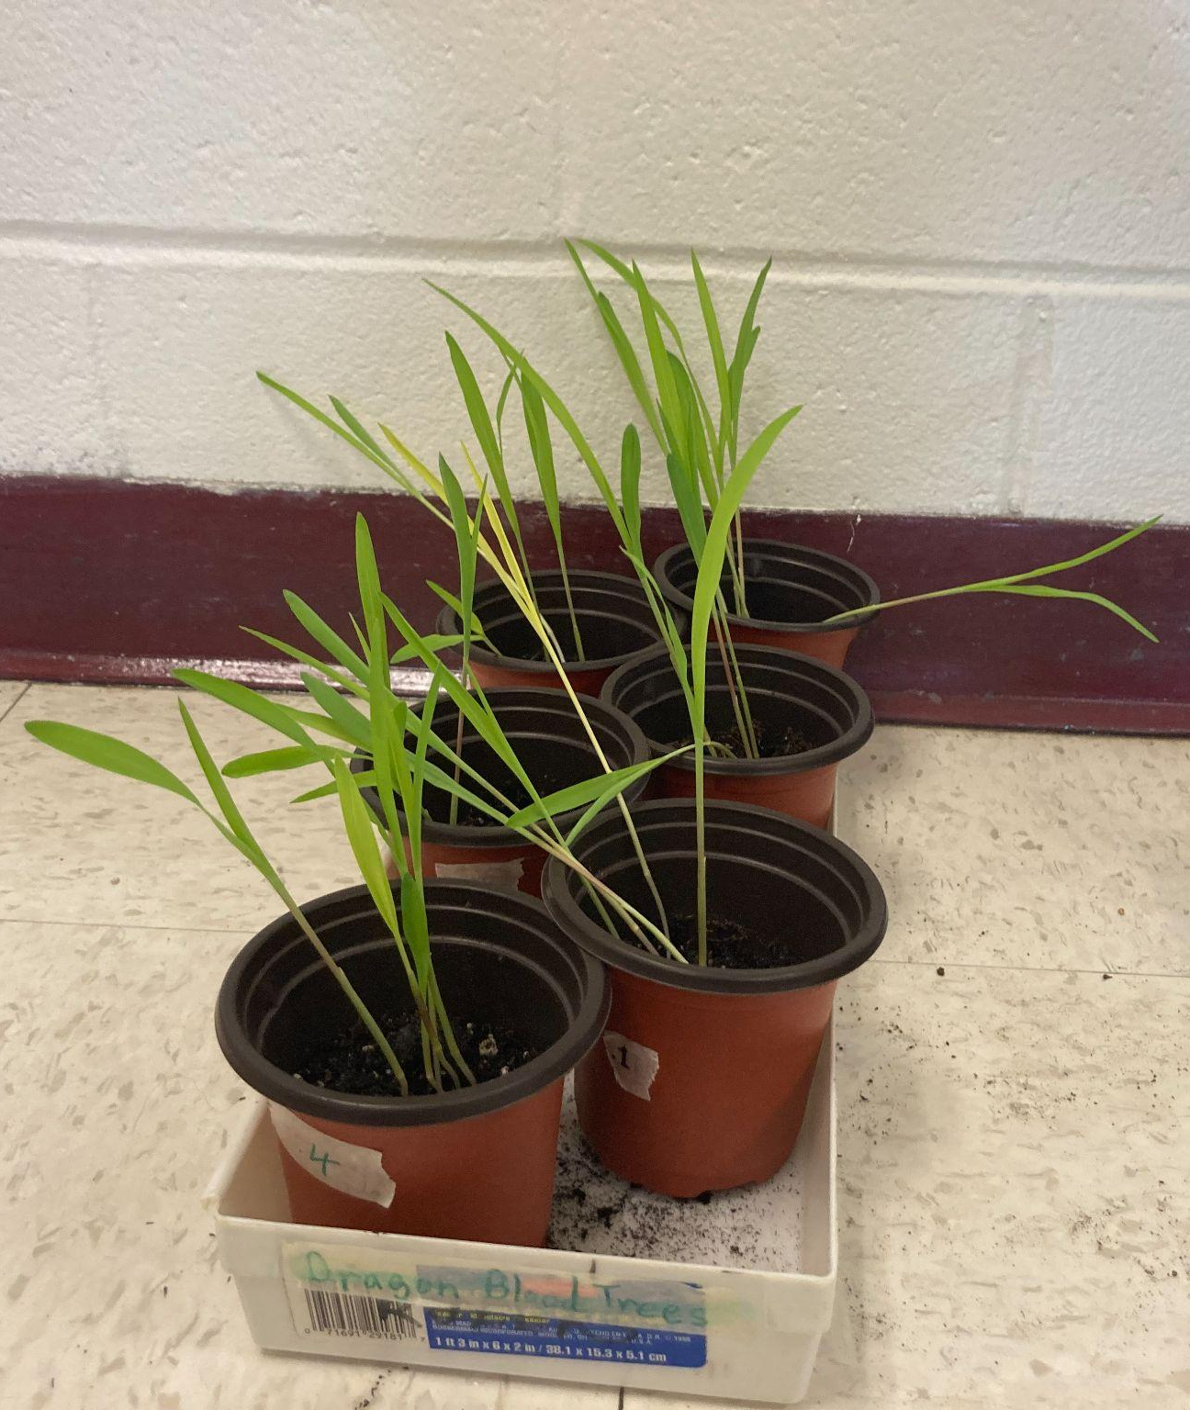
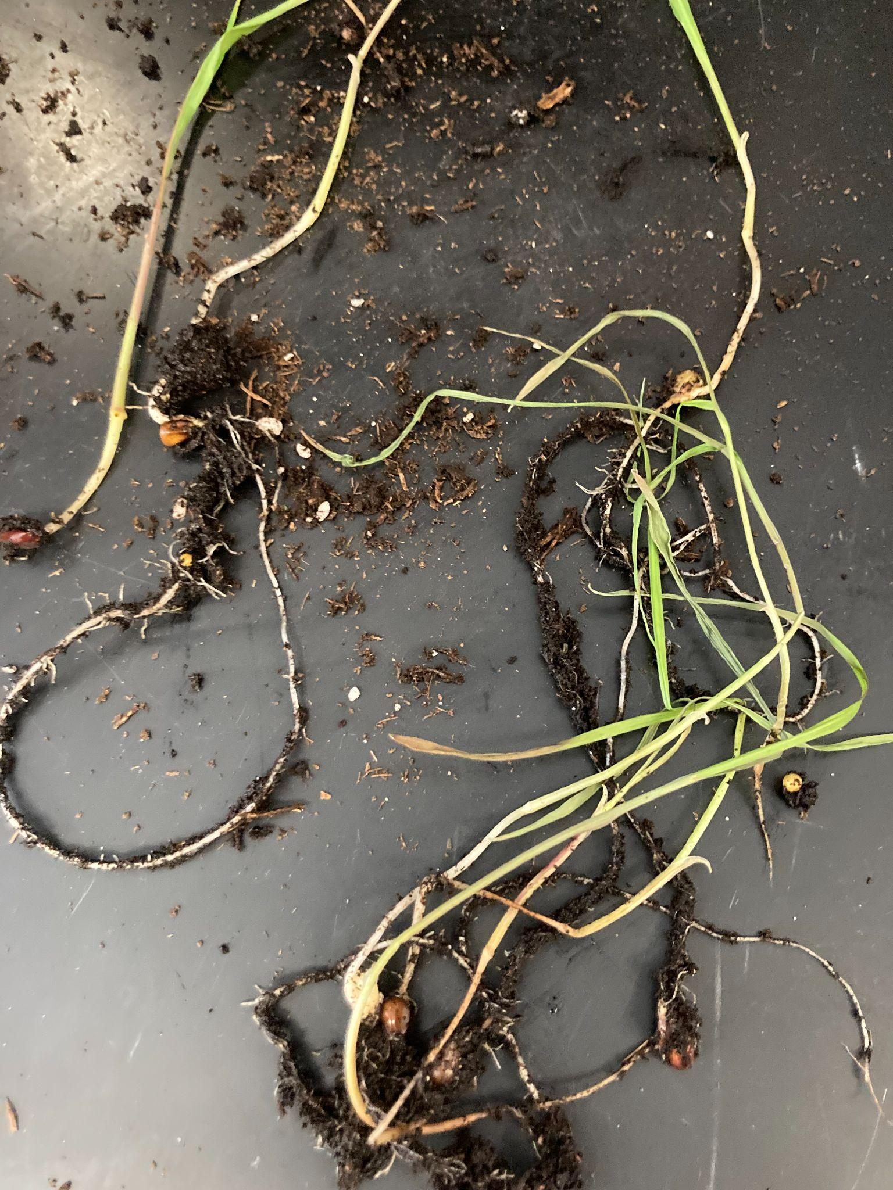
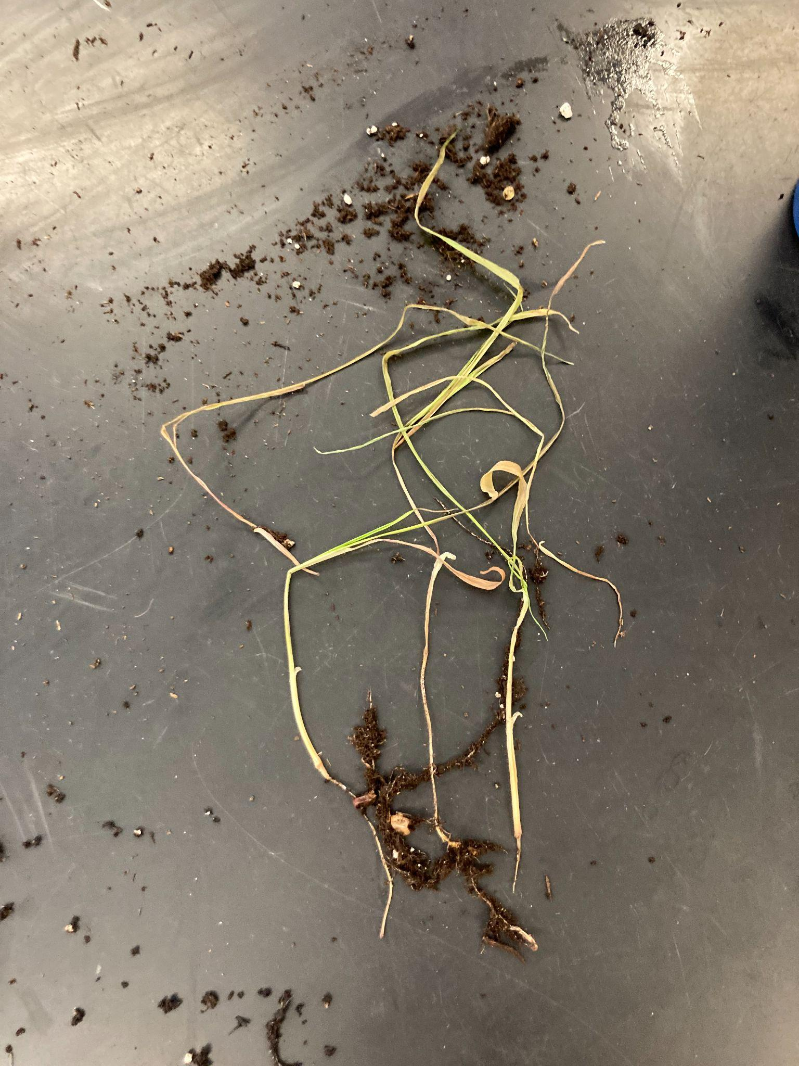
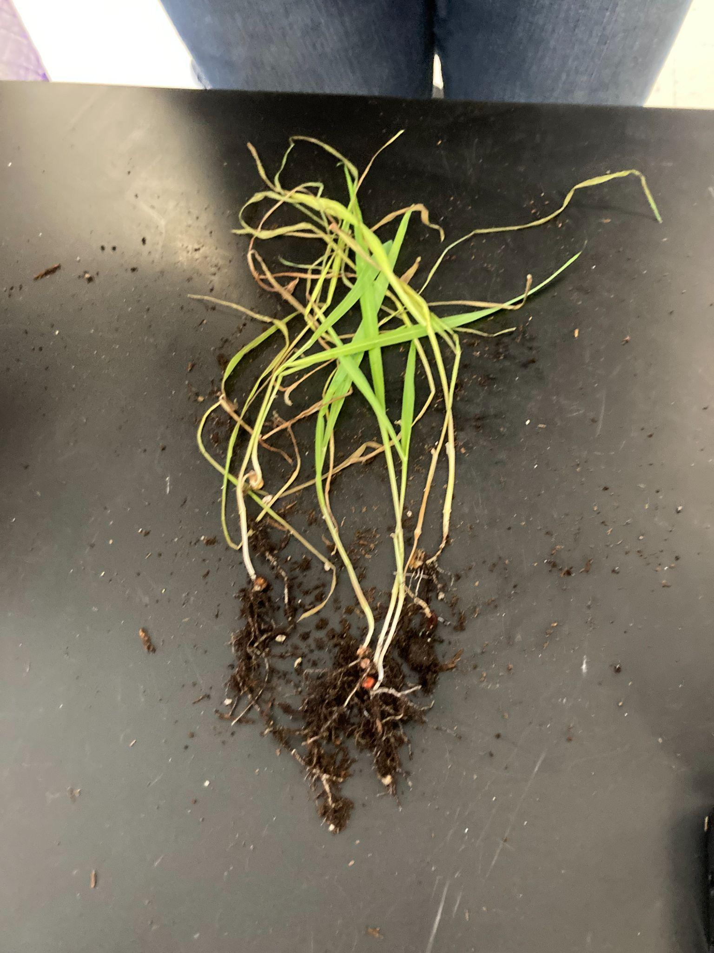
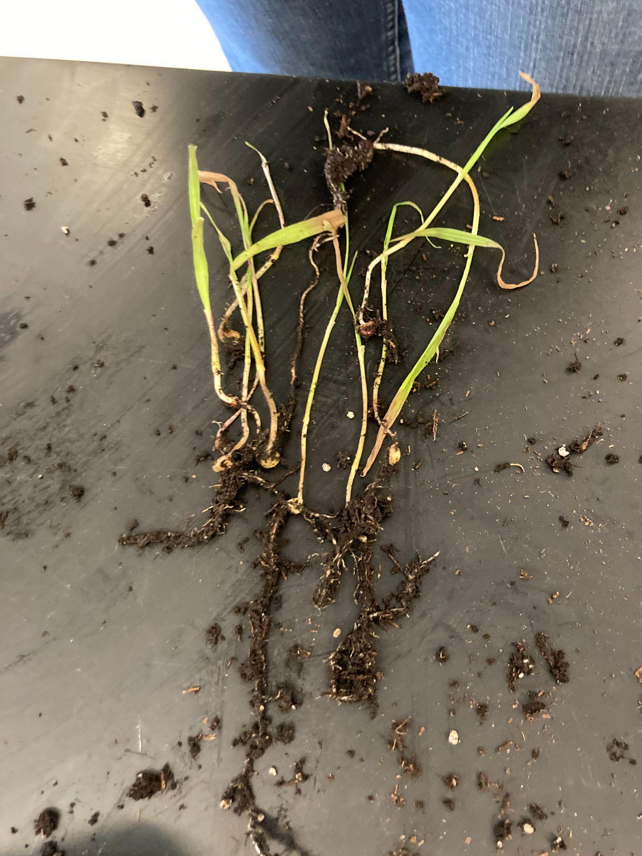
Pictures
Before they started to show signs of dying:
Root pictures:
Notes:
It is always a good idea to get photos of both groups when comparing.

Slide 12
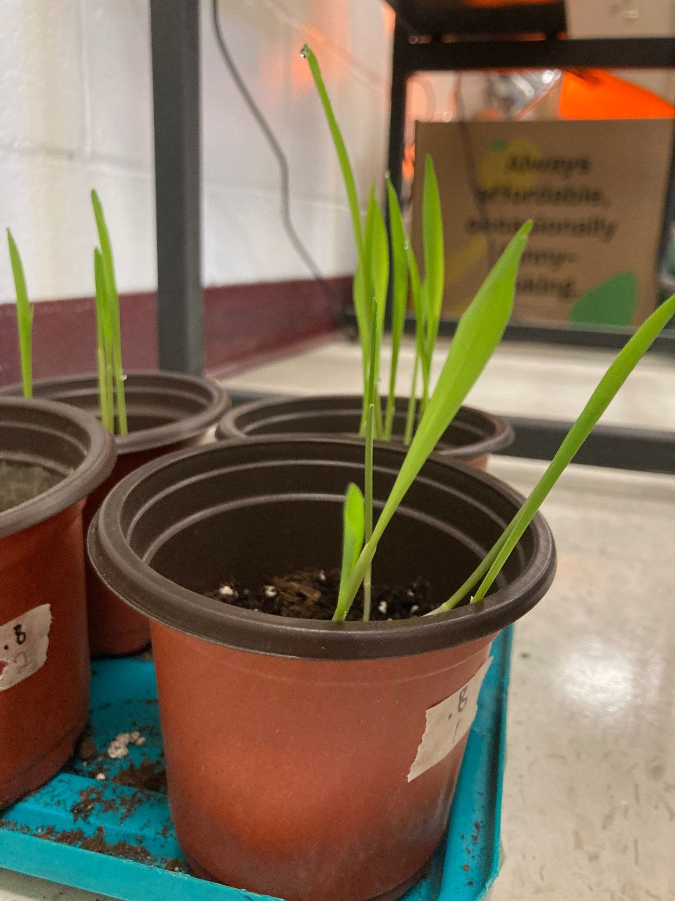
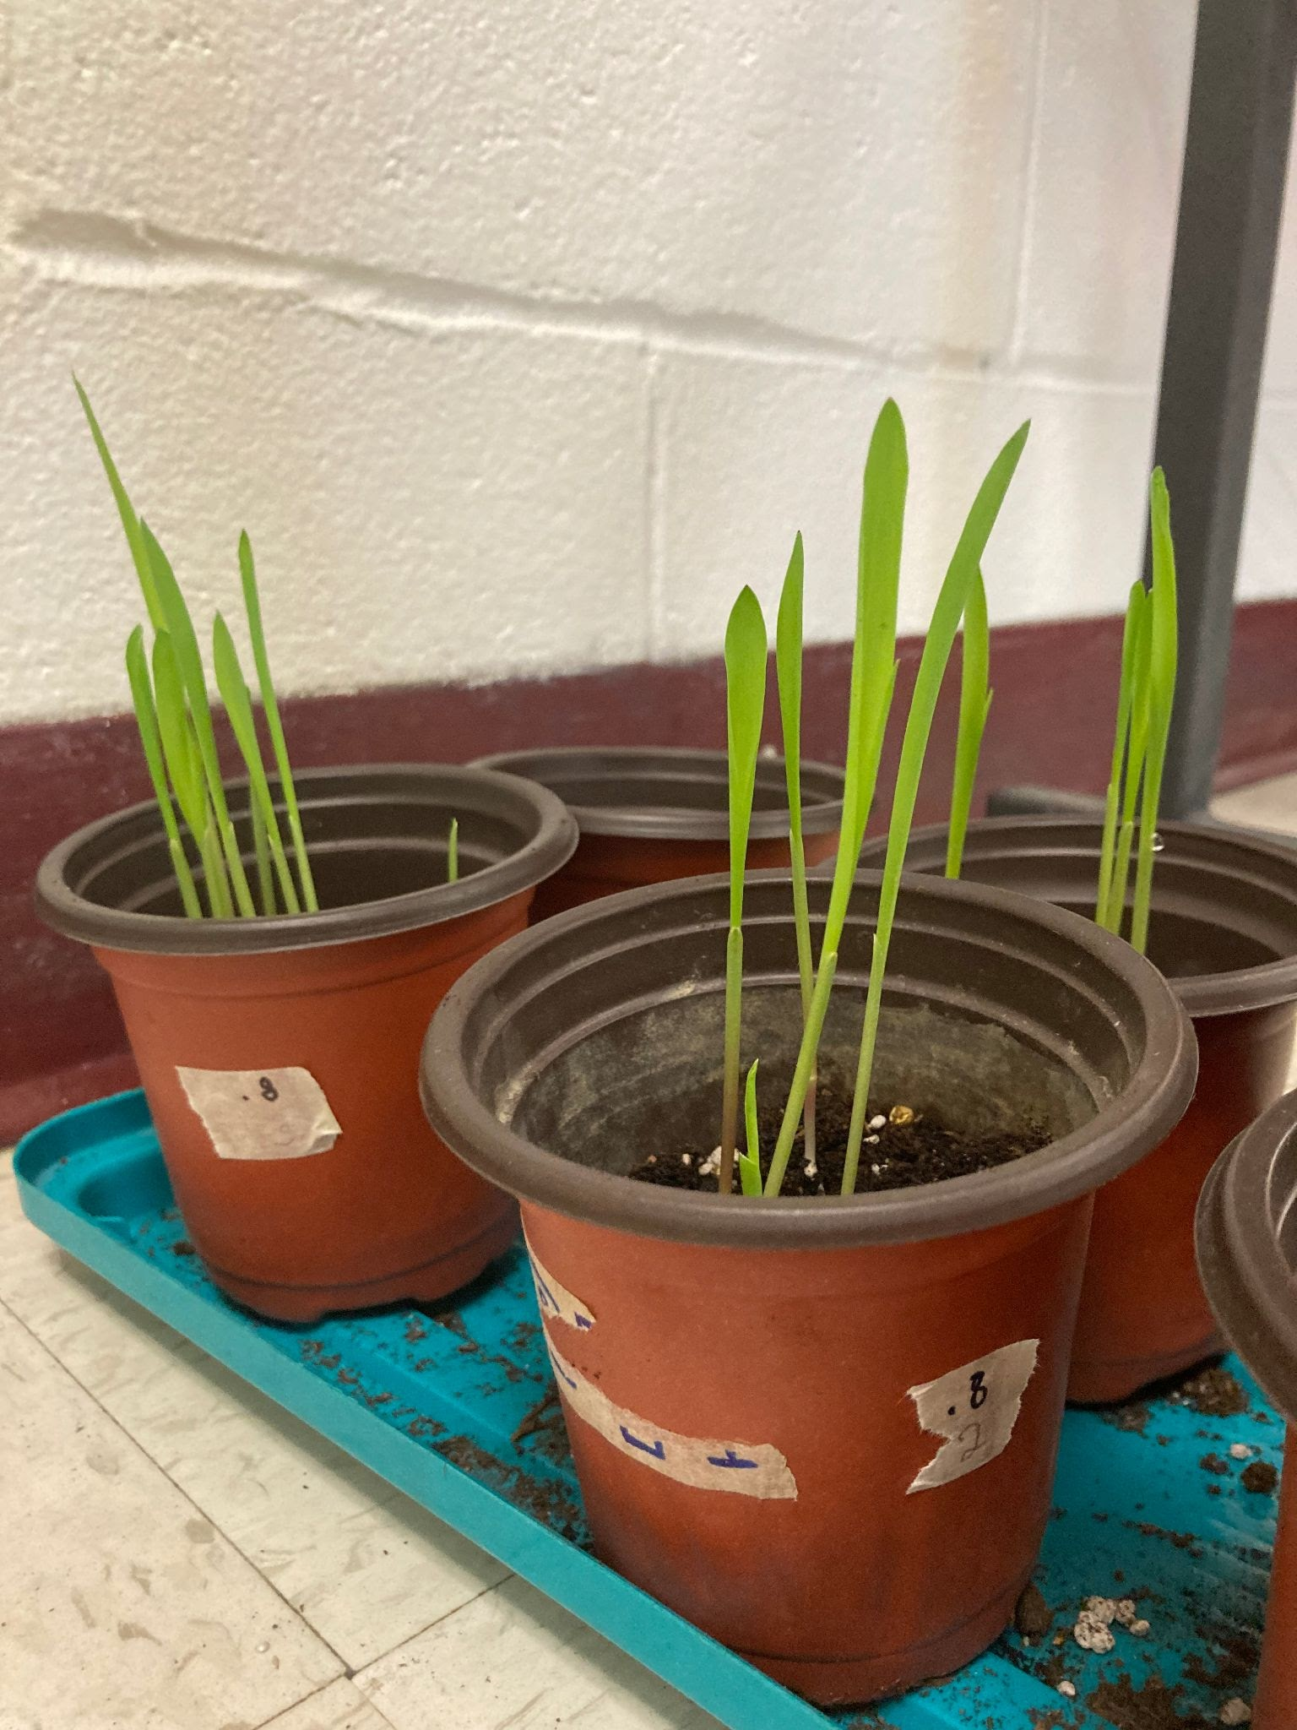
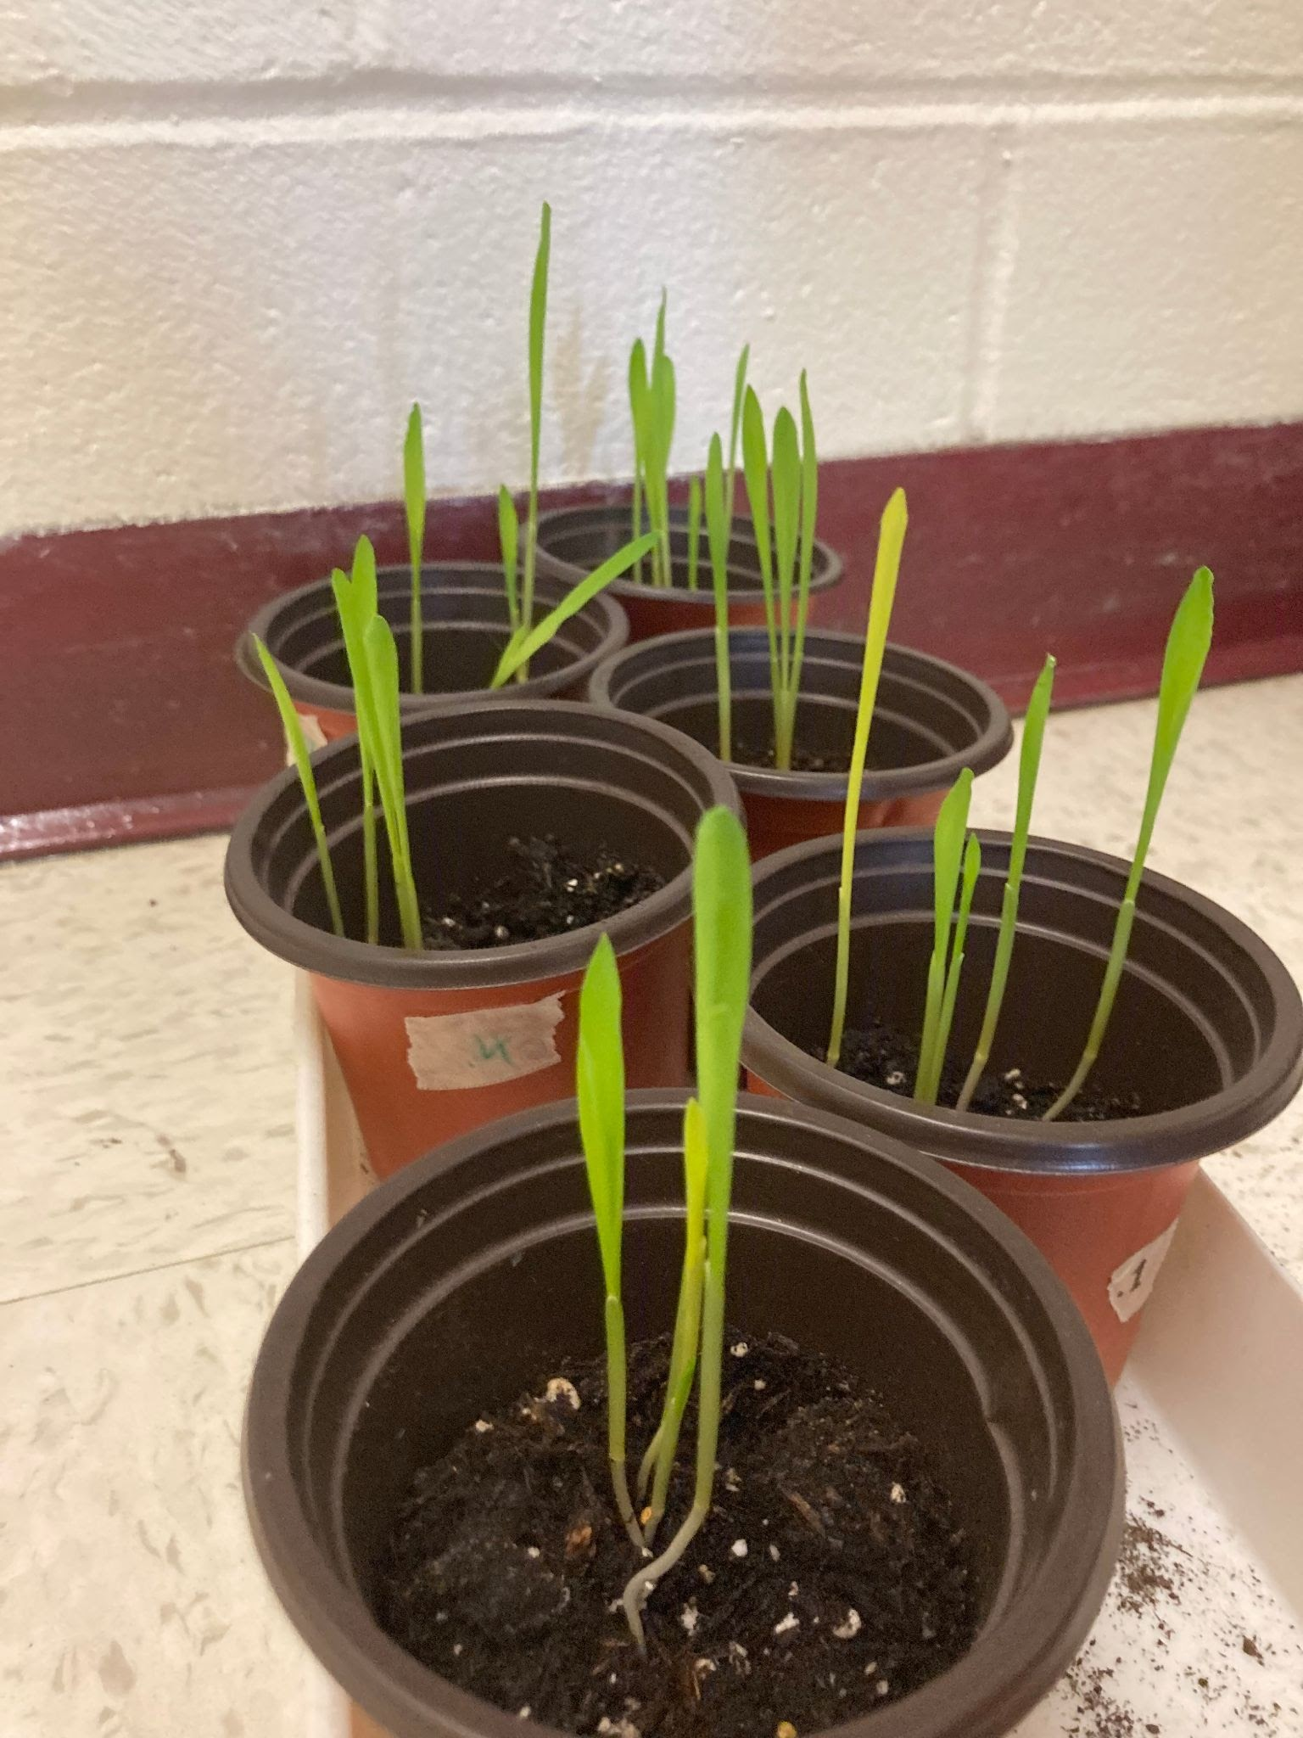
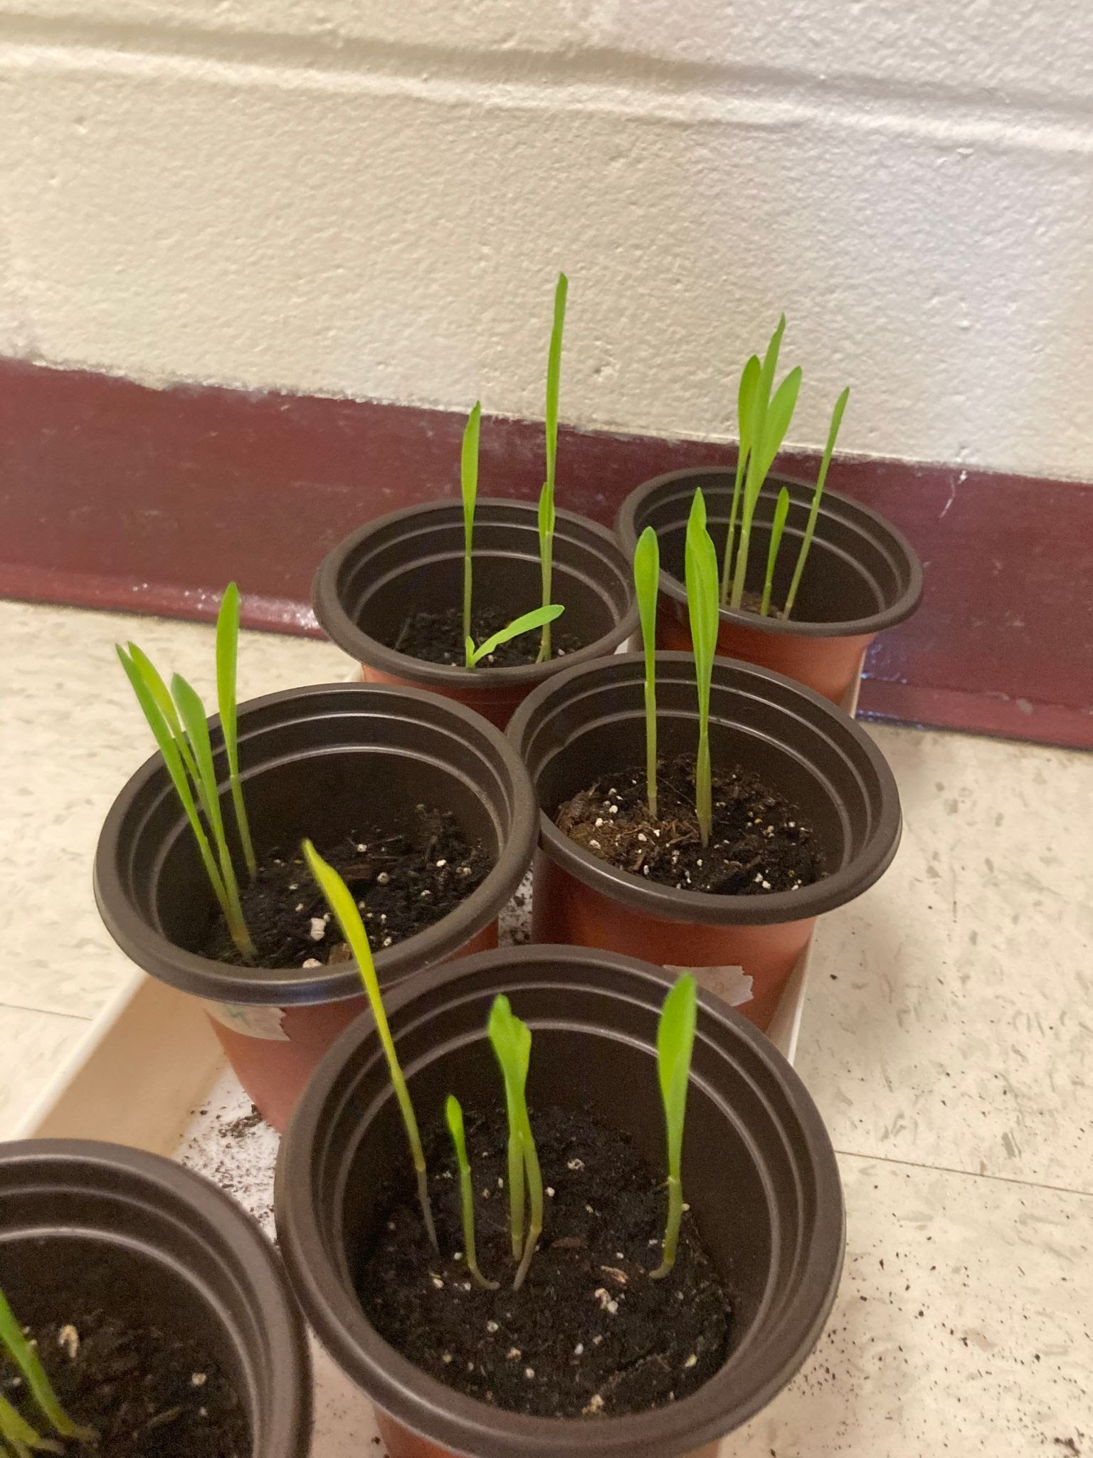
Pictures
Early signs of growth:

Slide 13
Special thanks to our mentor,
Professor Schnabel!
He helped us a lot!

