Slide 1
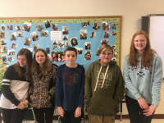
The Magnificent Melons
Skylar, Ben, Sarah, Allison, Tayler

Slide 2
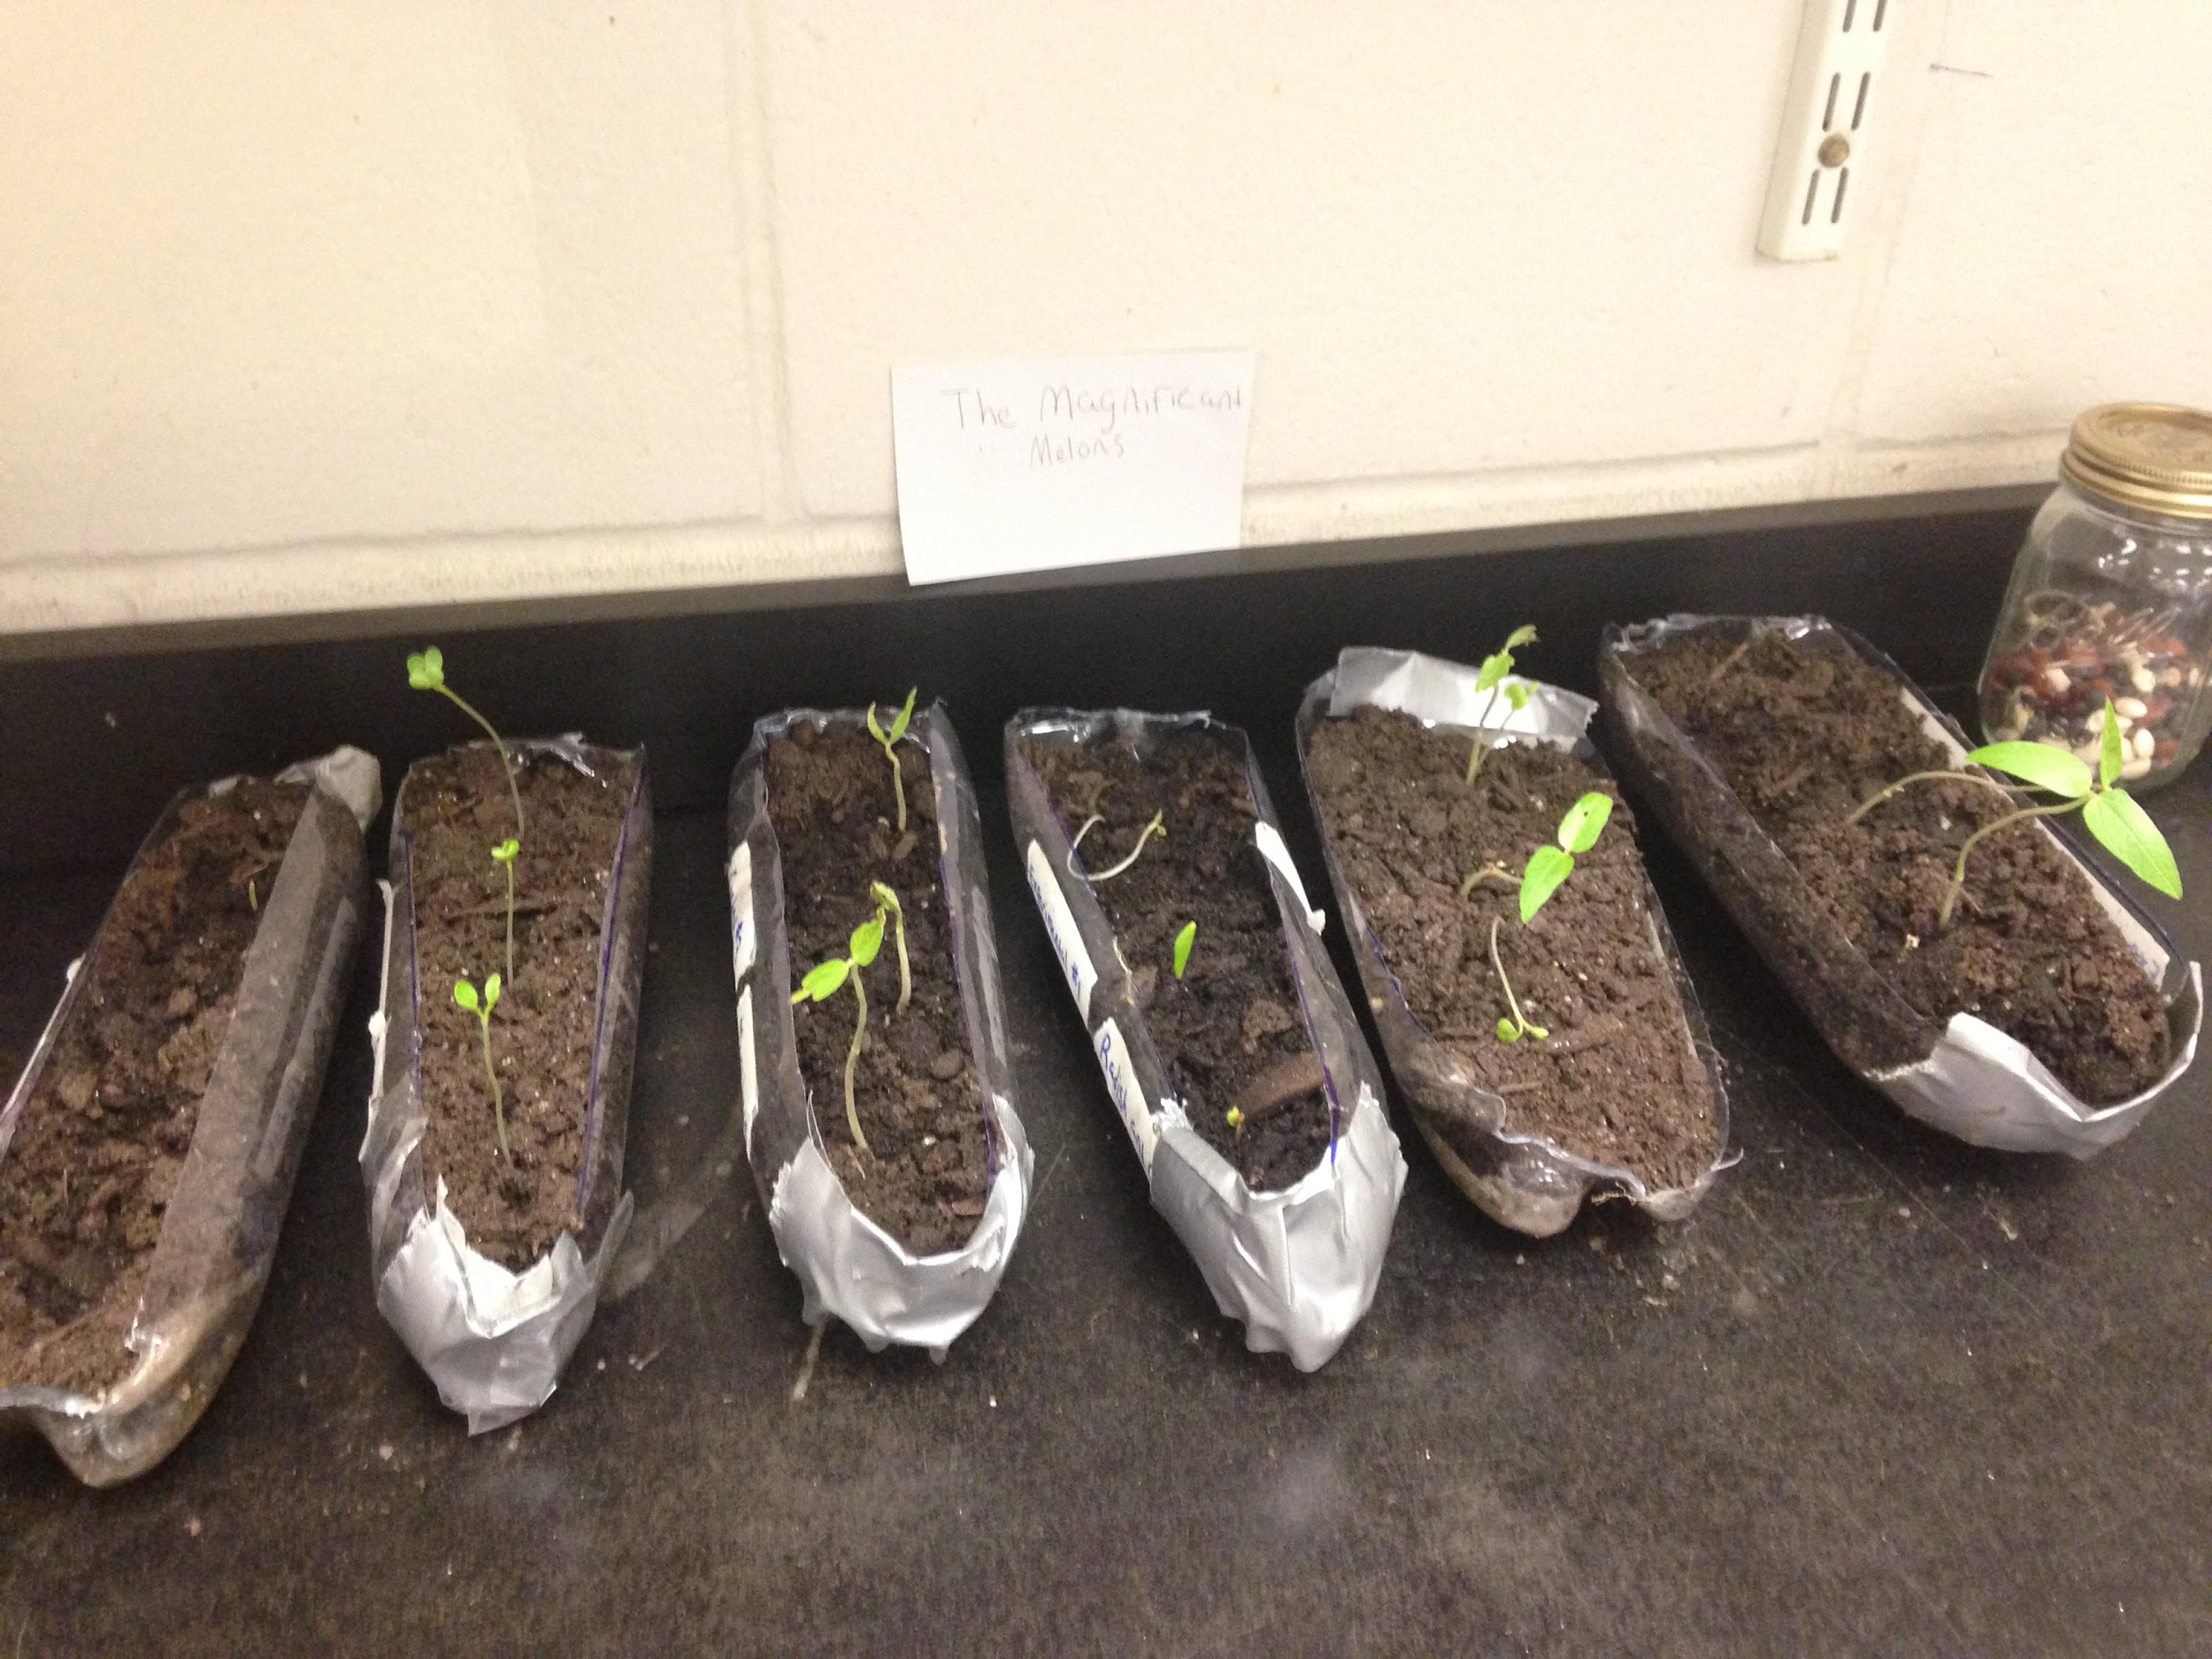
Intro
This experiment could be helpful to farmers because it will simplify the process instead of having to go through the process of grafting the plants
Germination/flooding/drought is important for agriculture because it helps the plants to grow and survive though different temperatures

Slide 3
Research Question
Would two seeds in the same spot, radish and corn, radish and mung bean, and mung bean and corn, grow better than one seed on its own?

Slide 4
Predictions
the plants with one seed will grow faster than the plant with two seeds, we think this because the plant with two seeds may be affected if the two plants are trying to grow together to form into one plant.
the radish and corn and the radish and mung bean will compete for space and water.
the mung bean and corn will try to grow into one because these two plants have roots that would grow easily together especially if placed in the same spot and watered the same amount of water. The radish is round so it wouldn't grow as well with roots.

Slide 5
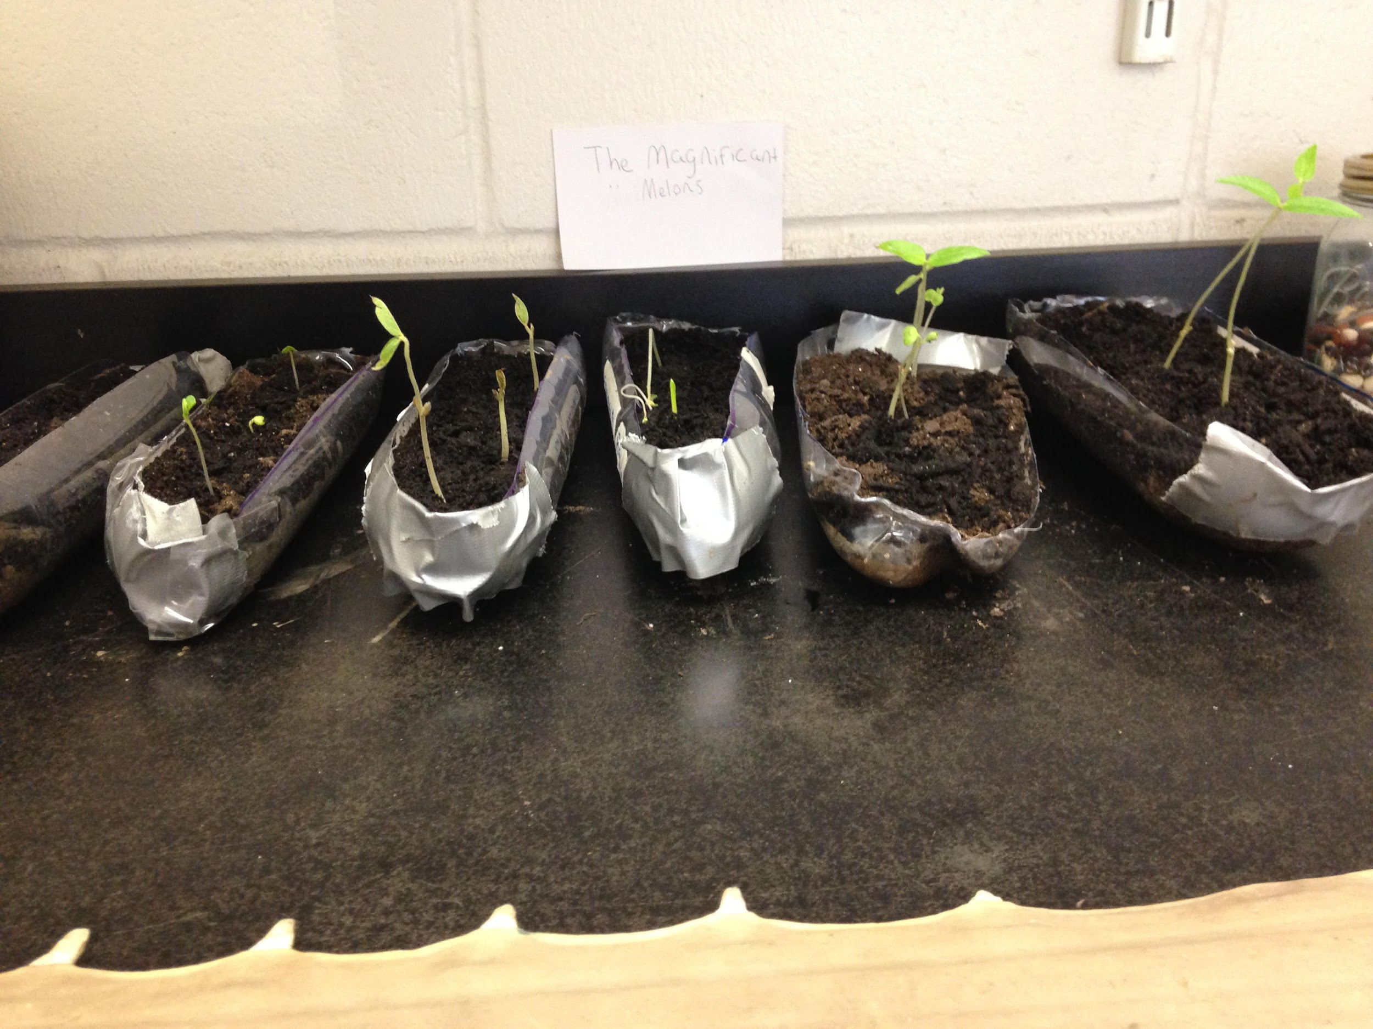
Methods
we planted 2 seeds in the same spot and then one seed type planted by itself.
We used 9 corn seeds, 9 mung bean bean seeds, and 9 radish seeds.
We cut 3 soda bottles in half and put 3 seeds in each
we originally used 60 ml of water per bottle/20ml per seed a day but that was too much so we cut it down to 30 ml a day.
Our group grew our experimental and control plants for 20 days.

Slide 6
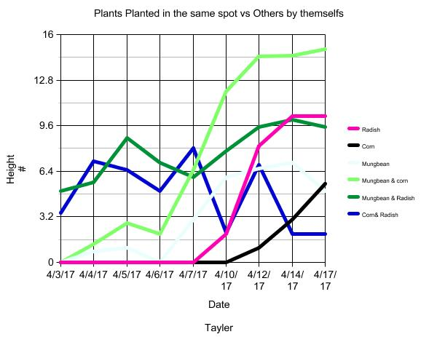
Results
After digging up the roots, we found that the plants did not grow together as we thought they might
The control plants roots and the experiment plants roots look the same

Slide 7
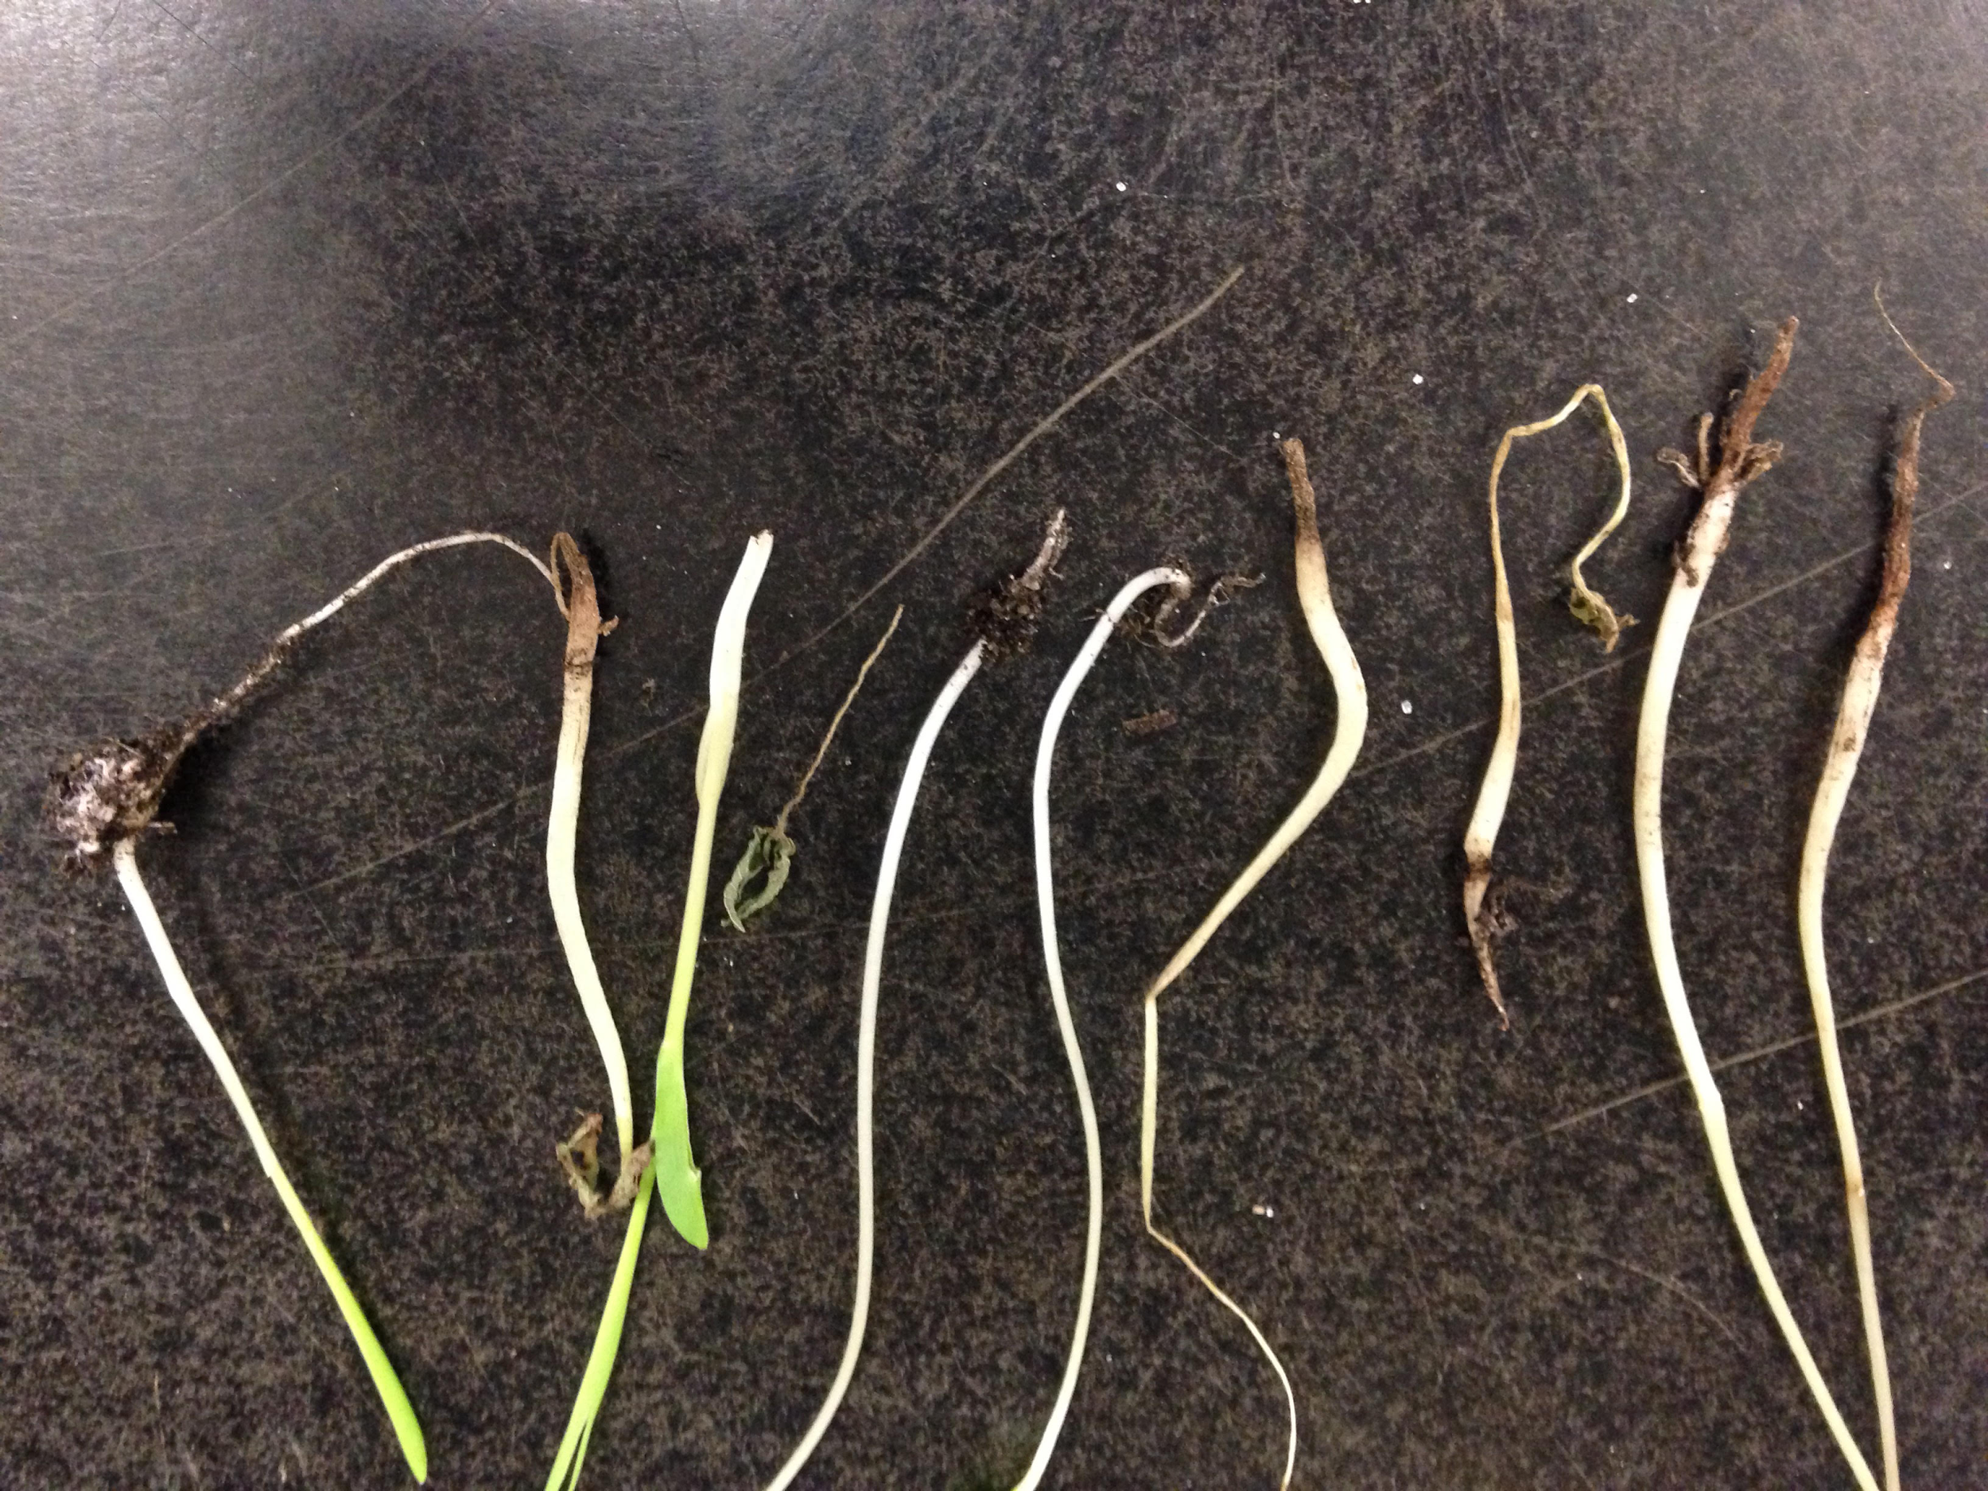
Conclusion
A possible explanation for our results is that the roots of the plants competed for resources such as space and water.
The data that we collected shows which plants grew best assuming that they did grow together.
If they did grow together than the data we collected would show us which plants grew best.
To further this experiment we could have planted perfectly at first instead of having to replant due to lack of soil and too much water.
Planting Science page:https://plantingscience.org/projects/nebuzzell15/feed

