Slide 1
Testing Ideas - Olivia

Slide 2
Planting Science
Olivia

Slide 3
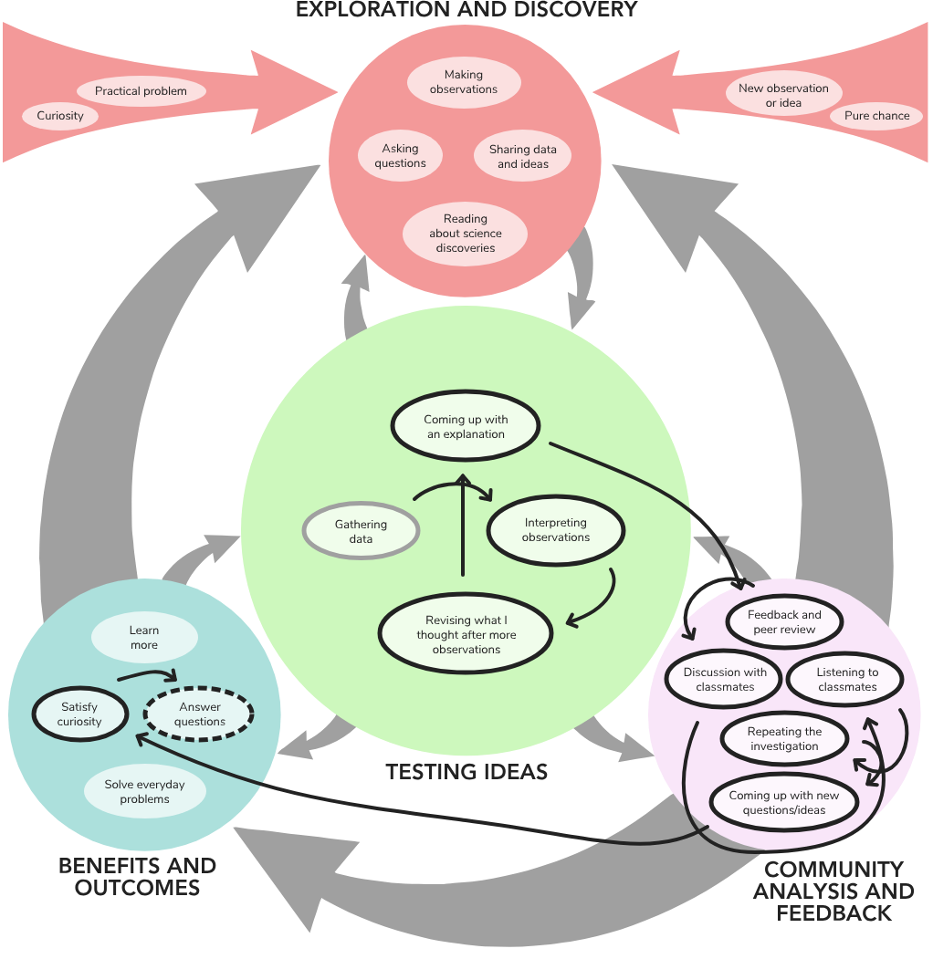

Slide 4
Curiosity
1
Practical problem
2
Making observations
3
Asking questions
4
Sharing data and ideas
5
Reading about science discoveries
6
New observation or idea
7
Pure chance
8

Slide 5
Curiosity
1
During our simple flower dissection, we were very curious about how the different parts of a flower functioned and what they contained. We also wanted to discover the different parts of the plant, and because of our curiosity, we learned that a plant has both male and female reproductive parts.
I think that throughout our entire "Planting Science" project, we will constantly be displaying a level of curiosity in whatever we are doing.

Slide 6
Practical problem
2
During the simple flower dissection, our "objective" was to dissect, label, and understand the different parts of the simple flower once it was dissected.
My group has come up with our research project question, which could possibly change in the future, which asks "What will happen if a plant is positioned very closely to a pollinator (ex:bees)? Is there such thing as over pollinating?"

Slide 7
Making observations
3
While my group did not necessarily write out full sentence observations for our simple flwoer dissection and any other planting science project work, we did illustrate and sketch out what we saw during the simple flower dissection. Our sketches were very detailed, and we labeled a few of our sketches.

Slide 8
Asking questions
4
We have not really dived into this part in our planting science project, but we develop a question (which could possibly be changed or revised in the future). Our question is:
"What will happen if a plant is positioned very close to a pollinator (ex: bees)? Is there such thing as over pollinating?"
If we have a general question, we go to out "planting science" mentor, who provides detailed and descriptive answers. For example, we asked our mentor for advice she had on future plant dissections which will be very useful for future plant dissections.

Slide 9
Sharing data and ideas
5
Because we are taking part in a "Planting Science" project, we are given mentors. My group and I have been sharing any results, data, photos, and observations with our mentor.
At times, we've also shared some sketches, ideas, and dissections with our teacher, but we mostly share our data and results with out mentor.

Slide 10
Reading about science discoveries
6
I'll admit, we haven't read that many science discoveries that relate to our planting science project. We should probably do this more often in the future, but as of now, I do not think we have read a previously documented science discovery or journal.

Slide 11
New observation or idea
7
I don't know if we've had a "new observation" or idea, but we did come up with a quesiton which has sparked interesting discussions within my group and could possibly result in new information for my me and my group.

Slide 12
Pure chance
8
I don't think that this is applicable to our planting science project (so far).

Slide 13
Gathering data
1
Interpreting observations
2
Revisiting what I thought after more observations
3
Coming up with an explanation
4
Feedback and peer review
5
Discussion with classmates
6
Listening to classmates
7
Repeating the investigation
8
Coming up with new questions/ideas
9
Satisfy curiosity
10
Answer questions
11

Slide 14
Gathering data
1
We performed a total of 4 trials, with each trial lasting 10 minutes. In order to compare data, we had one of the flowers located at Daphine's house, where she had beehives. Daphine placed the plants 3 feet away from the beehives and recorded her data at around the same time we would do so at the school, so that the weather conditions and temperature would be around the same. The weather was, for the most part, cold and sunny. There were times where it was warmer or cloudier, but the most part it was very cold.
We didn't get many pollinators, but when we did get pollinators at the school, they were never bees. Instead, spiders and ants were found on the flowers, which can sometimes be pollinators.

Slide 15
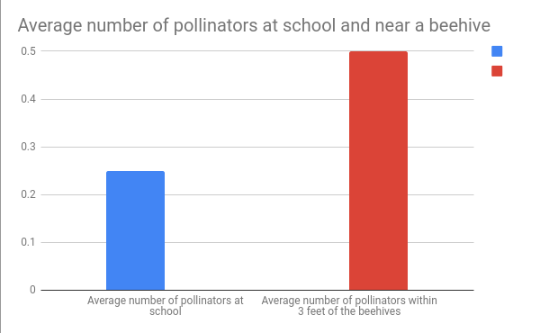
Interpreting observations
2
Because I used a bar graph to represent my data, I am only able to identify one "trend" I notice. The average number of pollinators within 3 feet of the beehives was higher than the average number of pollinators at school. This could be because the flower that was located near the beehives, increasing the chances of more pollinators coming to pollinate the flower. In contrast, the flowers at school were not strategically placed near a source of pollinators, meaning that it did not get as many pollinators as the flowers near the beehives.

Slide 16
Revisiting what I thought after more observations
3
After making observations and collecting data, we realized that our initial thoughts were correct. The location of a plant (or in this case, mums) affects the number of pollinators that come to the plant.
One qualitative observation that we thought was really interesting was how the flowers that were at Daphine's house (the flowers that were located close to the beehives) had so much pollen in between the petals, even though during the ten minute durations she was unable to spot any pollinators (during one trial she did). This shows that while we were unable to see any pollinators during the 10-minute trials, pollinators did come at one point during the day.

Slide 17
Coming up with an explanation
4
The reason more pollinators came to the flower that was positioned near the beehives was due to the fact that the range between the beehives and the flowers was much smaller compared to the location of the flowers at school. Because the flowers were only 3 feet away from the beehive, the flowers were more vulnerable to being pollinated. On the other hand, the flowers at school did not get as many pollinators. This could be due to weather conditions, but the main reason this occurred was due to the fact that the flowers were not positioned near a reliable source of pollinators, meaning that the bees had to actively search for the flowers (unlike the other location of flowers).

Slide 18
Feedback and peer review
5
We were able to get feedback and peer review from our planting science mentors. Our mentor was really proactive with any questions we had and gave us advice for future science projects. Our teacher also answered any questions we had and gave us feedback on our project and the results we recieved. We were given many sources of feedback, which helped us improve our project.

Slide 19
Discussion with classmates
6
I don't think we had many discussions with classmates because we were all working on slightly different projects. But at times, I did ask my classmates some questions and have some small discussions. However, there were not many opportunities to hold huge discussions among my classmates.

Slide 20
Listening to classmates
7
Whenever my classmates had questions, I tried to answer them to the best of my ability. But I felt like I only talked to my planting science group during the duration of this project.

Slide 21
Repeating the investigation
8
If we could repeat the investigation, we would have tried to perform the trials in more ideal weather conditions (sunny and not too cold). At times, the weather was very cold and the sun was still rising. Because of this, it lowered the chances of pollinators coming to our plant. We'd also position the plant that was located at the school in a field, possibly a soccer field, where it is more exposed to pollinators. The position of the flowers at school was right next to a building, and constantly located in the shade. In summary, if we did this experiment again, we'd want to eliminate certain aspects of the experiment that would constantly vary because it would make our results inconsistent.

Slide 22
Coming up with new questions/ideas
9
Another question my group could have come up with or pursued was "can a flower be over-pollinated?" The reason my group did not pursue this question was that we knew that it would become too complicated, especially when figuring out how to "measure" our results.

Slide 23
Satisfy curiosity
10
This planting science project gave me the opportunity to answer some questions I had about pollination and flowers. After gathering the data and interpreting it, I was finally able to satisfy my curiosity about how location impacts pollination.

Slide 24
Answer questions
11
My group and I were able to get definitive results from our experiment, and from there, we were able to interpret the data and make a conclusion that could answer our question. Any minor "sub-questions" we had during our experiment were also "solved" through both the results we got and qualitative observations we made.

