Slide 1
Planting Science Presentation
Osmosis and Diffusion Lab
Shaunak, Amani, and Dhruv

Slide 2
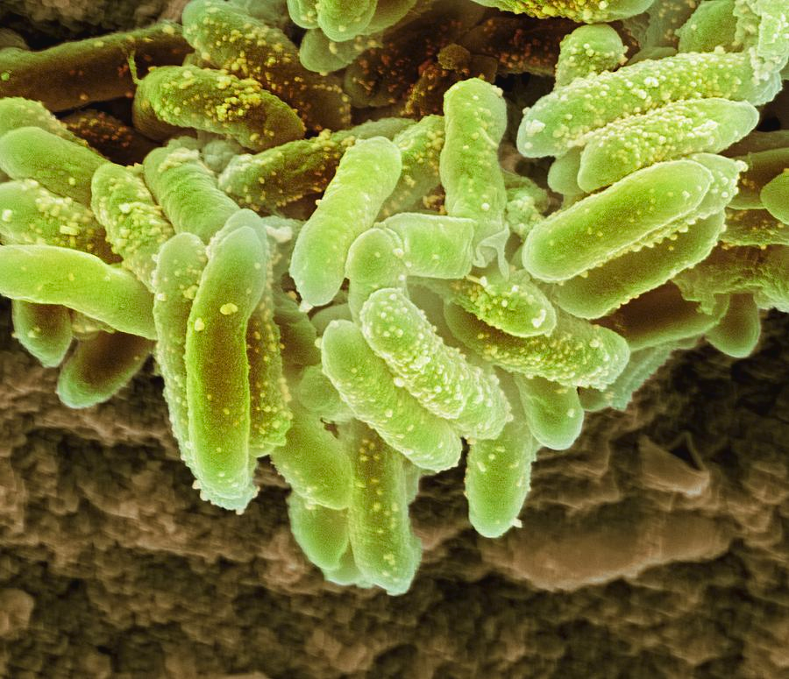
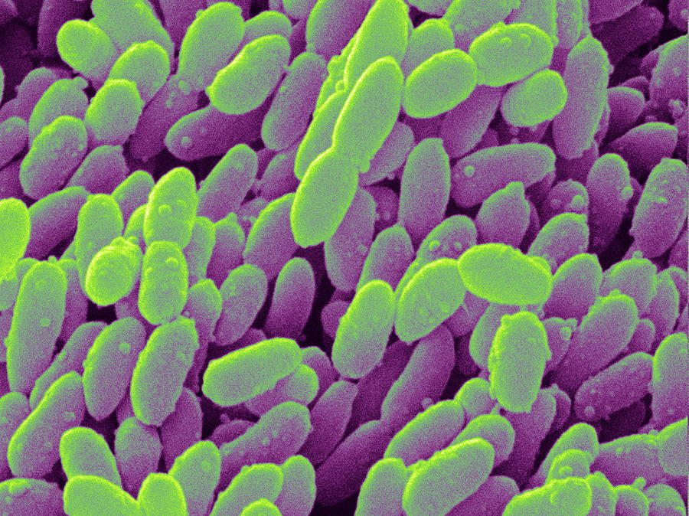
Explore
The Erwinia genus has several bacterium that are responsible for soft rot in potatoes along with other organisms. The main type of spoilage by these bacteria is soft rots caused by pectic enzymes that break down pectins, resulting in a mushy appearance, bad odor, water-soaked appearance. Soft rot is caused by pathogens, like those of the Erwinia genus, that secrete enzymes capable of decomposing cell wall structures, thereby destroying the texture of plant tissue (Taylor). When bacteria enters a host cell, it damages the membrane of the cell (de Haan). The bacteria may also produce toxins that take over and destroy the host cell. The production of these products results in the direct damage of the host cell. The goal was to the affect of the bacteria of the permeability of the cell membrane.

Slide 3
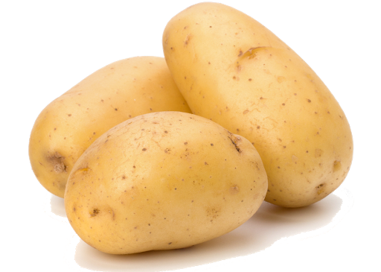
Research Question
Prediction
How does bacteria from the Erwinia genus affect the osmolarity of potatoes?
The infected potatoes will have a greater rate of osmosis as their cell membrane will be less selectively permeable than the membrane of the control. In other words, the masses of the infected potatoes will increase greater than the control.

Slide 4
Experimental Design
Bleach 2 potatoes for 20 minutes. Then, using a toothpick that has been dipped in the Erwinia Genus bacteria, prick the potato four times, once at each long end horizontal and once on top and bottom.
After 7 days, cut both potatoes into 4 similarly sized pieces each and mass each one.
Measure 150 mL of water into a beaker eight times. Put two drops of blue dye into each water and mix.
Submerge one potato piece into each beaker for 7 days and record observations.
At the end of the allotted time, remove the potatoes from the beakers and mass each piece. Calculate the mass differences.
Cut a small piece off one non-infected potato sample and one infected potato sample. Create microscope slides and observe/record differences.

Slide 5
Data Collection
Trial # | Control Before | Control After | % Mass Change | Bacteria Before | Bacteria After | % Mass Change
1 | 30.90 g | 12.94 g | -58.1% | 40.66 g | 18.29 g | -55.0%
2 | 36.61 g | 15.11 g | -58.7% | 39.68 g | 16.61 g | -58.1%
3 | 37.54 g | 35.77 g | -4.7% | 31.22 g | 15.36 g | -50.8%
4 | 34.20 g | 36.07 g | +5.5% | 35.05 g | 13.11 g | -62.6%
The table above shows the before and after measurements of the potato masses for each treatment. While the masses of both potatoes decreased after being submerged in water, the difference was greater for the infected potatoes. The trial #1 and #2 control potatoes had large decreases in mass because their cells burst before the full seven days had passed.

Slide 6
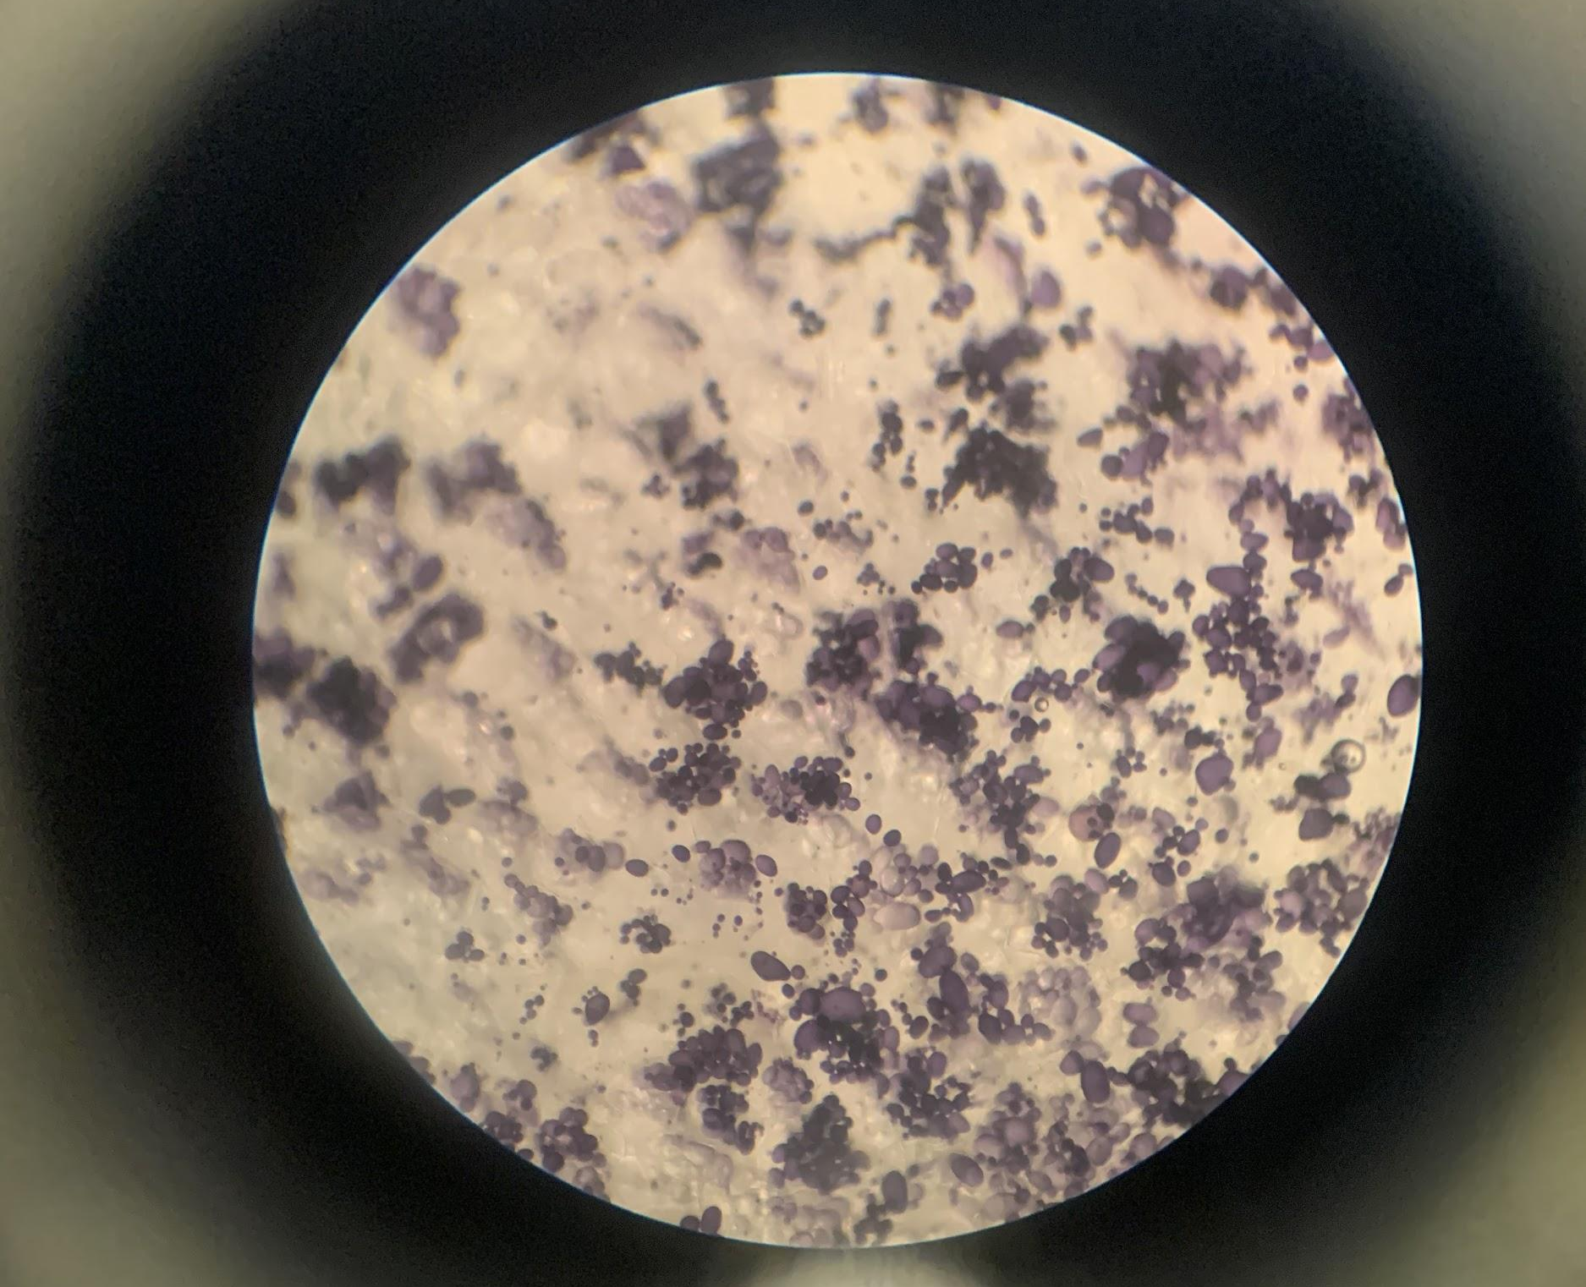
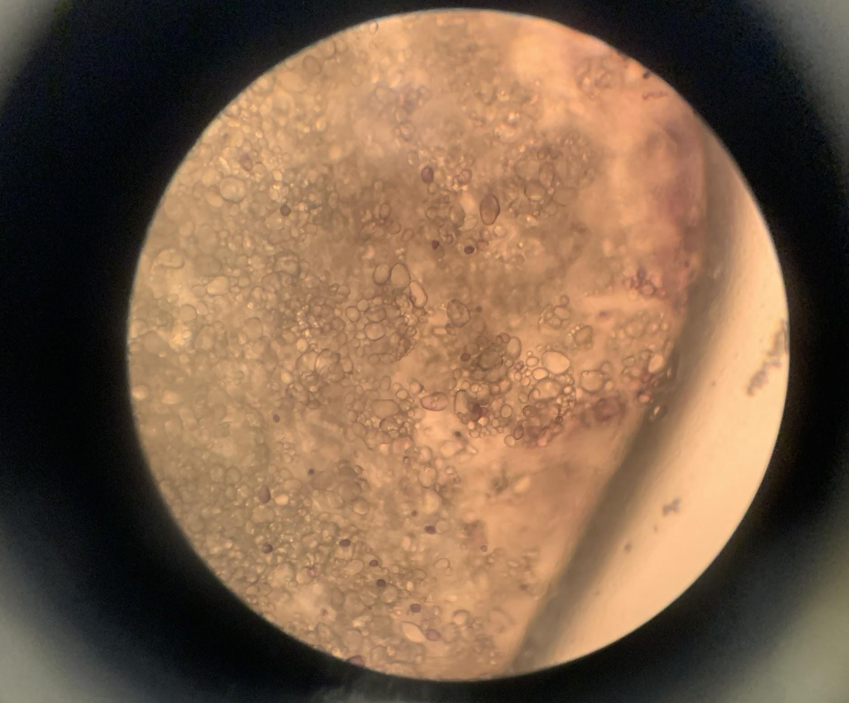
Use of Figures
Non-infected Bleached Potato cells are intact, water molecules are present, cell walls are intact, purple starch molecules are visible
Infected Bleached Potato
cells have burst, water molecules are present and there is no cell wall intact; purple starch molecules are washed out by water

Slide 7
Conclusion
Infected potato cells had a weaker cell membrane than the control potatoes after being placed in a hypotonic solution for seven days. The potato cells expanded and filled with water until they burst. This can be observed in the microscopic photos as there is no defined membrane and purple starch molecules are overwhelmed by transparent water molecules. The masses of the infected cells were much lower after the seven days compared to the initial measurements because cells of the potato pieces dissolved into the water. For this reason, our data may be inaccurate as the potatoes were soaked for an extended period of time. However, after the 7 days, it was clear that both treatments had water travel throughout the cell. In short, the bacteria infection weakened the potato cell membrane, ultimately causing them to burst in the hypotonic solution. The uninfected potatoes did not experience, but still had cells burst as they were placed in a hypotonic solution for a prolonged period of time.

Slide 8
Extension Questions
Does an increased bacteria concentration affect the cells with greater severity?
Given the relatively low and unmeasured concentration of bacteria we used, the effects of different bacteria levels could be measured (mainly linear vs. exponential).
How important is surface area vs volume/mass of an object?
The bacteria was shown to have an effect, but will the same effects translate to larger cells or will ‘damage’ be mitigated instead?
At what point do potato cells reach maximum water capacity and burst?
As seen in this lab’s results, the infected potato cells, after a certain period of time, burst. How many days or hours did this take?

Slide 9
Published Literature / Literature Cited
de Haan, E.G., Dekker-Nooren, T.C.E.M., van den Bovenkamp, G.W. et al. Pectobacterium carotovorum subsp. carotovorum can cause potato blackleg in temperate climates. Eur J Plant Pathol 122, 561 (2008). https://doi.org/10.1007/s10658-008-9325-y
Taylor, A. (2017, August 11). Soft rot diseases of potatoes | Agriculture and Food. Retrieved March 30, 2020, from https://www.agric.wa.gov.au/potatoes/soft-rot-diseases-potatoes
Erwinia - a description of the bacterial genus. (n.d.). Retrieved from https://catalog.hardydiagnostics.com/cp_prod/Content/hugo/Erwinia.htm

