Slide 1
The Effect of Sugar Content on Erwinia Carotovora Soft Rot in Potatoes
Catherine, Emilianne, Priya

Slide 2
Background Information
Erwinia is one of the most significant bacterial agents in the spoilage of fresh vegetables after they are harvested. Pectolytic enzymes in the pathogen break down pectins, while cellulolytic enzymes break down cellulose (Opara). Both pectin and cellulose are polysaccharides found in cell walls that give plants their structure. When these polysaccharides are destroyed by Erwinia, a mushy, “soft,” appearance is created and accompanied by a bad odor and discoloration (Horinouchi, Ikeda). Scientists design bio packaging and genetically modify fruits and vegetables in order to avoid soft rot caused by Erwinia. Our experiment aims to explore and demystify Erwinia Carotovora in particular and determine what puts a plant at risk for undergoing soft rot.

Slide 3
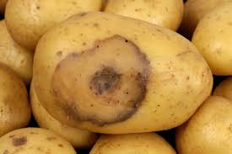
Research Question
We were interested in seeing if certain types of potatoes are able to better withstand infection by Erwinia. The question we chose to investage was: Does the sugar content of potatoes affect the rate of infection of the Erwinia soft rot?

Slide 4
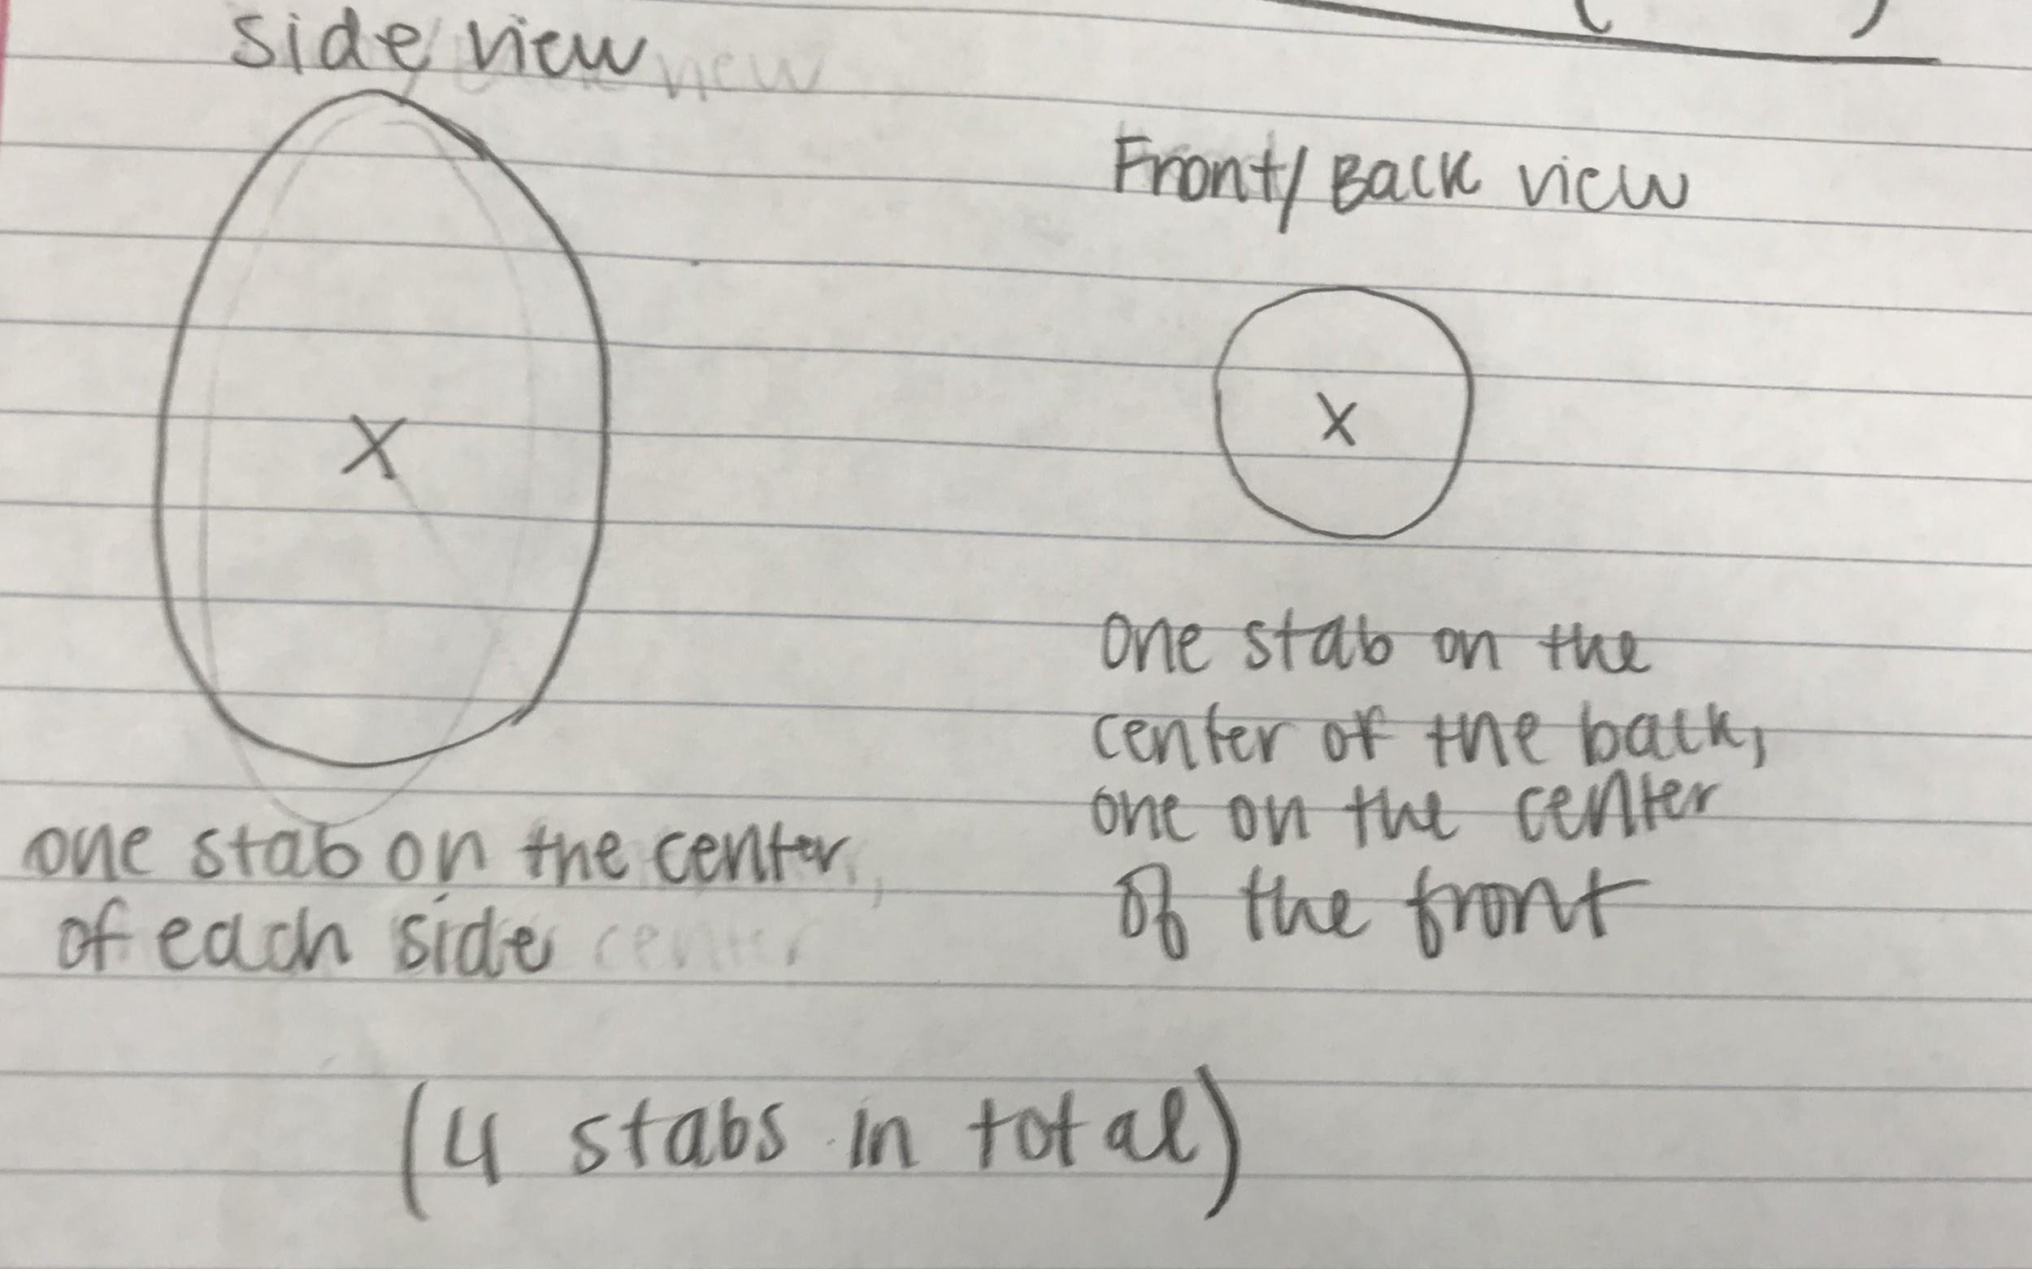
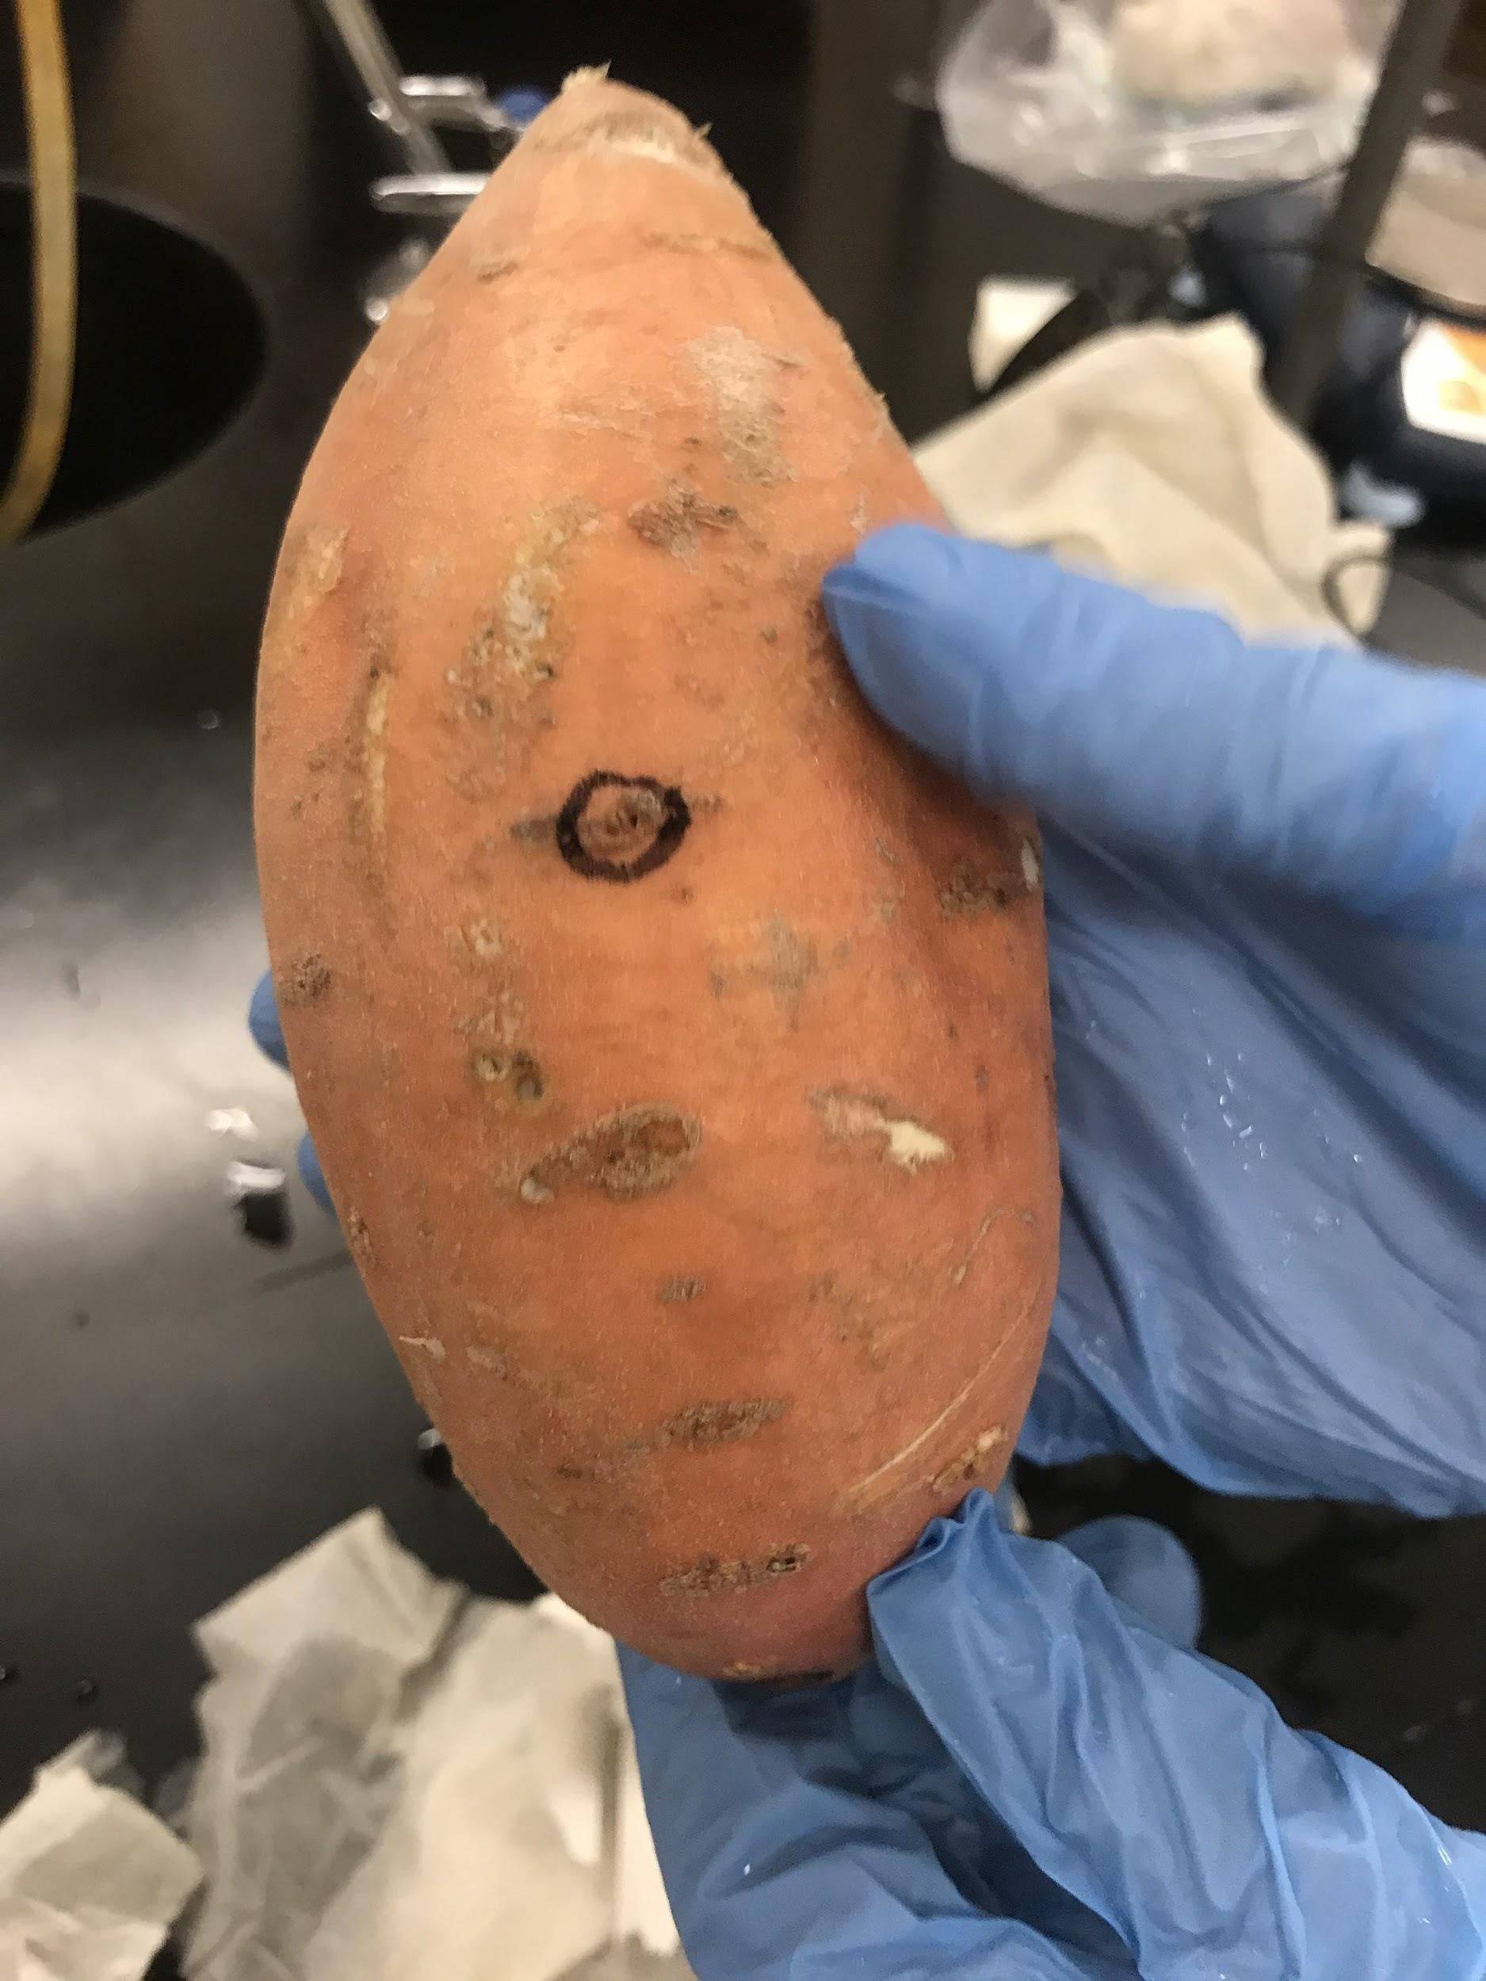
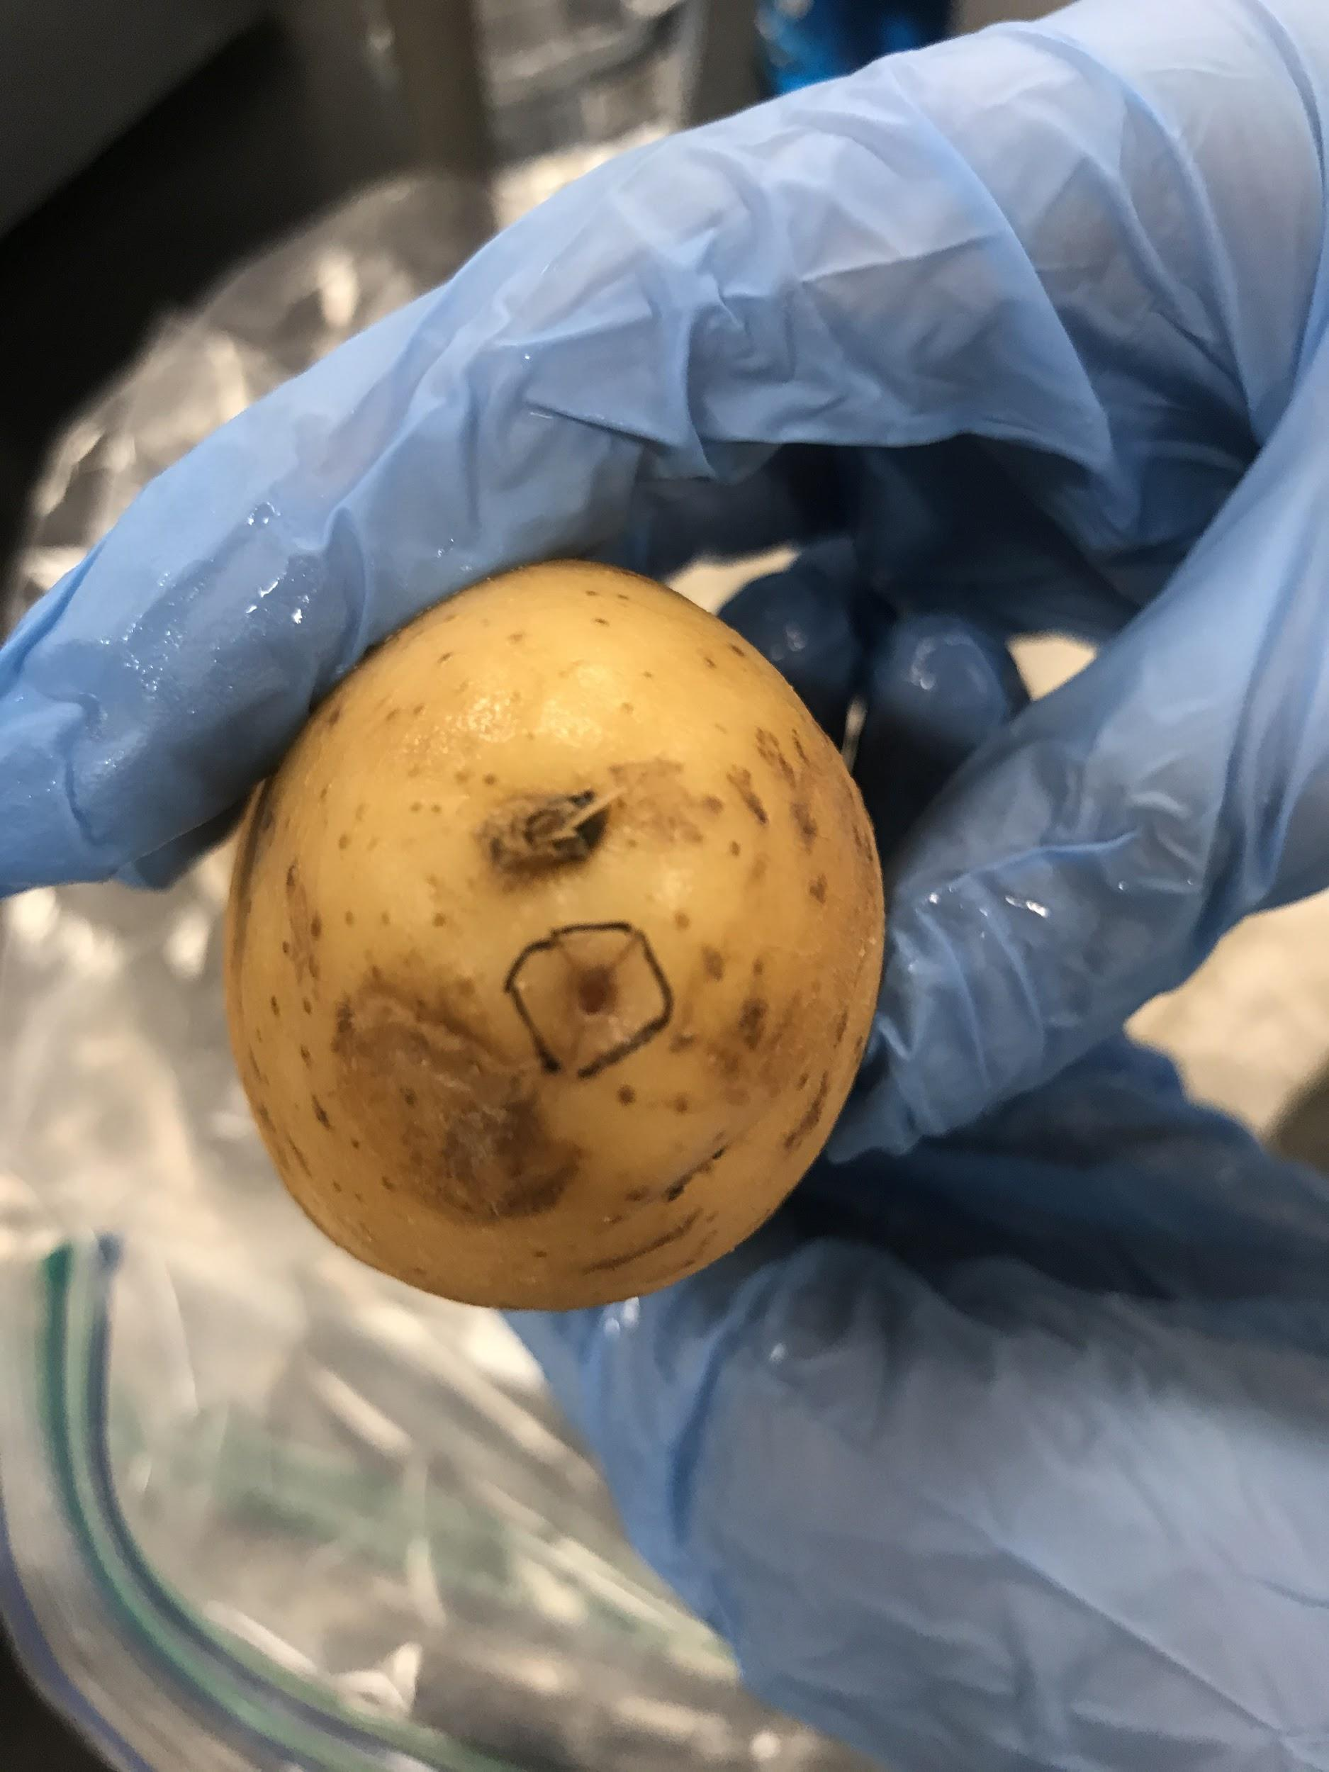
Experimental Design
We tracked rot growth in 3 different types of potatoes: regular white potatoes, white sweet potatoes, and orange sweet potatoes. We inoculated two of each type of potato in 4 areas with Erwinia carotovora culture using toothpicks. We wrapped the potatoes in moist paper towels and then double-bagged the pairs of potatoes in ziploc bags. These 3 ziploc bags were stored in at room temperature for a week. During this period, we measured rot growth twice.
Map of inoculation sites
“Side” inoculation “Front” inoculation

Slide 5
Hypothesis and Prediction
Hypothesis: Erwinia carotovora reproduces more quickly in environments with higher sugar content because there are more simple sugars to for bacteria to feed on.
Prediction: The rate of the rot growth will be the highest in the orange sweet potato, followed by the white sweet potato, followed by the white potato.

Slide 6
Results
Progress of Potato Rot Growth
Potato | Initial Rot Percentage | Midpoint Estimated Rot Percentage | Final Estimated Rot Percentage
White 1 | 0% | 20% | 30%
White 2 | 0% | 40% | 50%
White Avg. | 0% | 30% | 40%
White Sweet 1 | 0% | 10% | 20%
White Sweet 2 | 0% | 0% | 15%
White Sweet Avg. | 0% | 5% | 17.5%
Orange Sweet 1 | 0% | 10% | 10%
Orange Sweet 2 | 0% | 0% | 10%
Orange Sweet Avg. | 0% | 5% | 10%
The white potatoes had the highest rot growth rate, followed by the white sweet potatoes. The orange sweet potatoes had the lowest growth rate.

Slide 7
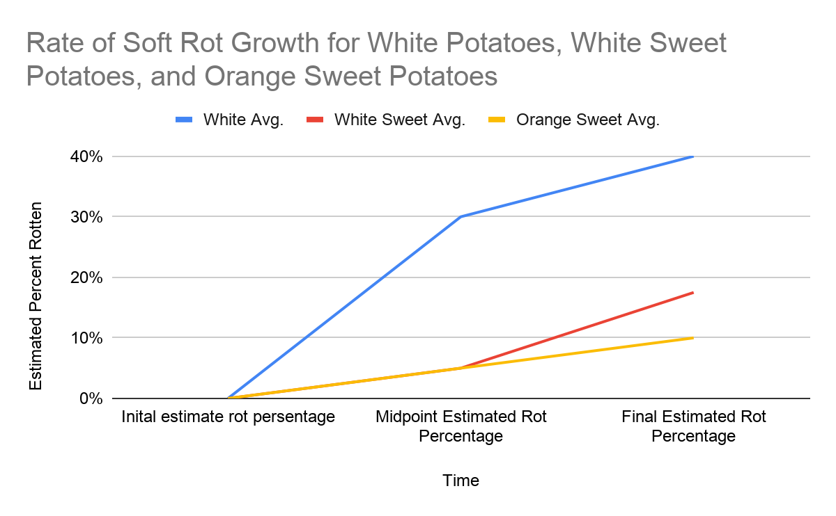
Results contd.
The white potatoes had a significantly higher rate of soft rot growth than the white sweet potatoes and orange sweet potatoes. In addition, the white potatoes had a much higher final estimated rot percentage than the white sweet potatoes and orange sweet potatoes.

Slide 8
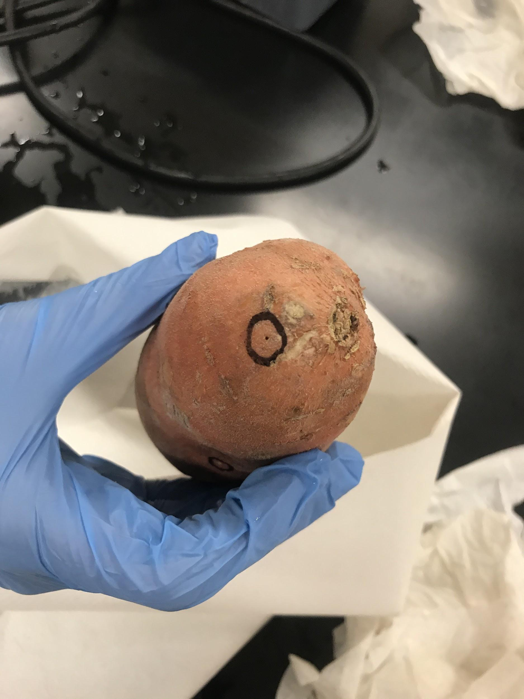
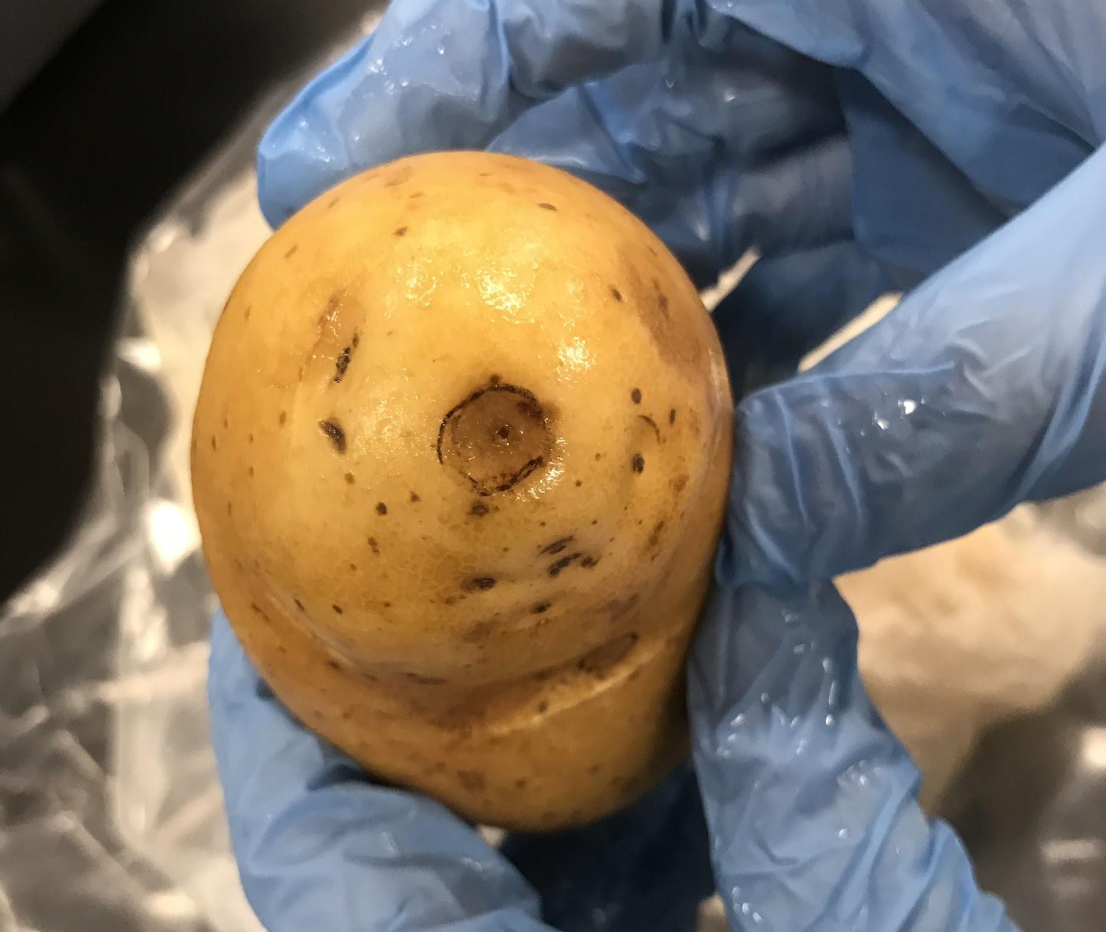
Results contd.
Comparison of inoculation site discoloration in white potato and orange sweet potato.
The white potato is clearly more discolored than the orange sweet potato.

Slide 9
Conclusions
The data suggest that Erwinia carotovora grows faster in potatoes with lower sugar content, such as the white potato, as compared to the white sweet potato and the orange sweet potato. Our hypothesis was not supported. While we had thought that higher sugar content would encourage the growth of Erwinia carotovora, we failed to take into account the amount of fiber in the potatoes. Soft rot is produced by the breaking down of pectins and cellulose plant cell walls (Opara). It may be that the higher fiber content in orange sweet potatoes and white sweet potatoes made the effects of Erwinia carotovora’s cellulose degradation less visible in the form of soft rot. However, because we weren’t able to control all variables except for sugar content (fiber content was a confounding variable), we cannot make any confident conclusions.

Slide 10
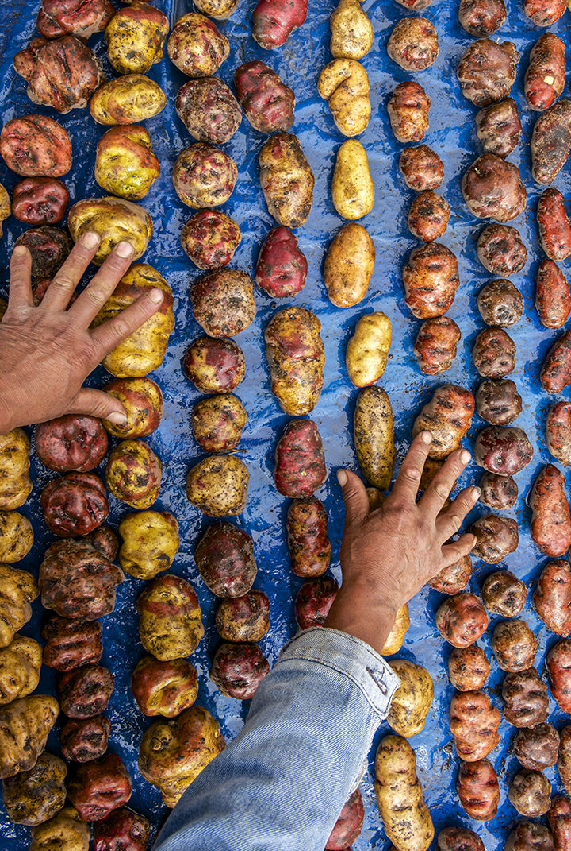
Significance
Our initial hypothesis was not able to be supported because of our inability to control all non-experimental variables. However, we believe the experiment may still indicate the importance of fiber content (pectin and cellulose content) in the progression of Erwinia soft rot in plants. This points to new possible ways the growth of Erwinia could be contained in the agricultural industry. Artificial selection could be introduced to select for plants with more fiber in order to reduce the amount of potato crops lost seasonally due to Erwinia. This may reduce the economic losses sustained by farmers due to rotten crops.

Slide 11
Alternate Explanations
Although our strain of Erwinia carotovora has been proven to show symptoms in potatoes with lower sugar contents, variation in the genetic makeup of our specific strain of Erwinia carotovora may explain this trend. According to research done at the University of Wisconsin Madison, E. carotovora has been shown to be surprisingly genomically diverse compared to other pathogens. A comparison of 23 mdh (a critical enzyme in oxidation pathways) sequences revealed an average pairwise difference of 2.13%, a noticeably high difference compared to other subspecies of Erwinia and other pathogens all together (Barak, Chakowski, Yap). These differences can have an effect on the virulence of a pathogen (its aggressiveness) which could have impacted our variation in results across the different potatoes.

Slide 12
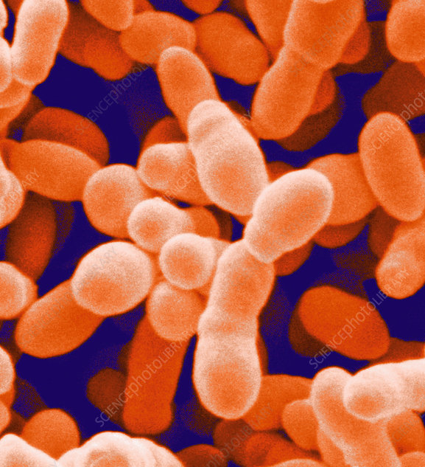
Further Study
Further study of interest may focus on the different strains and genetic diversity of E. carotovora rather than the hosts that E. carotovora infects. This could be done by using a control host and breeding multiple generations of E. carotovora until a significant change is observed in its behavior and virulence. This could shed light on how E. carotovora may change over time and how quickly it may change.

Slide 13
Literature Cited
Baylis, C. L. (2006). Food Spoilage Microorganisms. Campden and Chorleywood Food Research Association, UK. doi: https://doi.org/10.1533/9781845691417.5.624
Opara, E. (2016, June). An Overview of Characterization and Identification of Soft Rot Bacterium Erwinia in Some Vegetable Crops. Retrieved March 31, 2020, from https://www.researchgate.net/publication/313086913_An_Overview_of_Characterization_and_Identification_of_Soft_Rot_Bacterium_Erwinia_in_Some_Vegetable_Crops
Yap, M.-N., Barak, J. D., & Charkowski, A. O. (2004, May 1). Genomic Diversity of Erwinia carotovora subsp. carotovora and Its Correlation with Virulence. Retrieved March 31, 2020, from https://aem.asm.org/content/70/5/3013

