Slide 1
Photosynthesis Experiment
By Mikaela, Hannah, and Gabby
Mentor Kate

Slide 2
What is photosynthesis?
When light strikes an object, it may be transmitted, absorbed, or reflected. In plant cells, several different pigments can absorb light energy. Each pigment is a chemical compound that absorbs only certain wavelengths of light and reflects or transmits all others. Green plants, for example, appear green because chlorophyll absorbs most wavelengths of visible light except green, which it reflects. Three major events occur in photosynthesis: (1) absorption of light energy, (2) conversion of light energy into chemical energy, and (3) storage of chemical energy in carbohydrates (sugars).
6CO2 + 6H2O ------> C6H12O6 + 6O2

Slide 3
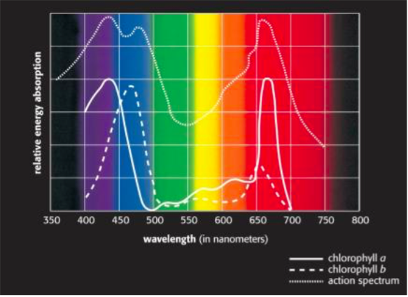
From this picture we can hypothesize that the spinach leafs have mostly chlorophyll a. We can infer this because our data shows similar results the effect of light with blue absorbing the least amount of energy and clear absorbing the most.

Slide 4
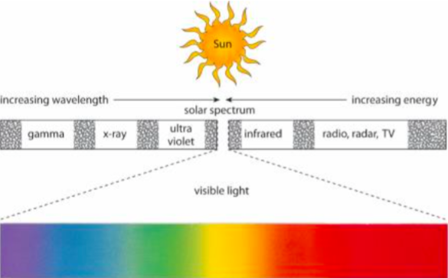
Light spectrum

Slide 5
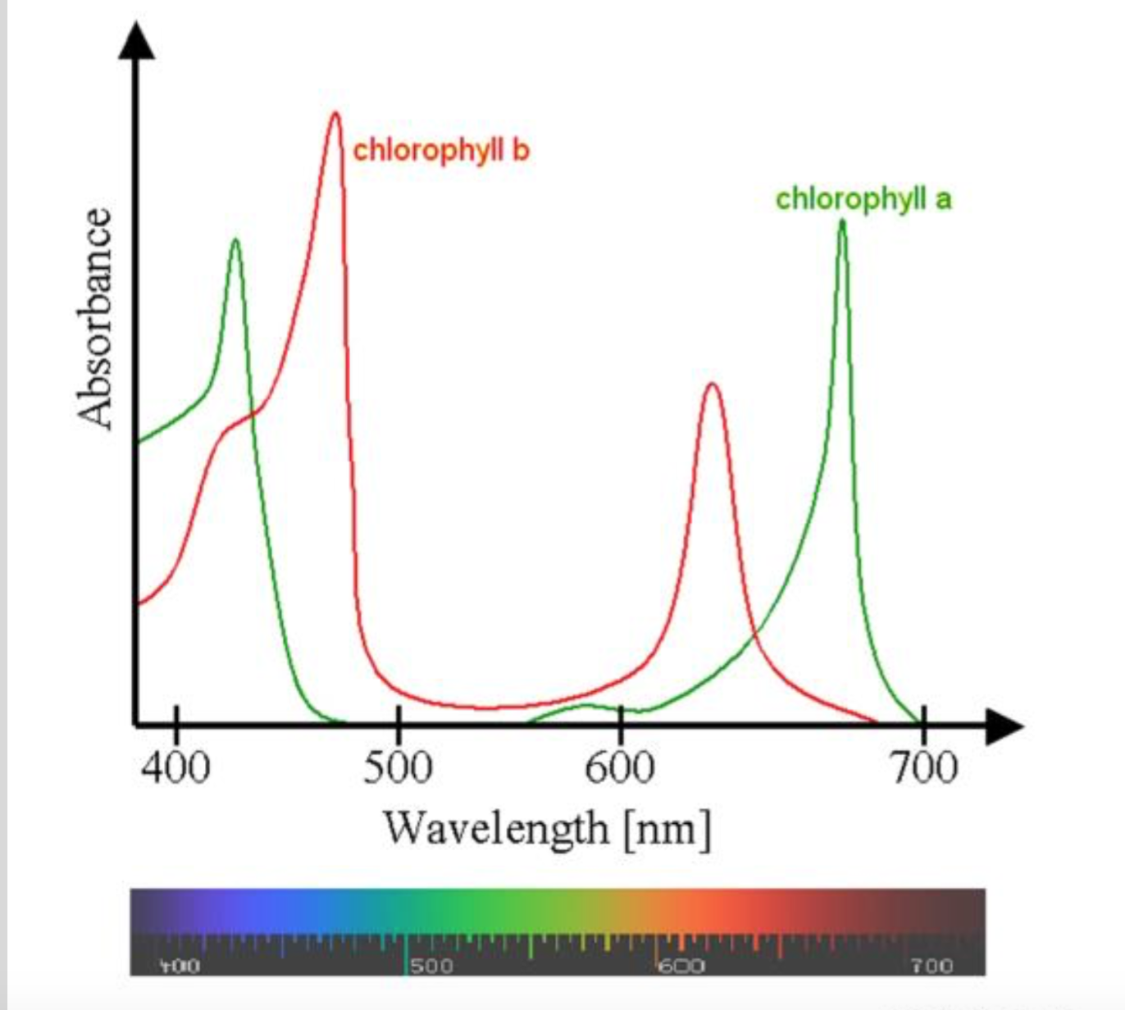
In our first experiment we saw that our data was chlorophyll a

Slide 6
How do different colors of light affect leafs ability to perform photosynthesis?

Slide 7
The Experiment

Slide 8
Materials
4 plastic cups
Baking soda, soap mixture (100 ml in each cup)
4 groups of 13 leaf disk
Clear, red, blue, green food coloring and seran sheets.
Light

Slide 9
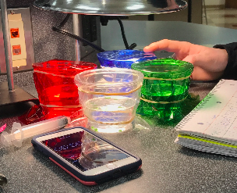
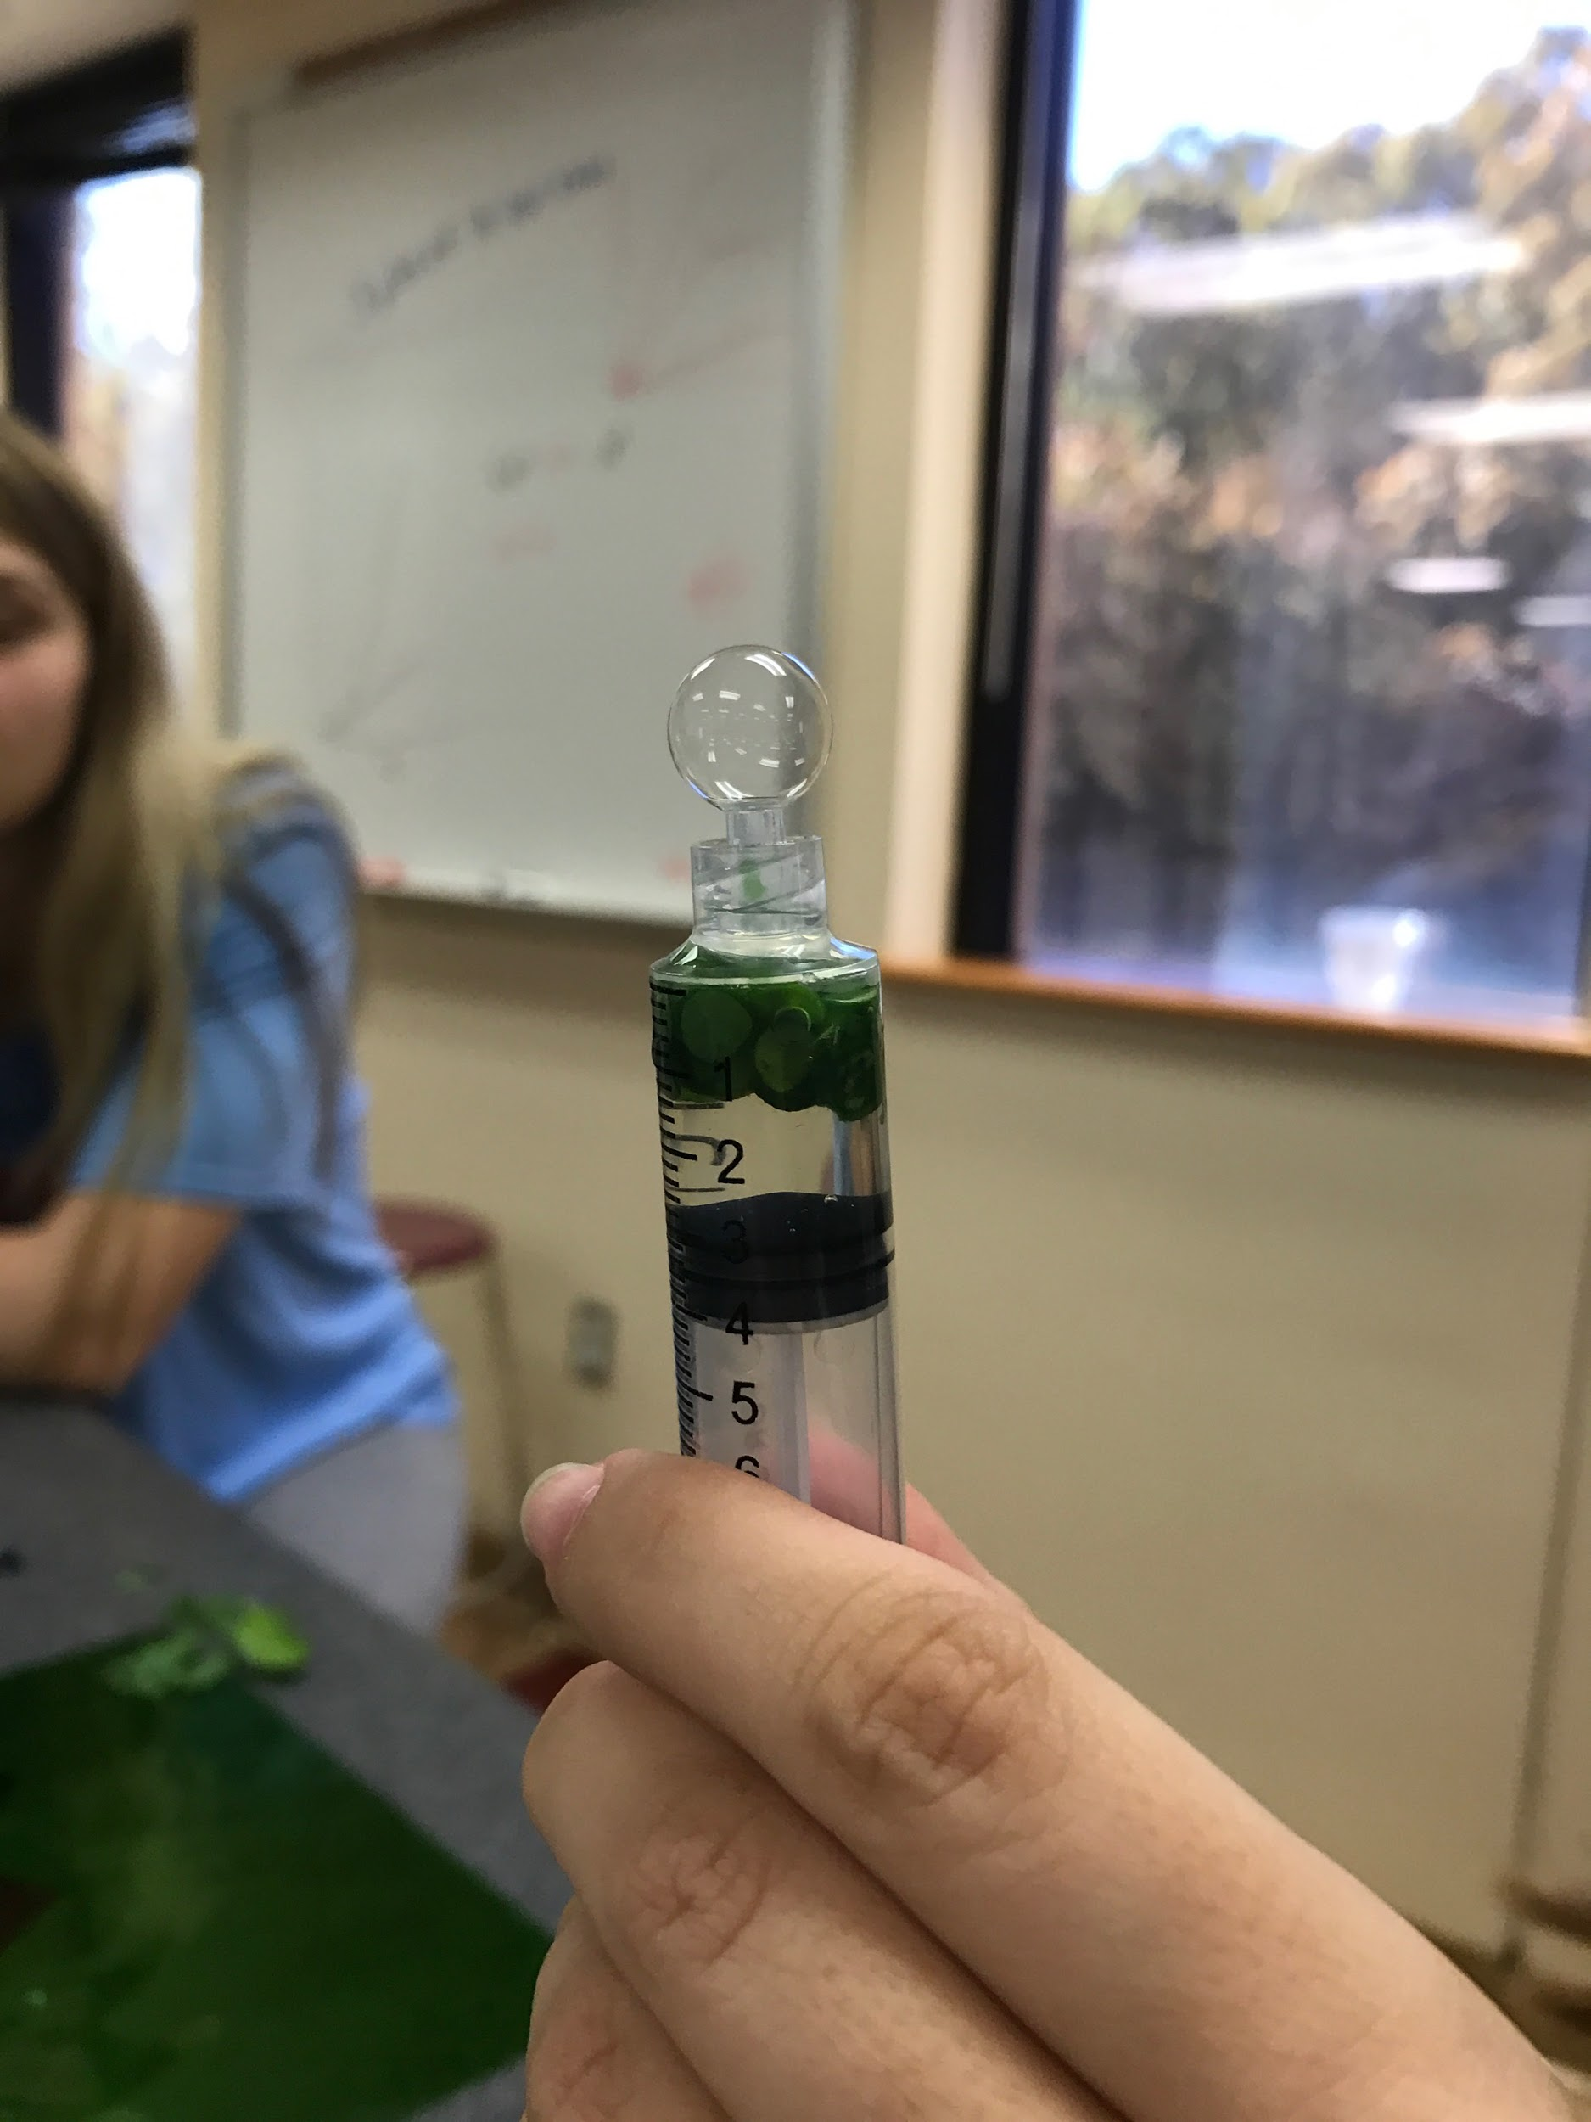
Procedure
Get a big glass beaker filled with distilled water
Put soap in the water to get rid of the wax on the leaf
Put in one teaspoon of baking soda
Cut out 52 leaf disk out of spinach leaves and put them in groups of 13
Get 4 plastic cups and put 100 ml of the soapy water baking soda mix in each one
Get a 4 syringes, and fill each with 13 leaf disk. Pull out the air in leafs.
Pull plunger out of syringe, put each group on a different plastic tray.
Make sure cups are labeled with which light it will be under. (Blue, red, green, and regular light.)
Make sure each tray has 13 leafs.
Put the leafs in their separate containers
Completely covering the cup, place the specified color sheet over the cup securing with a rubber band. (Blue, red, green, and regular light.)
Make the 4 light fixtures evenly leveled over the cups and turn them on at the same time while timing.
Have a graph ready
Record data.

Slide 10
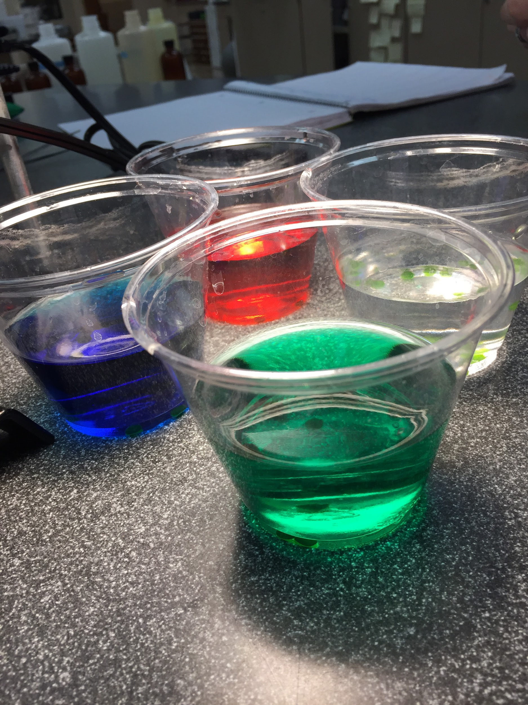
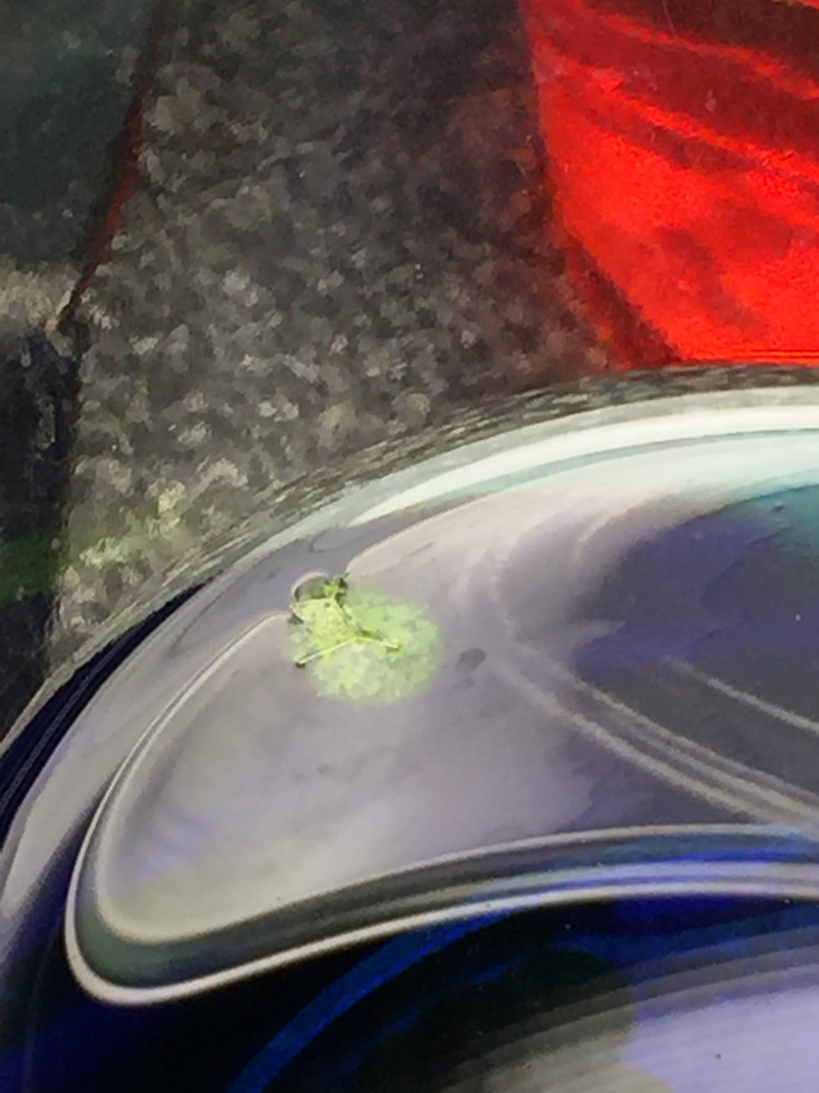
Procedure 2
Get a big glass beaker filled with distilled water
Put soap in the water to get rid of the wax on the leaf
Put in One teaspoon of baking soda
Cut out 52 leaf disk out of spinach leaves and put them in groups of 13
Get 4 plastic cups and put 100 ml of the soapy water and baking soda mix in each one
Get a 4 syringes, and fill each with 13 leaf disk. Pull out the air in leafs.
Pull plunger out of syringe, put each group on a different plastic tray.
Make sure cups are labeled with what food coloring it will have.
Make sure each tray has 13 leafs.
Put the leafs in their separate containers
Put in drops of food coloring as needed (Blue, Red, Green, and regular light.)
Make the 4 light fixtures evenly leveled over the cups and turn them on at the same time while timing.
Have a graph ready
Record data.

Slide 11
Hypothesis

Slide 12
We expected the darker colors to negatively affect the rate of photosynthesis the most.

Slide 13
Hypothesis support
I think this is what’s going to happen because…
Red light is absorbed by chlorophyll a and b whereas blue and green are not absorbed by chlorophyll a and b. Clear light allows for all colors to be absorbed proving most effective.
Variables that may affect the outcome...
How much food dye we put in the water.
If one cup gets more light than another.
Different amounts of oxygen in the leafs.

Slide 14
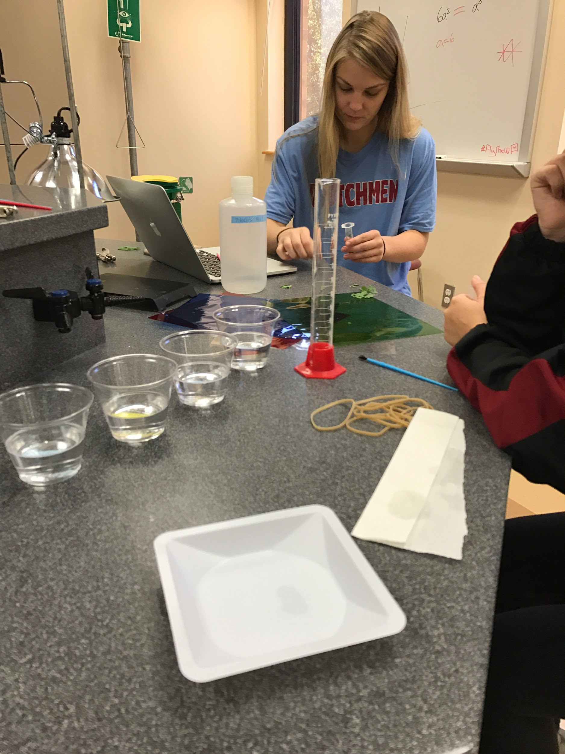
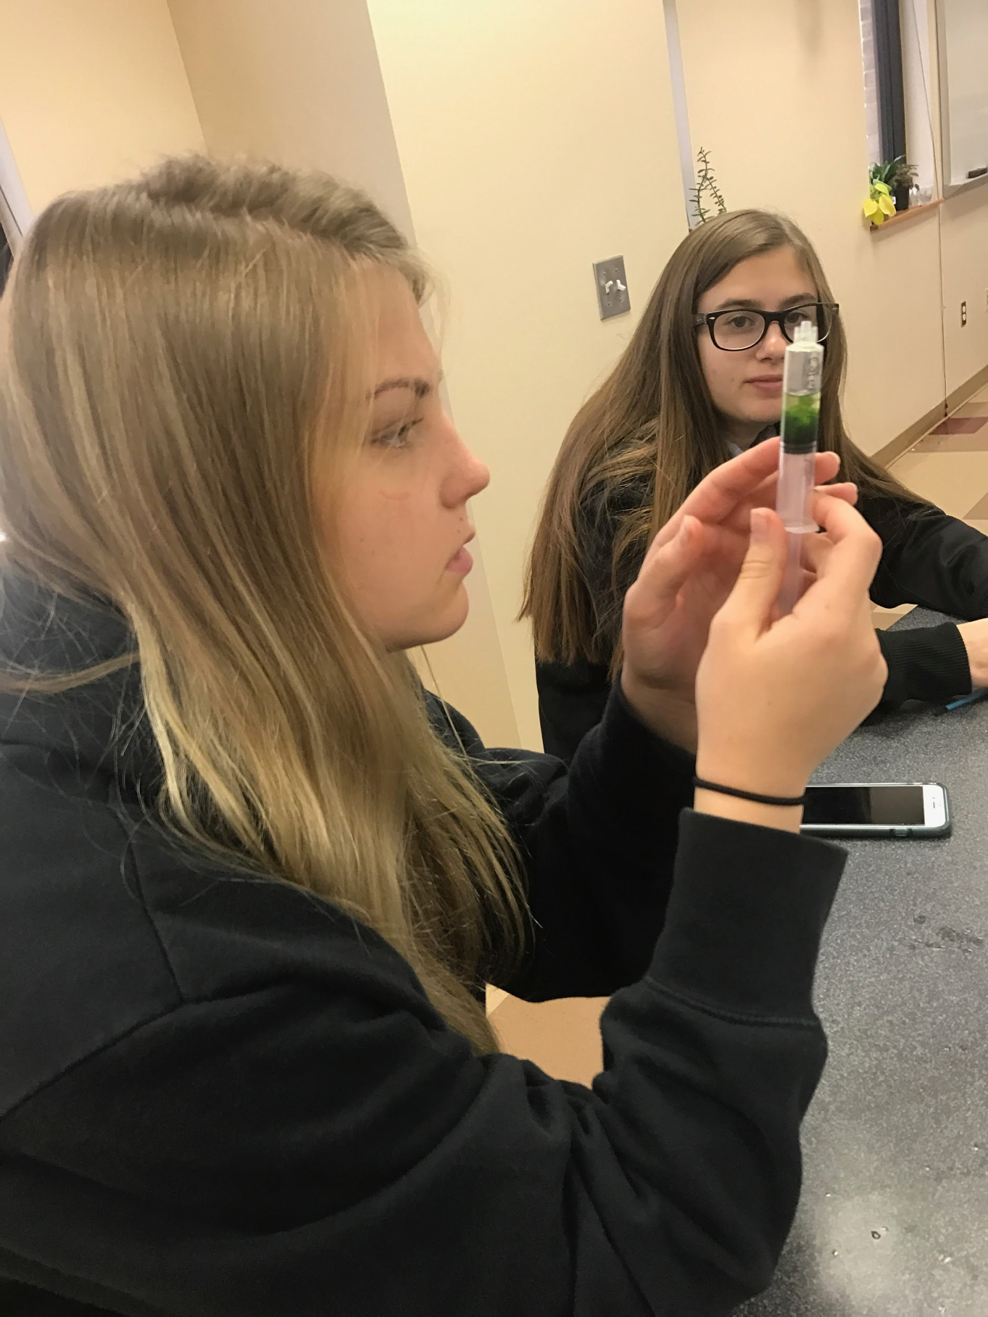
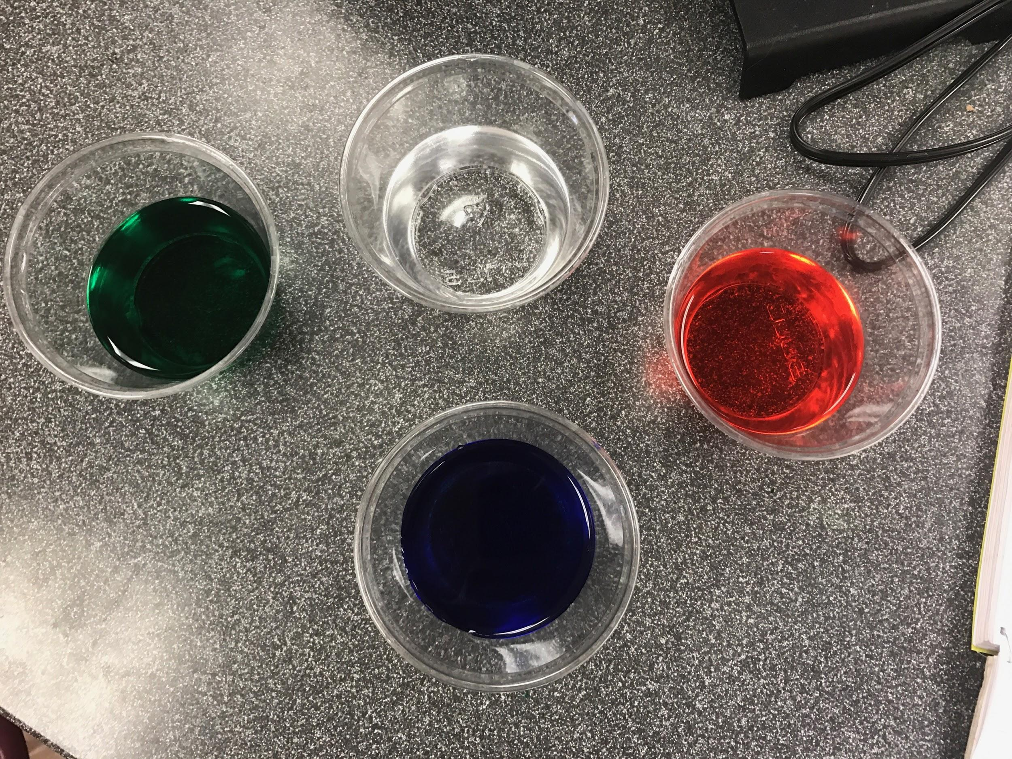
The experiment

Slide 15
Conclusion
In summation, the rate of photosynthesis in plants does depend greatly on a light source. White light is the most effective light for photosynthesis because it provides a wide range of colored lights for various pigments to use. When only a single color is used, red is the most effective color of light. Red has a long wavelength, allowing it to radiate more energy and allow for an increased rate of photosynthesis in plants. This lab proved that the length of a wavelength of light a plant is exposed to is directly related to the rate of photosynthesis. In addition, more colors available for the plant allow more pigments to be activated, also leading to higher rates of photosynthesis.

Slide 16
A question we still have.
How can we determine how much chlorophyll a and b are in the leafs?

Slide 17
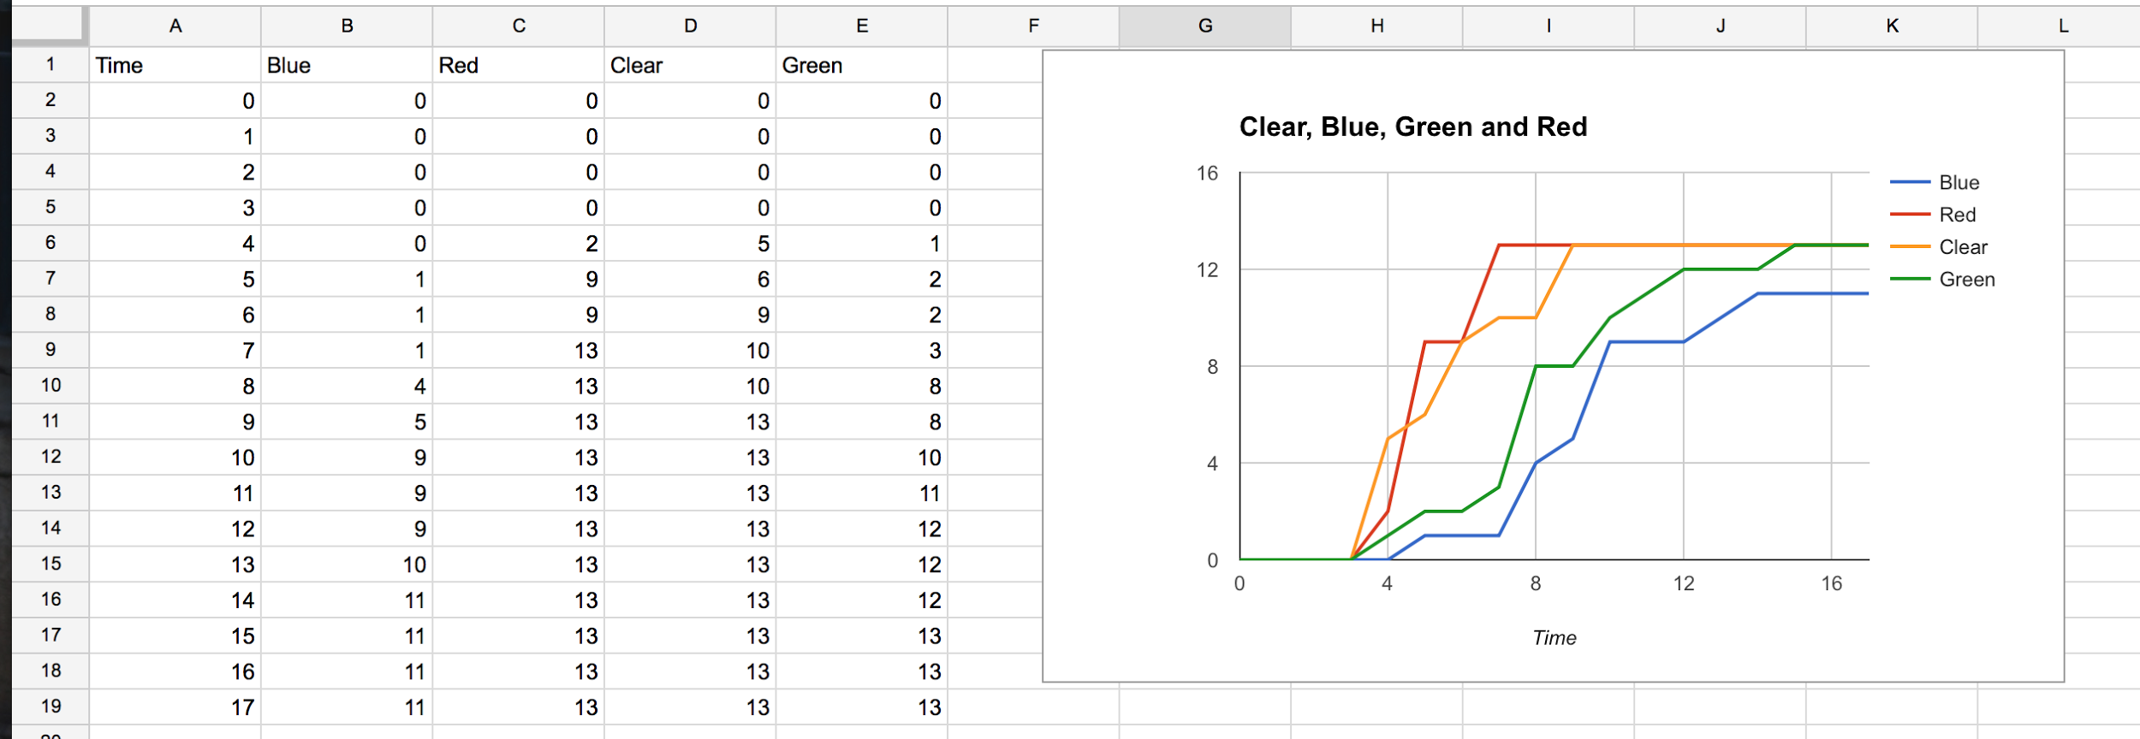
Experiment 1

Slide 18
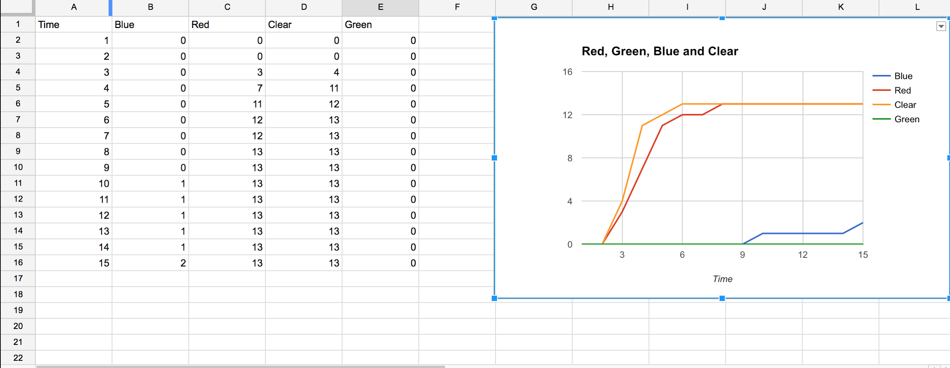
Experiment 2

