Slide 1
Photosynthesis Experiment
The effect of color
By Mikaela, Hannah, and Gabby
Mentor Kate

Slide 2
What is photosynthesis?
When light strikes an object, it may be transmitted, absorbed, or reflected. In plant cells, several different pigments can absorb light energy. Each pigment is a chemical compound that absorbs only certain wavelengths of light and reflects or transmits all others. Green plants, for example, appear green because chlorophyll absorbs most wavelengths of visible light except green, which it reflects. Three major events occur in photosynthesis: (1) absorption of light energy, (2) conversion of light energy into chemical energy, and (3) storage of chemical energy in carbohydrates (sugars).
6CO2 + 6H2O ------> C6H12O6 + 6O2

Slide 3
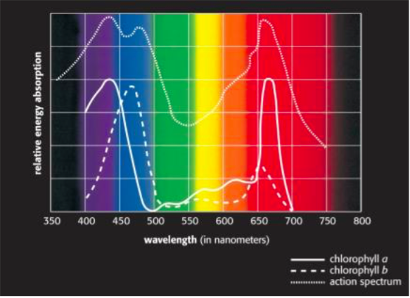
From this picture we can hypothesize that the spinach leafs have mostly chlorophyll a. We can infer this because our data shows similar results the effect of light with blue absorbing the least amount of energy and clear absorbing the most.

Slide 4
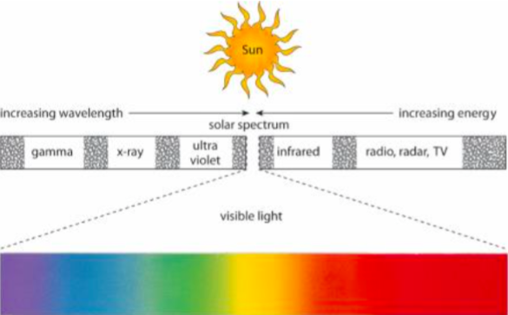
Light spectrum

Slide 5
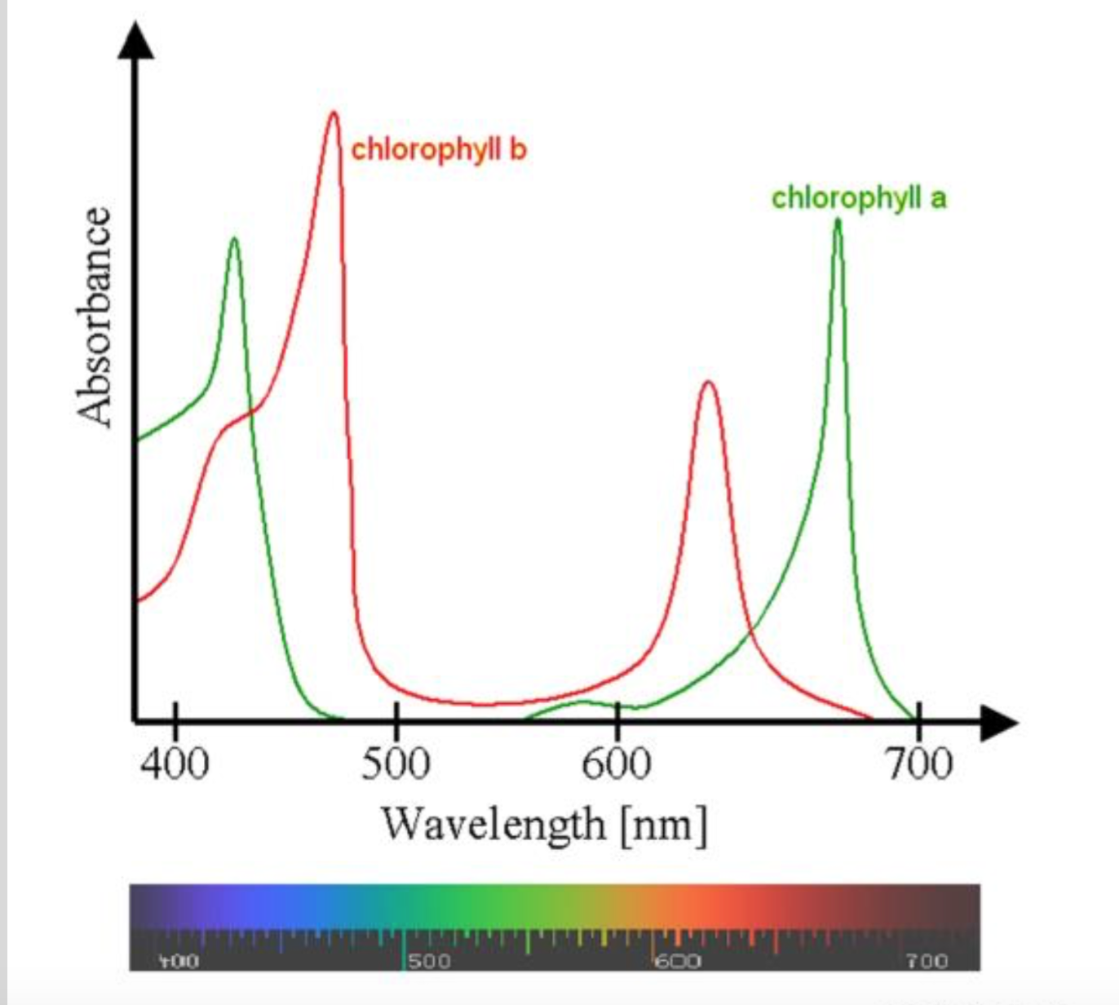
In our first experiment we saw that our data was chlorophyll a and in our second experiment we concluded that it was also chlorophyll a but we saw more of chlorophyll b in it then we did with the first experiment

Slide 6
How do different colors of light affect leafs ability to perform photosynthesis?

Slide 7
The Experiment

Slide 8
Materials
4 plastic cups
Baking soda, soap mixture (100 ml in each cup)
4 groups of 13 leaf disk
Clear, red, blue, green food coloring and seran sheets.
Light

Slide 9
Independent, Dependent, and Controlled Variables
Independent
Amount of leaves
Amount of time they were under the light
The different colors we used
Controlled
The cups we used
The amount of leaves we used
The type of leaves we used
The colors we used
Dependent
When the leaves float
How many leaves float

Slide 10
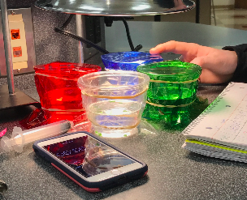
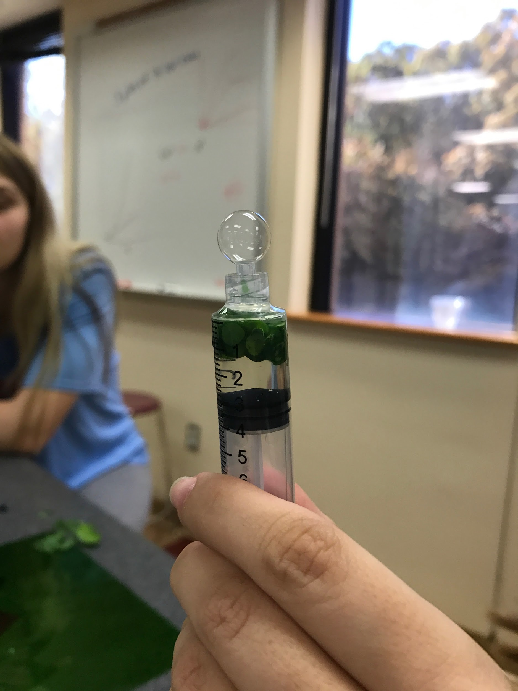
Procedure
Get a big glass beaker filled with distilled water
Put soap in the water to get rid of the wax on the leaf
Put in one teaspoon of baking soda
Cut out 52 leaf disk out of spinach leaves and put them in groups of 13
Get 4 plastic cups and put 100 ml of the soapy water baking soda mix in each one
Get a 4 syringes, and fill each with 13 leaf disk. Pull out the air in leafs.
Pull plunger out of syringe, put each group on a different plastic tray.
Make sure cups are labeled with which light it will be under. (Blue, red, green, and regular light.)
Make sure each tray has 13 leafs.
Put the leafs in their separate containers
Completely covering the cup, place the specified color sheet over the cup securing with a rubber band. (Blue, red, green, and regular light.)
Make the 4 light fixtures evenly leveled over the cups and turn them on at the same time while timing.
Have a graph ready
Record data.

Slide 11
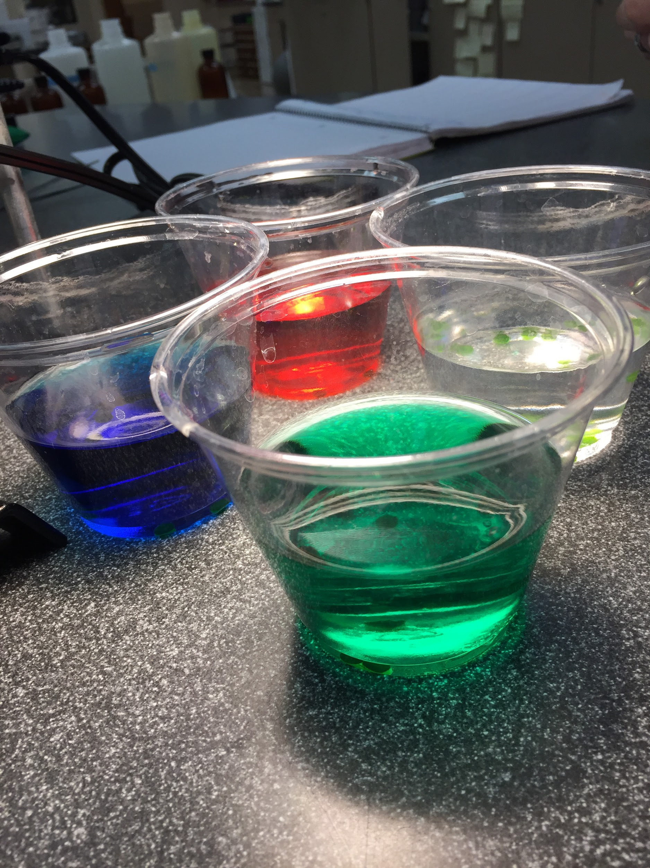
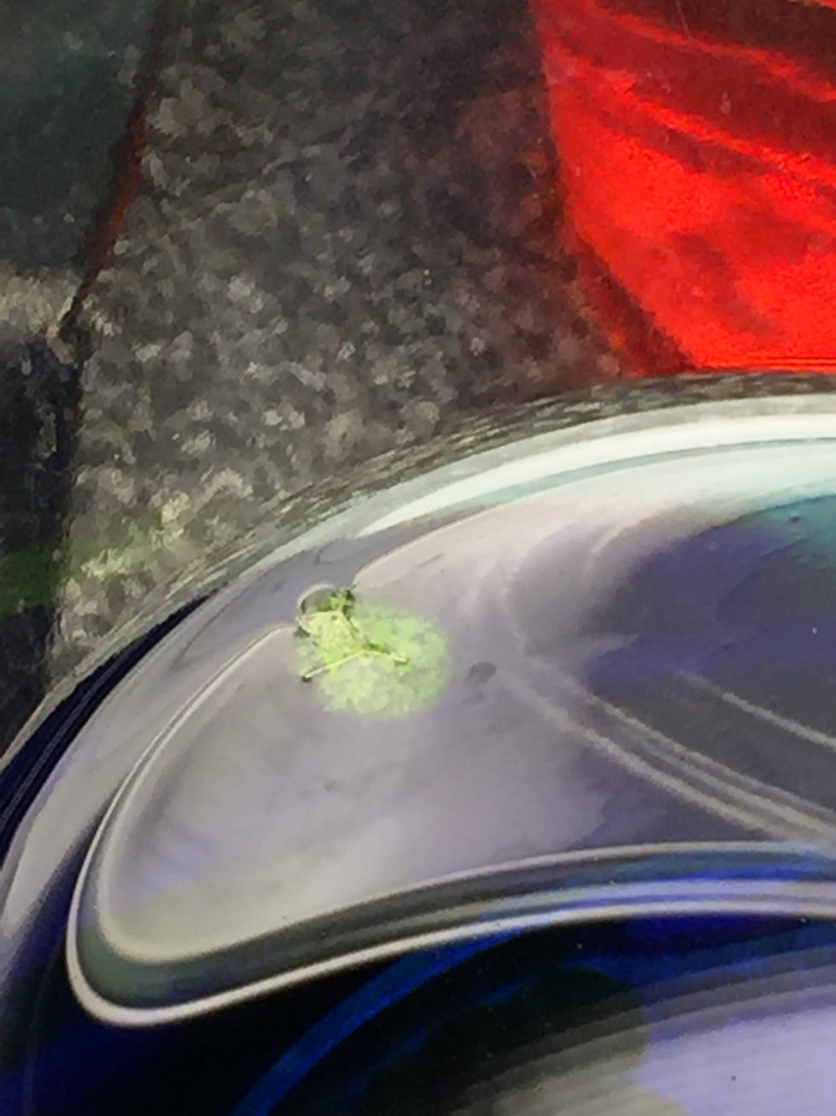
Procedure 2
Get a big glass beaker filled with distilled water
Put soap in the water to get rid of the wax on the leaf
Put in One teaspoon of baking soda
Cut out 52 leaf disk out of spinach leaves and put them in groups of 13
Get 4 plastic cups and put 100 ml of the soapy water and baking soda mix in each one
Get a 4 syringes, and fill each with 13 leaf disk. Pull out the air in leafs.
Pull plunger out of syringe, put each group on a different plastic tray.
Make sure cups are labeled with what food coloring it will have.
Make sure each tray has 13 leafs.
Put the leafs in their separate containers
Put in drops of food coloring as needed (Blue, Red, Green, and regular light.)
Make the 4 light fixtures evenly leveled over the cups and turn them on at the same time while timing.
Have a graph ready
Record data.

Slide 12
Hypothesis

Slide 13
We expected the darker colors to negatively affect the rate of photosynthesis the most.

Slide 14
Hypothesis support
I think this is what’s going to happen because…
Red light is absorbed by chlorophyll a and b whereas blue and green are not absorbed by chlorophyll a and b. Clear light allows for all colors to be absorbed proving most effective.
Variables that may affect the outcome...
How much food dye we put in the water.
If one cup gets more light than another.
Different amounts of oxygen in the leafs.

Slide 15
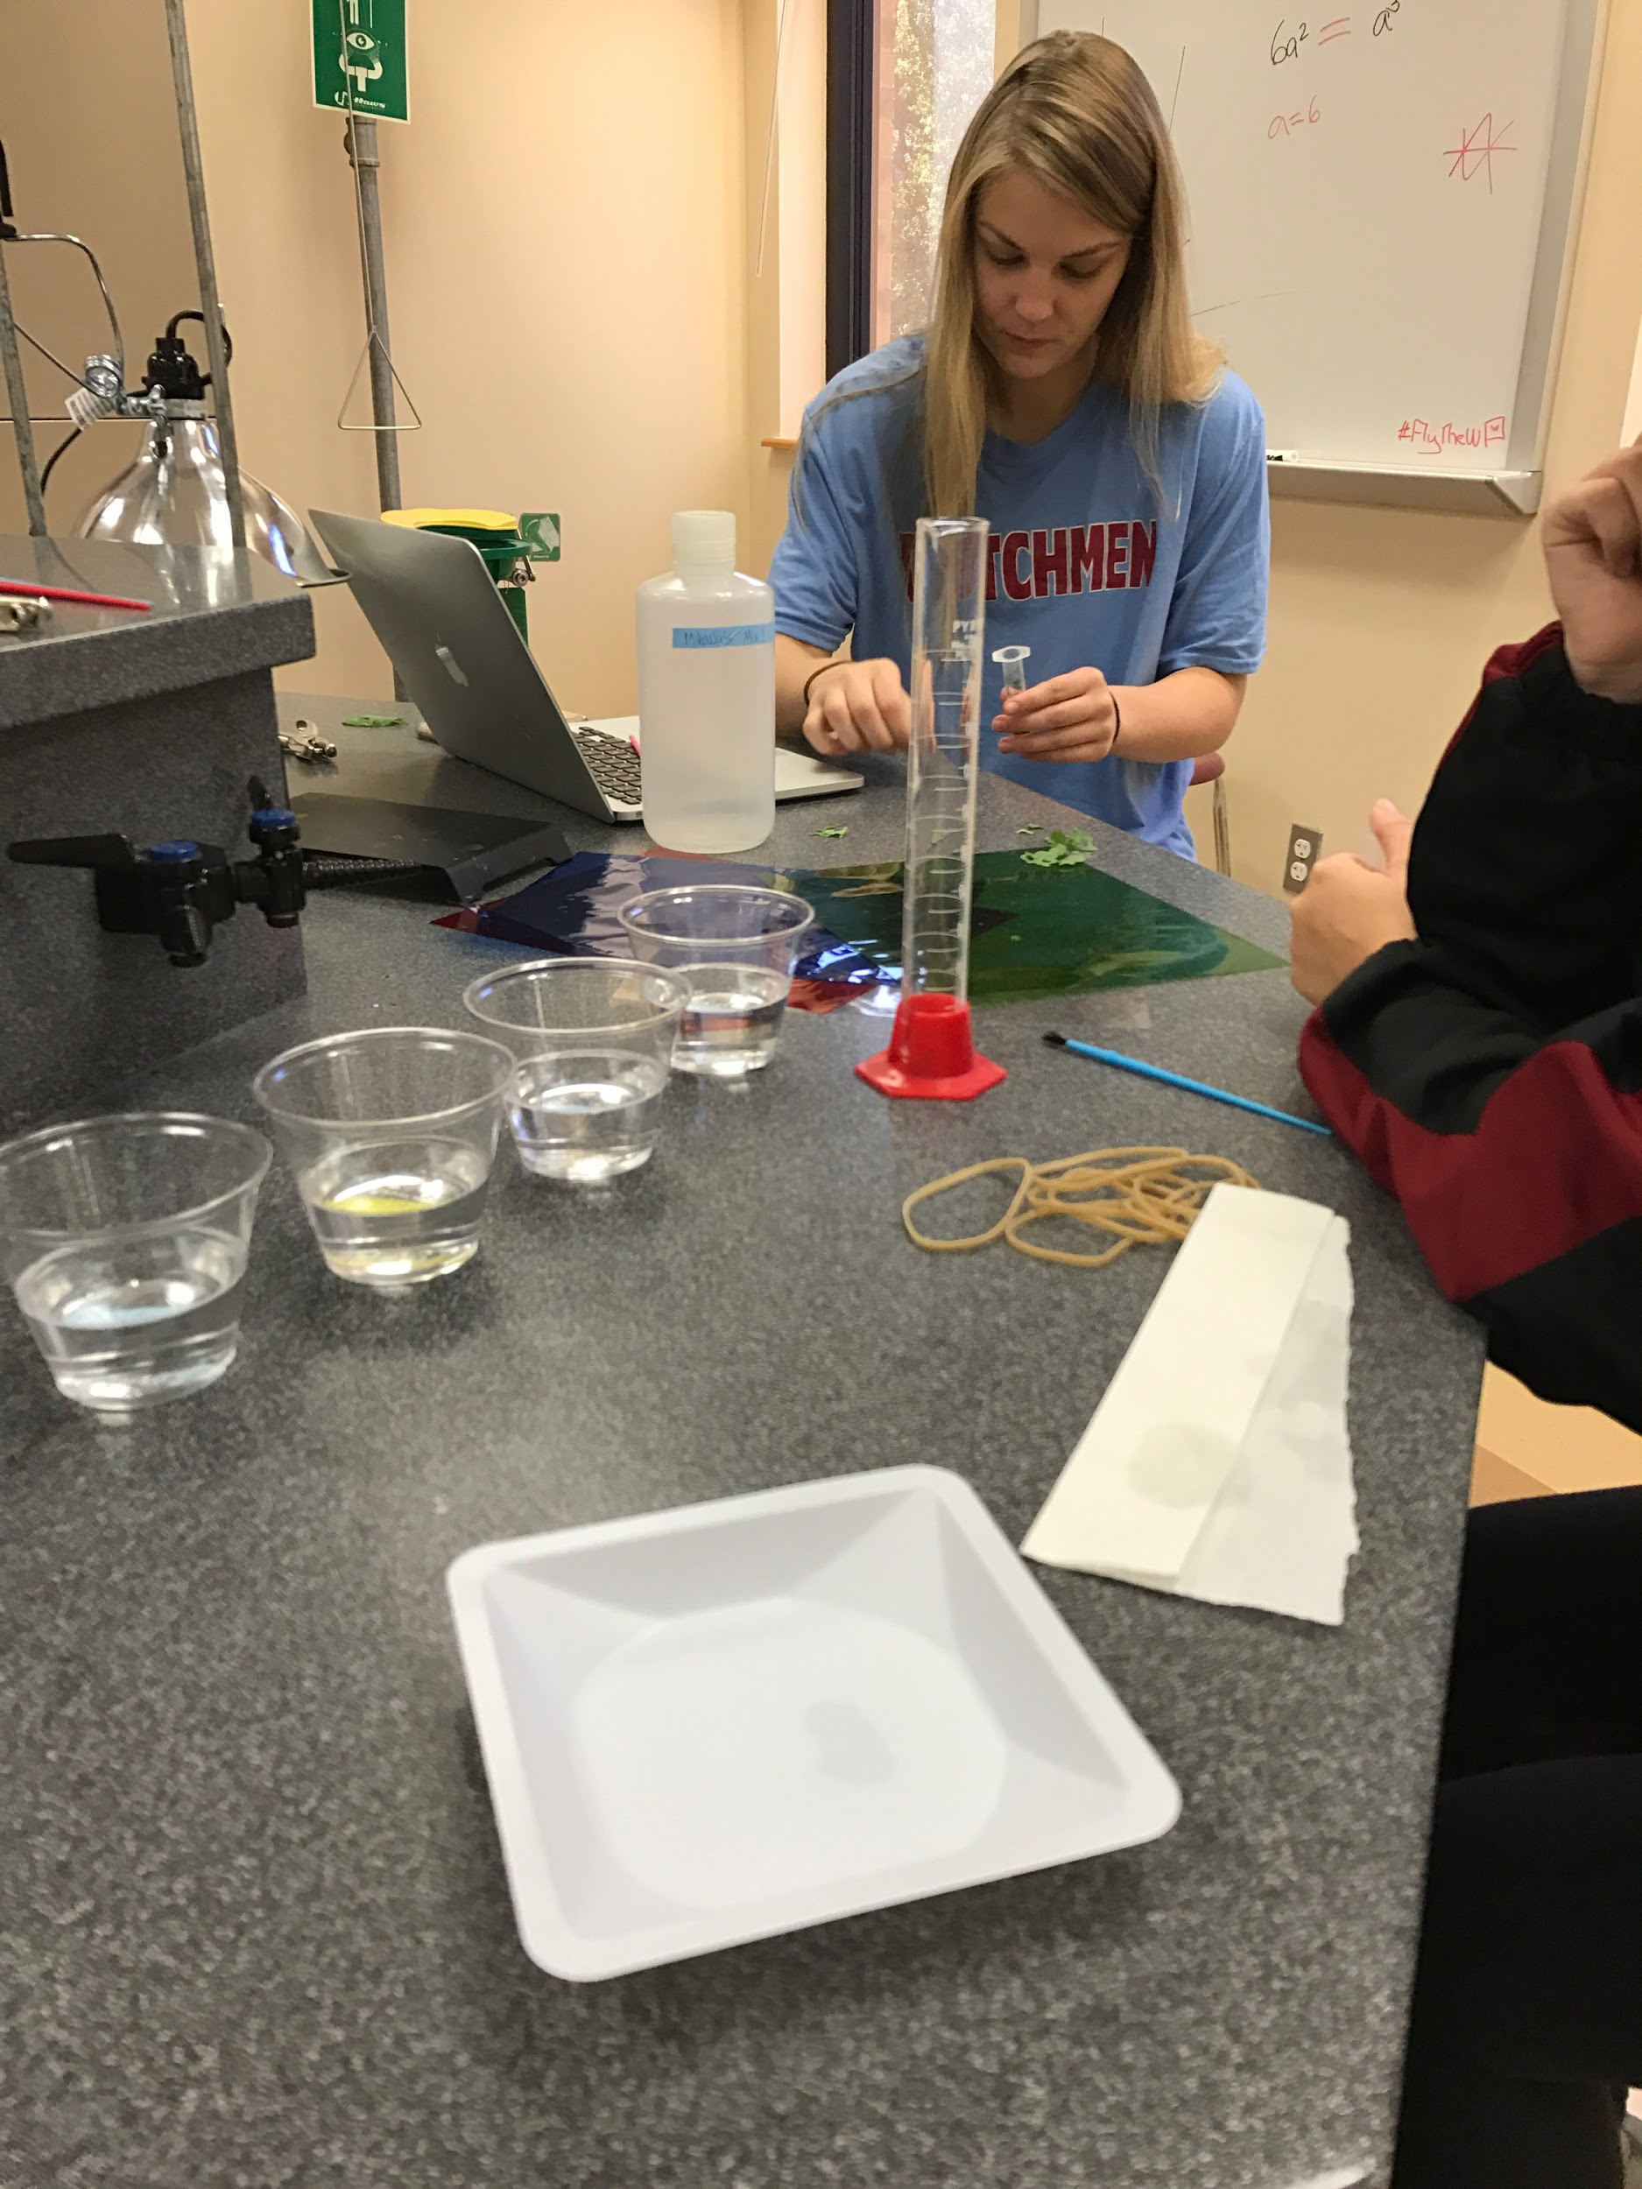
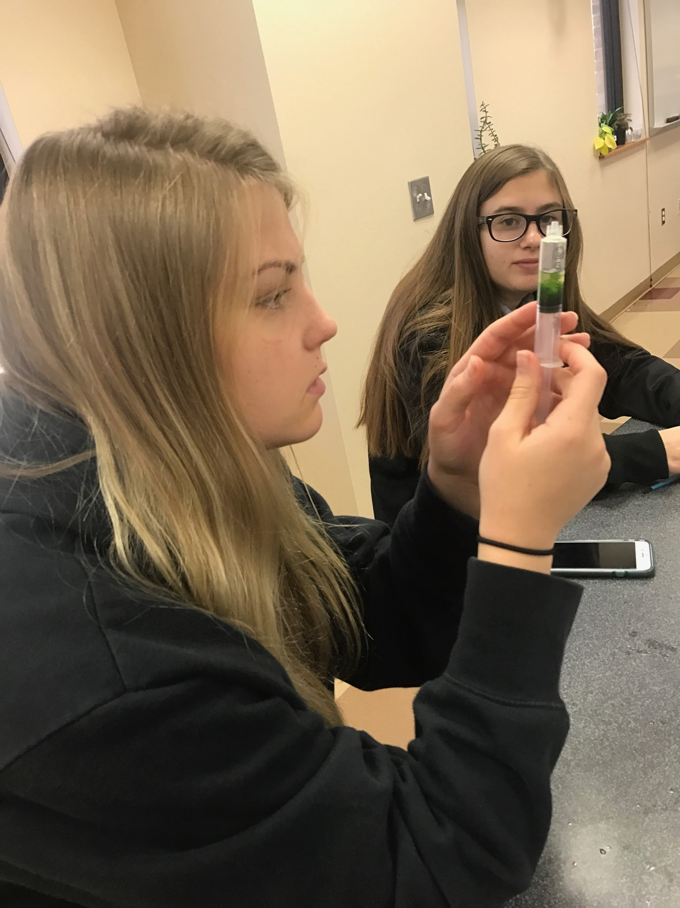
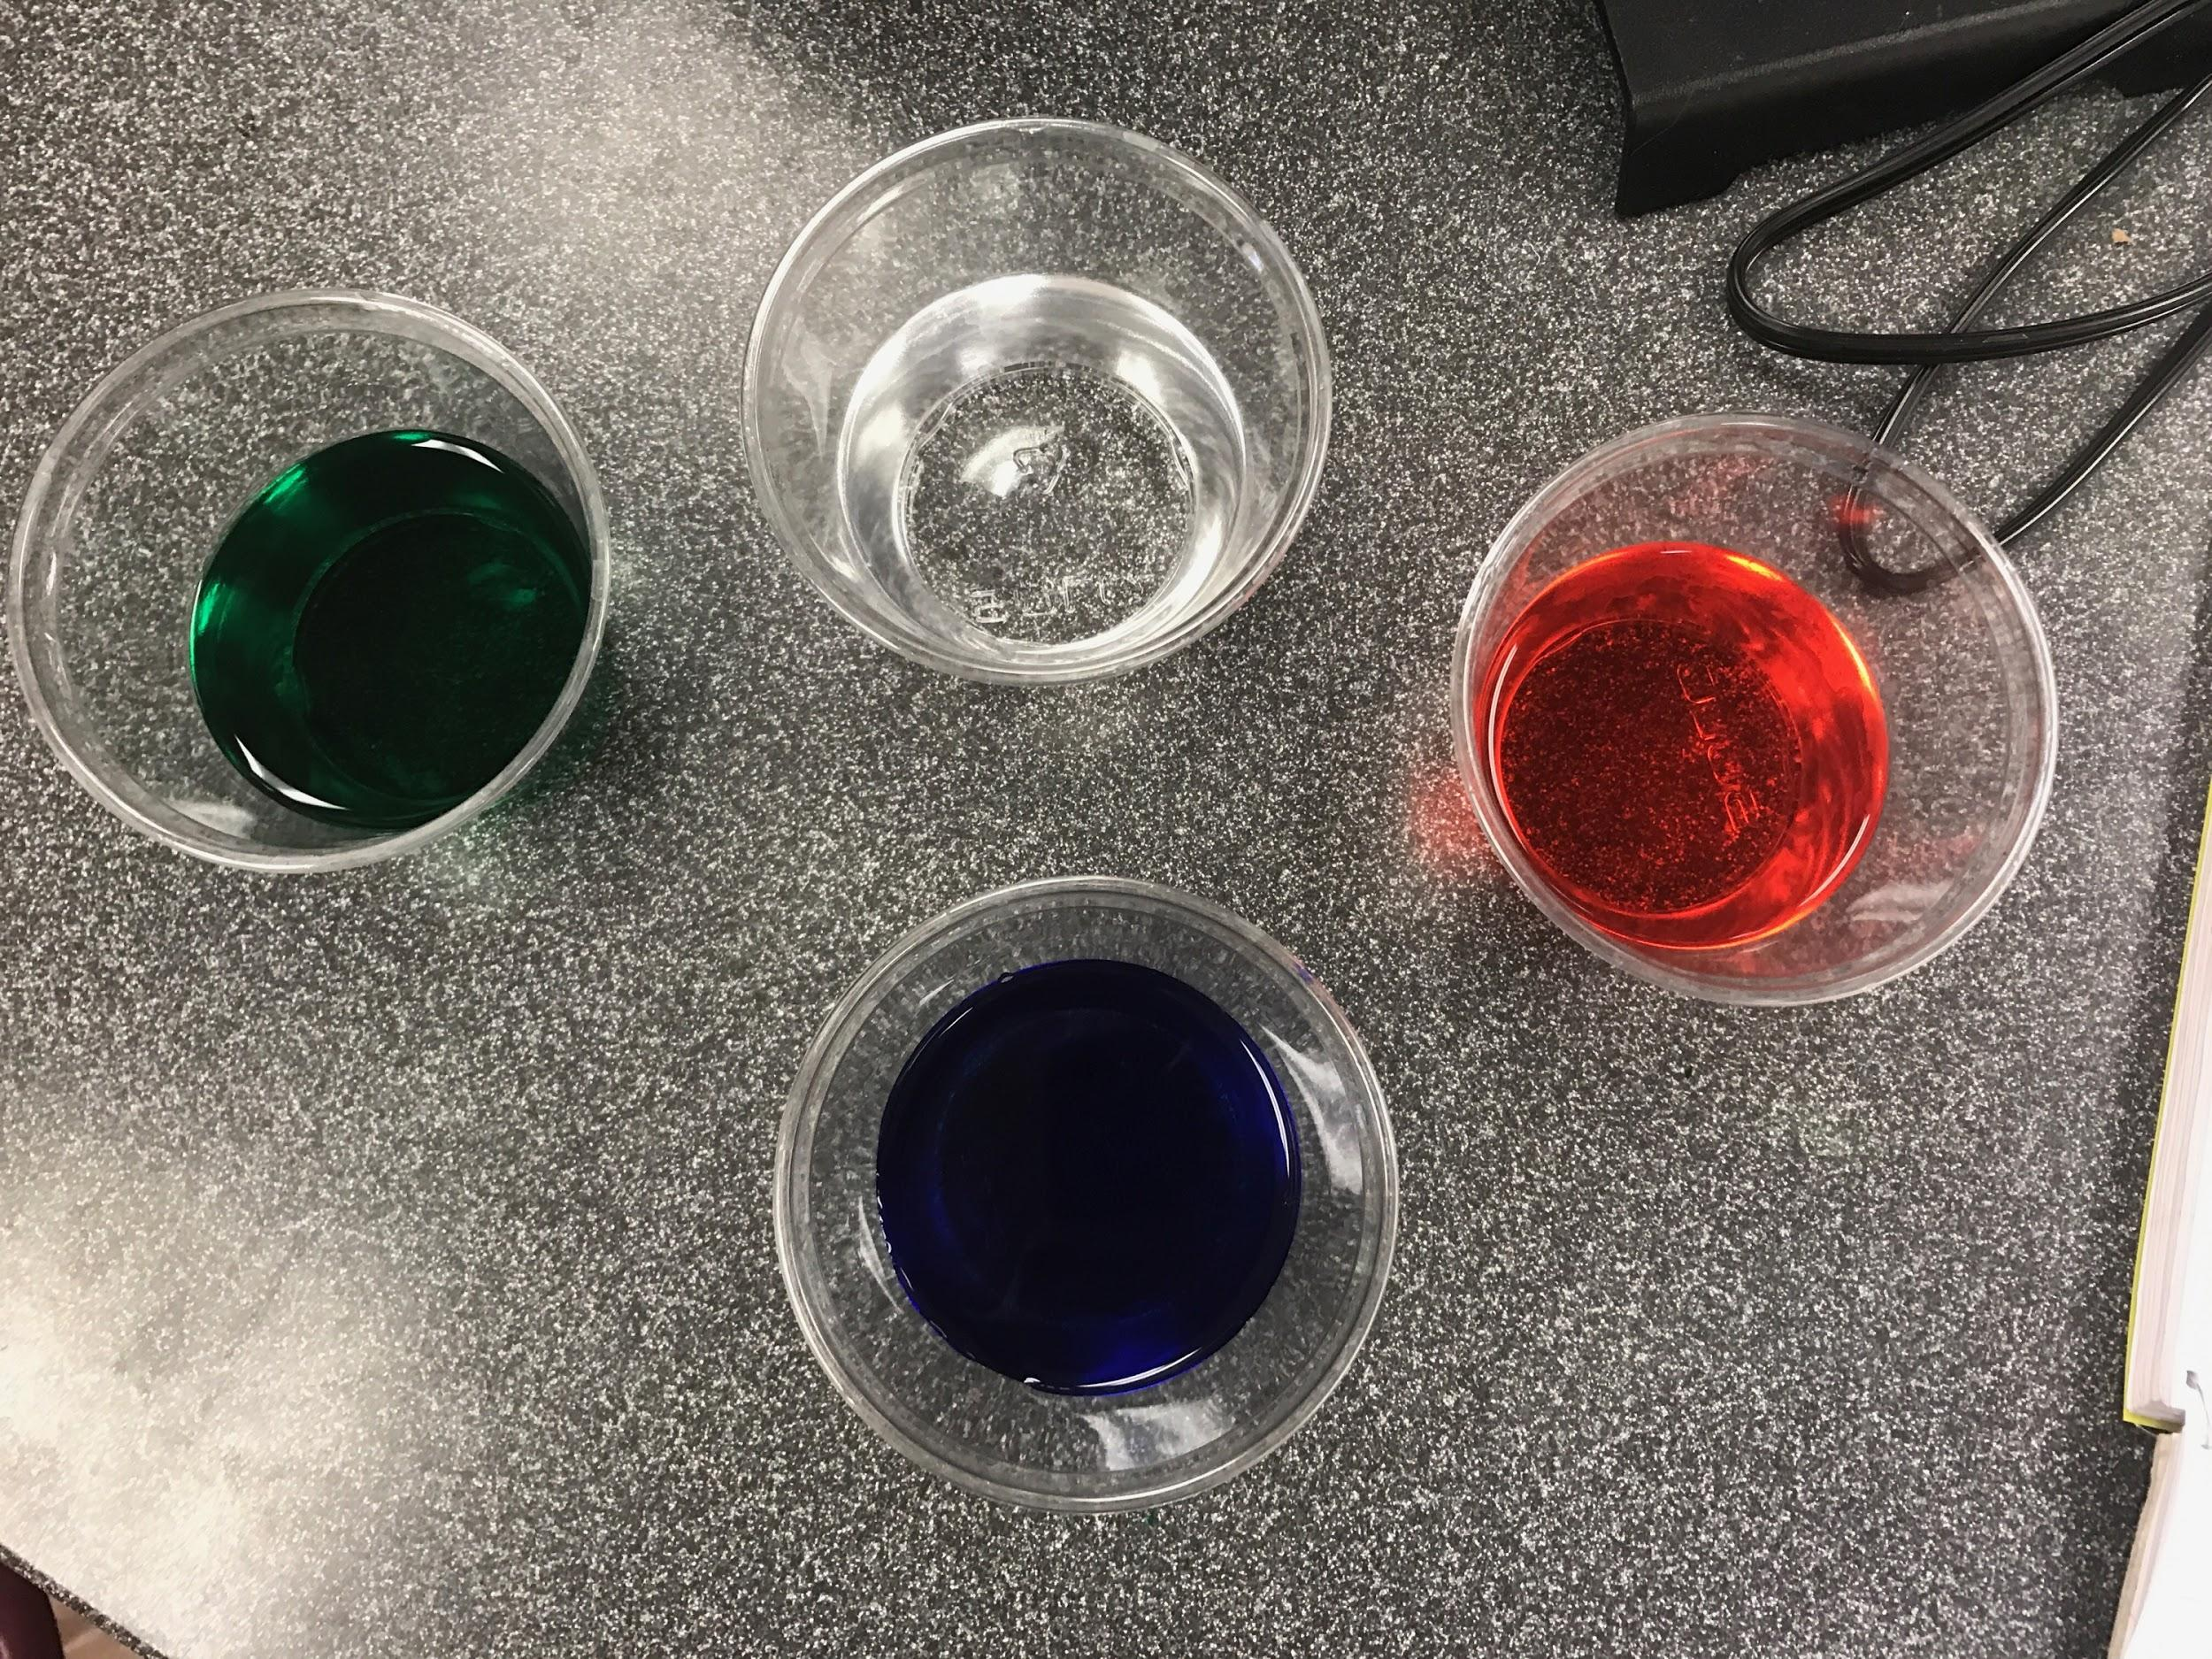
The experiment

Slide 16
Conclusion
The rate of photosynthesis in plants does depend on a light source. White light is the most effective light for photosynthesis because it has a wide range of colored lights for different pigments to use. When only one color is used, red is the most effective color of light. Red has a long wavelength, allowing it to radiate more energy and allow for an increased rate of photosynthesis in plants. This lab proved that the length of a wavelength of light a plant is exposed to is directly related to the rate of photosynthesis. In addition, more colors available for the plant allow more pigments to be activated, also leading to higher rates of photosynthesis.

Slide 17
A question we still have.
How can we determine how much chlorophyll a and b are in the leafs?

Slide 18
If we could redo this experiment we would do...
Test both Types of experiments at once so we would have an equal amount of oxygen in all the leafs and so we could compare the data as we are doing the experiments. We would also want more time to let the leafs float up and collect more data until all of the leafs are floating just to compare times between different colors.

Slide 19
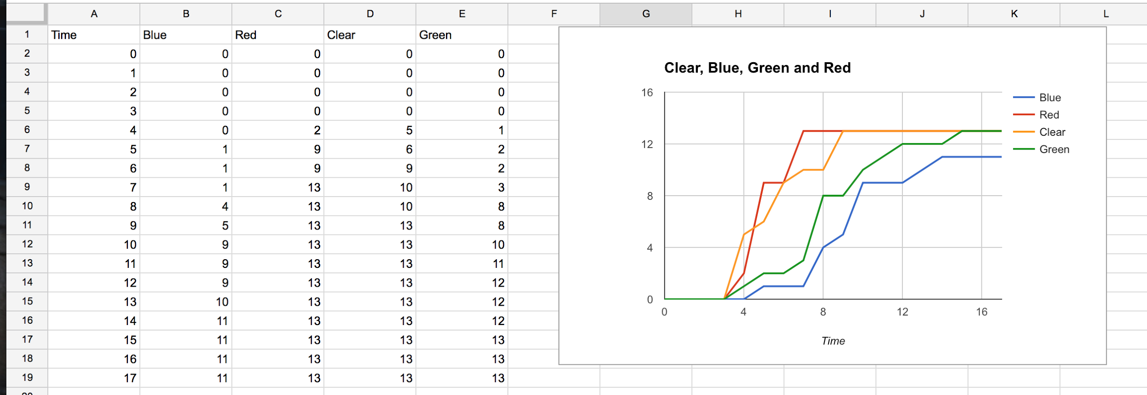
Experiment 1

Slide 20
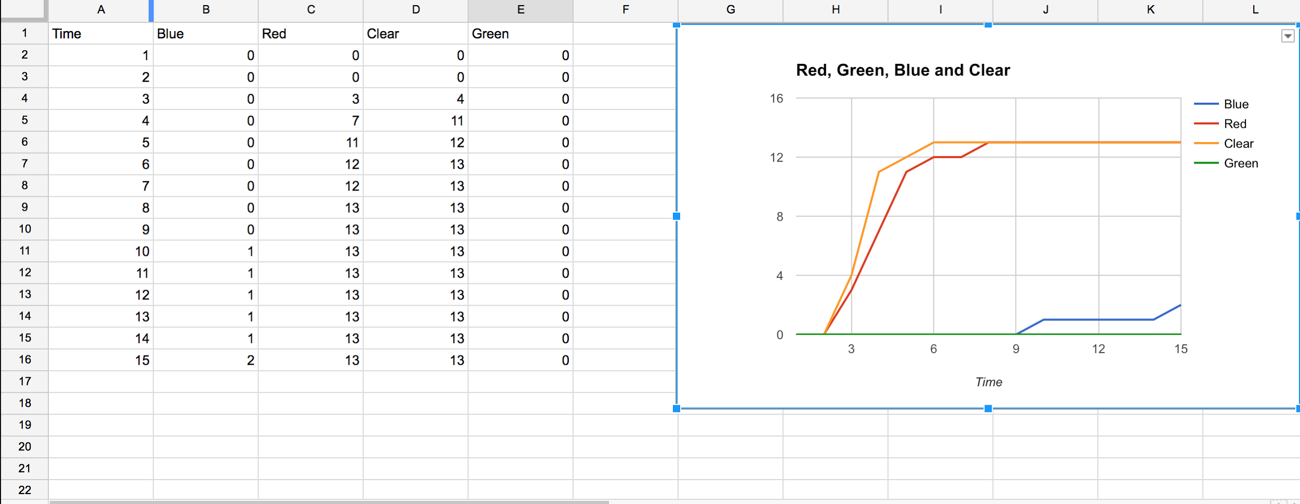
Experiment 2

Slide 21
How does this relate to something bigger?
Solar panels purpose are to absorb as much light as possible to provide energy. Therefore having the solar panels be black, absorbs all spectrums of light resulting in the most efficient way to produce energy through solar panels. A british nanotech company has created what it says to be the world's darkest material. It is so dark the human eye can’t discern its shape and form, creating what has been called a black hole. It absorbs 99.96 percent of all light compared to a normal black of 95 percent.

Slide 22
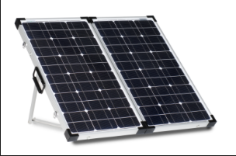

Slide 23
Sources
More about photosynthesis.pdf Planting science reference; more about photosynthesis, August 2016
https://hollandhall.haikulearning.com/kshingleton/shingletonbiology2016-2017/cms_file/show/59912008.pdf?t=1477854801
http://www.cnn.com/2014/07/17/business/worlds-darkest-marterial/
Cnn Is this the new real black?

